Slide 1
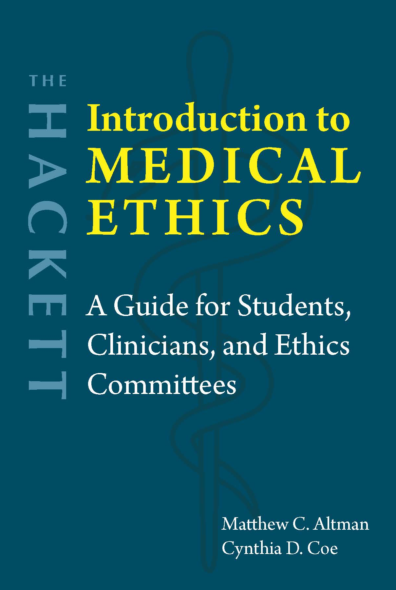
Chapter 1 Moral Reasoning in a Medical Context

Slide 2
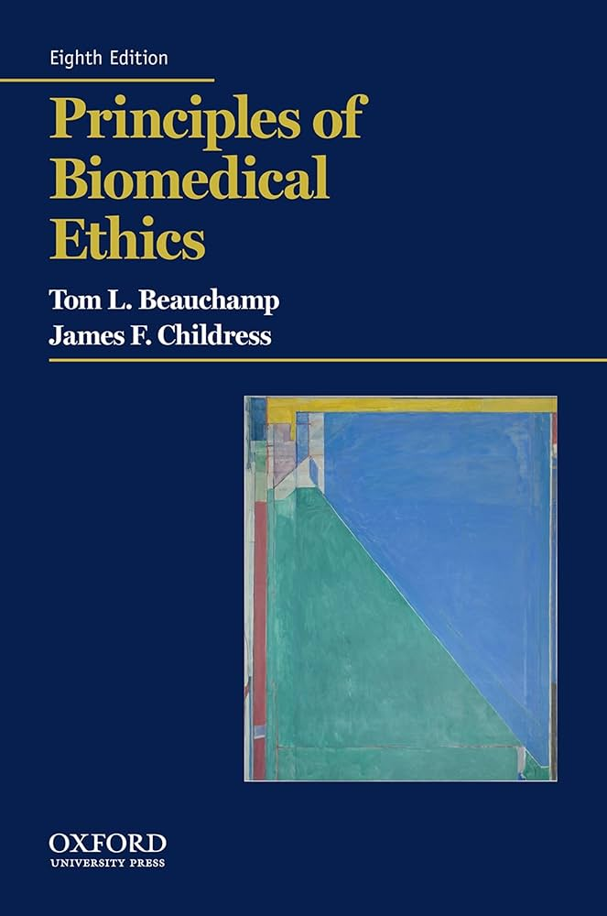


Principlism
Tom Beauchamp (1939-2025)
James Childress (1940-present)

Slide 3
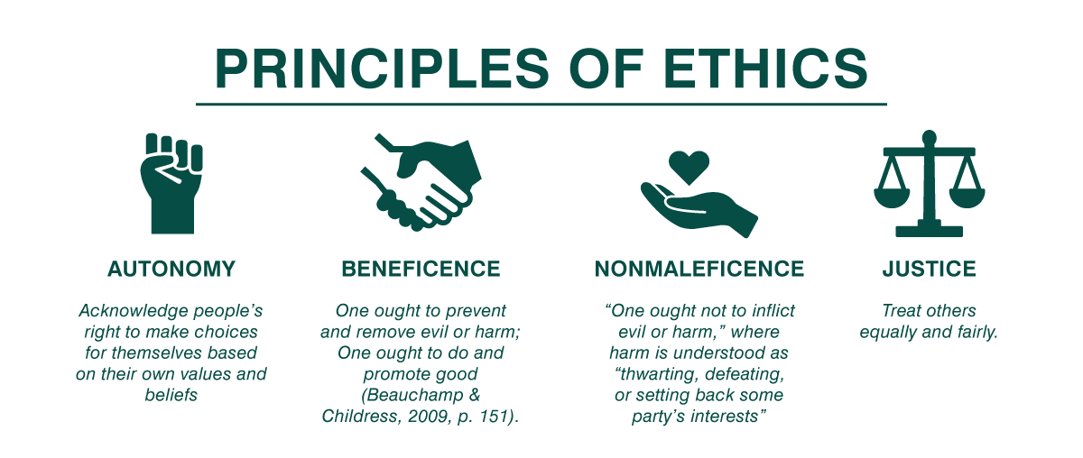
The common morality includes …
Image: https://caregivereducationeotterbacher.wordpress.com/2019/01/26/a-matter-of-ethics-caregiver-need-through-an-ethical-lens%EF%BB%BF/

Slide 4

Principle 1: Respect for autonomy
Liberty
Understanding
Agency
Kant: “So act that you use humanity, whether in your own person or in the person of any other, always at the same time as an end, never merely as a means.”

Slide 5


Informed consent
Threshold elements
Competence (ability to understand and decide)
Voluntariness (in deciding)
Information elements
Disclosure (of material information)
Recommendation (of a plan)
Understanding (of 3 and 4)
Consent elements
Decision (in favor of a plan)
Authorization (of the chosen plan)

Slide 6

Principle 2: Nonmaleficence
Principle 3: Beneficence
Consequentialism
Utilitarianism
Primum non nocere
Positive beneficence vs. Utility
Specific vs. General beneficence
Cost-benefit analysis (CBA)
Cost-effectiveness analysis (CEA)
Quality-adjusted life years (QALYs)
Image: https://donoharmmedicine.org/

Slide 7
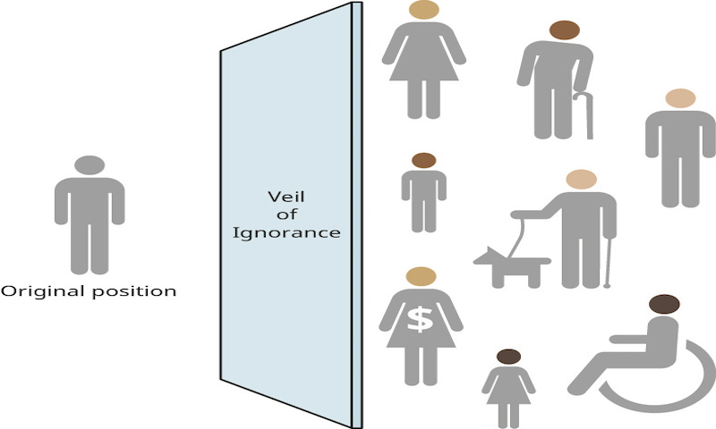
Principle 4: Justice
Justice as fairness (Rawls)
Liberty principle
Distribution principle
Egalitarian theory (Daniels)
Capability theory (Sen and Nussbaum)
Well-being theory (Powers and Faden)
Image: https://jborden.com/2019/09/07/using-the-veil-of-ignorance-to-create-a-just-society/

Slide 8
 |  | Circumstances
 |  | c₁ | c₂ | c₃
Decisions | d₁ | -5 | -5 | 40
 | d₂ | 5 | 5 | 5
 | d₃ | 6 | 8 | 10
Maximin principle: Maximize the benefit for the least well off.

Slide 9
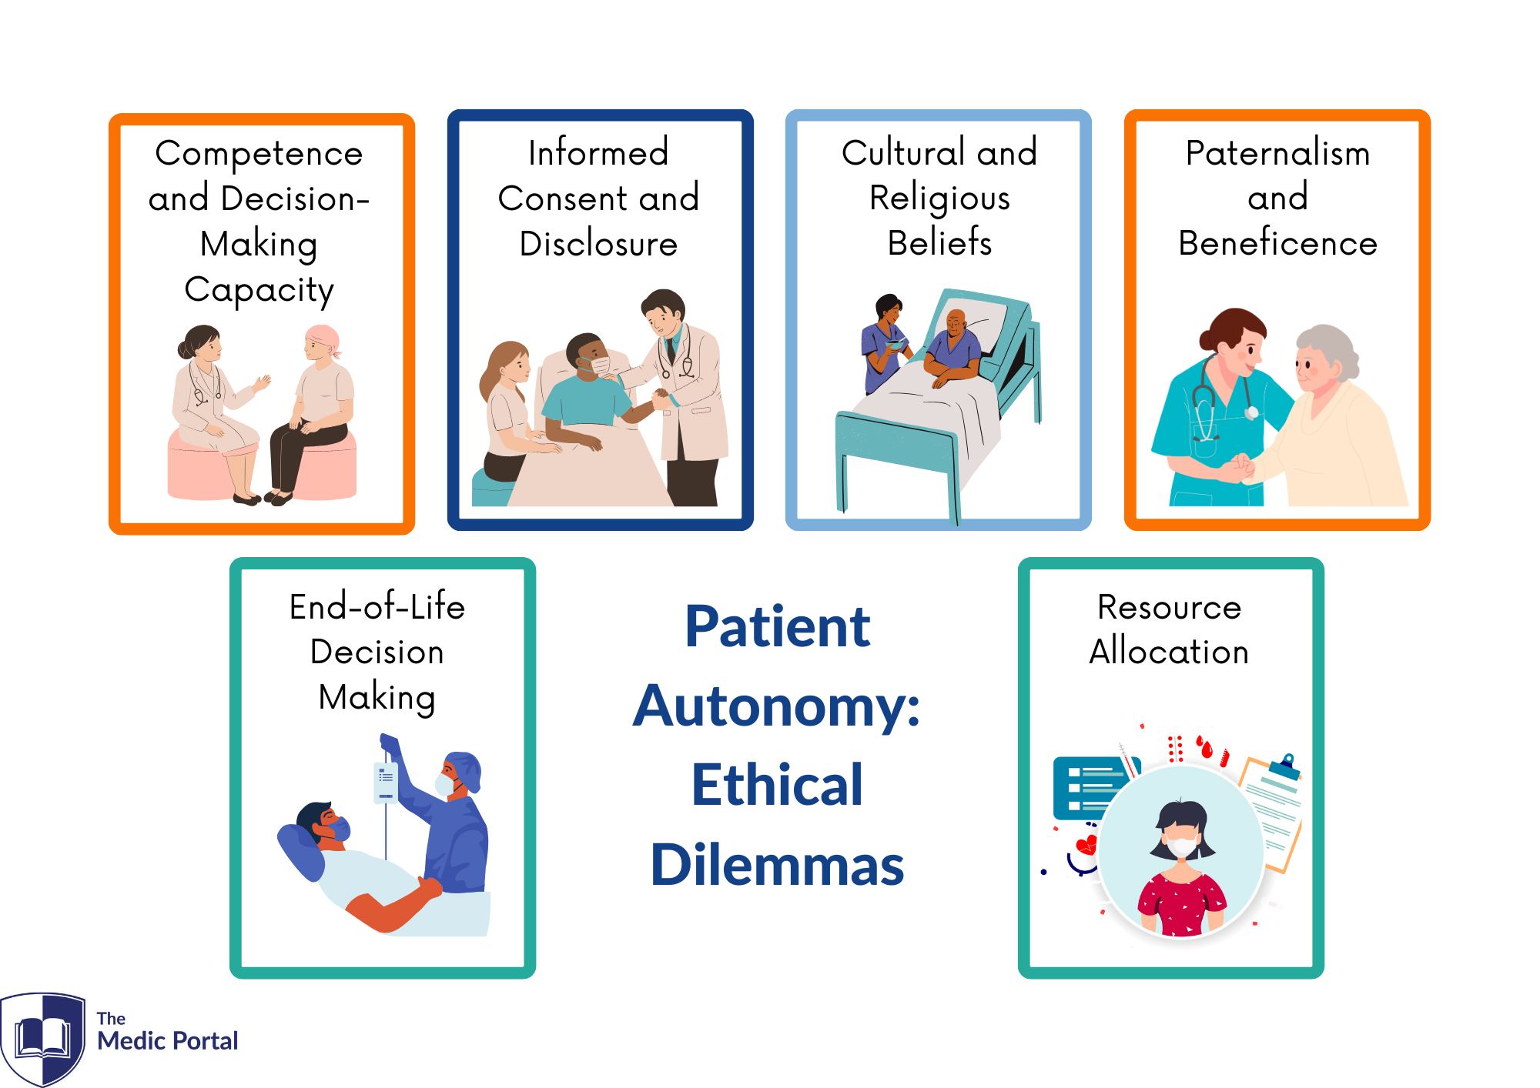
Applications
Respect for autonomy
Nonmaleficence
Beneficence
Justice
Image: https://www.themedicportal.com/application-guide/medical-school-interview/medical-ethics/medical-ethics-autonomy/

Slide 10

Moral character
Compassion
Discernment
Trustworthiness
Integrity
Conscientiousness

Slide 11
Moral status
Guideline 1. “All human beings who are sentient or have the biological potential for sentience have some level of moral status; all human beings who are not sentient and have no biological potential for sentience have no moral status” (85).
Guideline 2. “All human beings who are sentient have some level of moral status; all human beings who are not sentient, including those with only a potential for sentience, have no moral status” (85).
Human properties
Cognitive properties
Moral agency
Sentience
Relationships
Guideline 3. “All sentient beings have some level of moral status; the level is elevated in accordance with the level of sentience and the level of cognitive complexity” (86).
Guideline 4. “All human beings capable of moral agency have equal basic rights; all sentient human beings and nonhuman animals not capable of moral agency have a diminished set of rights” (86).
Guideline 5. “All sentient laboratory animals have a level of moral status that affords them some protections against being caused pain, distress, or suffering; as the likelihood or the magnitude of potential pain, distress, or suffering increases, the level of moral status increases and protections must be increased accordingly” (87).

Slide 12

Objections to principlism
Methodological concerns
Ethics of care objection
Moral imperialism objection

Slide 13
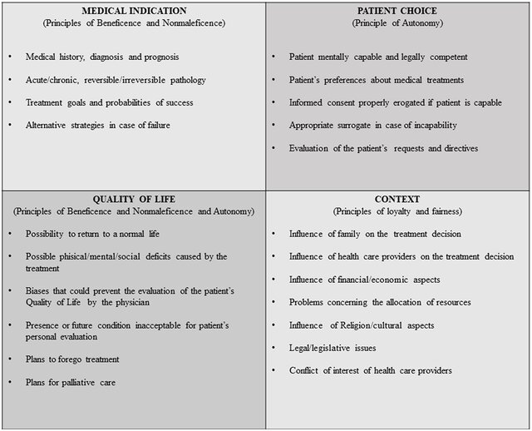
Alternatives
Appeal to common morality
Casuistry/case-based reasoning (Four Box Method)
Narrative approach

Slide 14
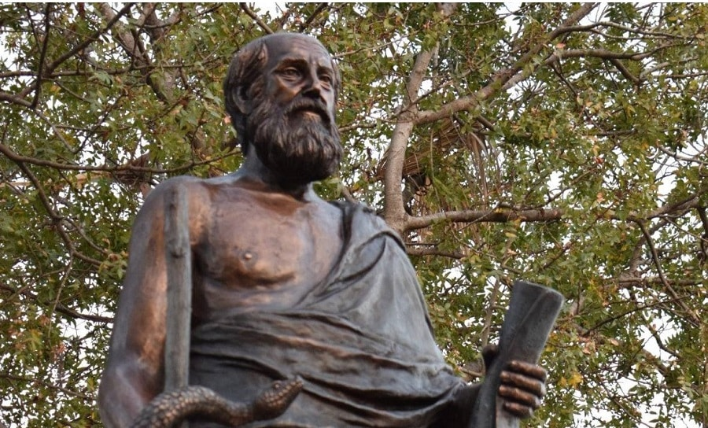
Questions?
Respect for autonomy
Nonmaleficence
Beneficence
Justice
Hippocrates (c. 460-370 BCE)

