Slide 1
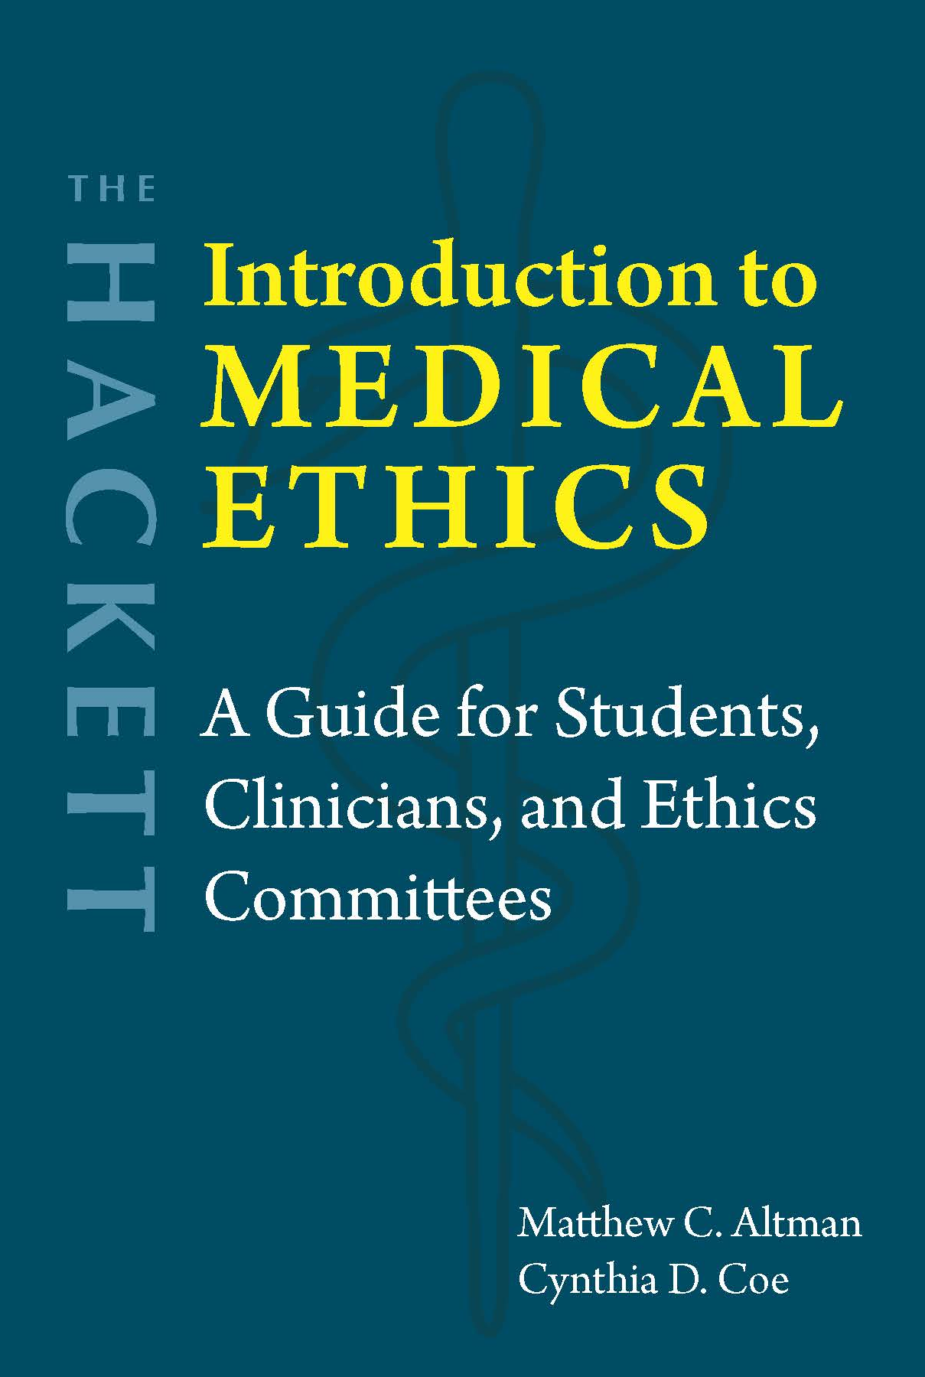
Chapter 10 Allocating Scarce Medical Resources

Slide 2
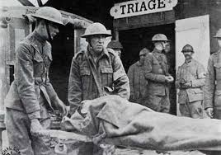
Triage as early form of healthcare rationing
From the French trier (“to sort”)
Military contexts (e.g., World War I)
Three categories
Patients likely to live without immediate treatment
Patients likely to die even with immediate treatment
Patients for whom immediate treatment would dramatically affect their health outcome [highest priority]

Slide 3
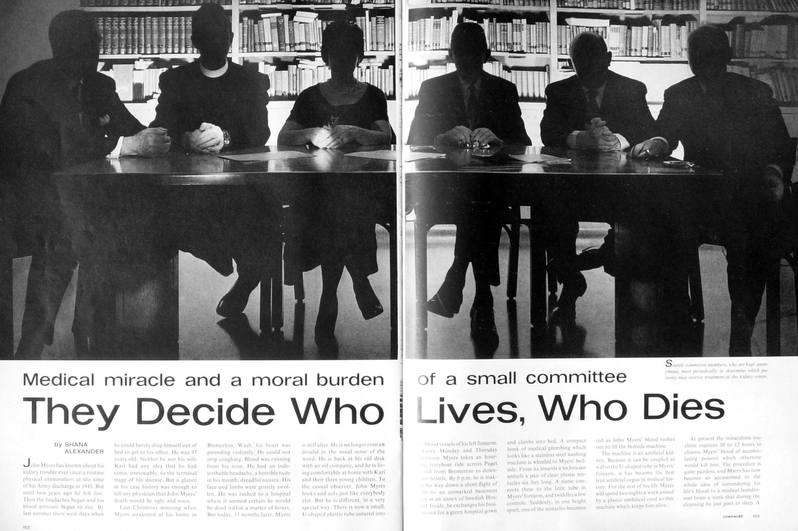
The “God Committee” Seattle Artificial Kidney Center, early 1960s
Selection criteria:
a stable, emotionally mature, responsible citizen disabled by the symptoms of uraemia [waste products in the blood due to worsening renal function];
absence of long-standing hypertension and its permanent complications, particularly coronary artery disease and cerebrovascular disease;
demonstrated willingness to cooperate in carrying out the prescribed treatment, especially the dietary restrictions;
age 25–45 years;
slow deterioration of renal function (serum creatinine 8–12 mg/dl), since any residual function simplified the therapeutic problem;
six months residence in the area (Washington, Alaska, Idaho, Montana and Oregon);
financial support;
value to the community;
potential for rehabilitation;
psychological and psychiatric compatibility; and
children and young adults who were not potentially self-supporting were excluded.

Slide 4
Principles of allocation
Category one: Treating people equally
Lottery
First-come, first-served
Category two: Favoring the worst-off (prioritarianism)
Sickest first
Rule of rescue
Youngest first
Fair innings
Category three: Maximizing total benefits (utilitarianism)
Save the most lives
Prognosis or life years
Category four: Promoting and rewarding social usefulness
Instrumental value
Reciprocity

Slide 5


Principlism
Preconditions: Equal worth + fair opportunity
Utilitarianism
Medical utility: Health prospects
Social utility: Future contributions to society
Beauchamp
Childress

Slide 6
Quality-adjusted life year (QALY)
Time + quality of life
Quality determined by: Health-related quality of life survey, time trade-off questions, or standard gamble questions
Measures benefits and burdens of medical interventions
Compare QALYs for alternatives → Maximize the good
0 = death
1 = one year of healthy life
Disability-adjusted life year (DALY)
Years lived with disability + Years of life lost
Years with disability adjusted by: Disability weight
1 DALY = 1 year of healthy life lost
Measures overall disease burden
Discriminatory?

Slide 7
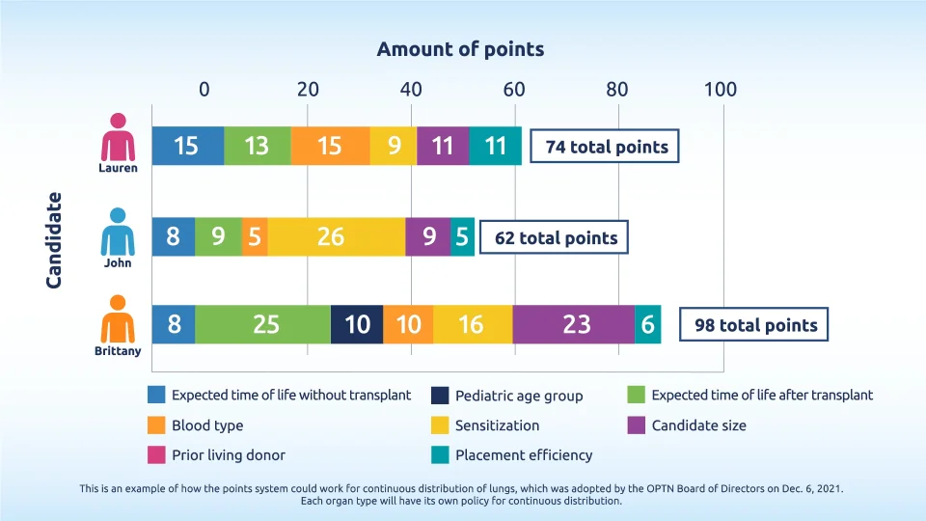
UNOS Points System
https://embed-ssl.wistia.com/deliveries/8978a79a1d68ca499caa67e2d130d621.webp?image_crop_resized=960x540

Slide 8
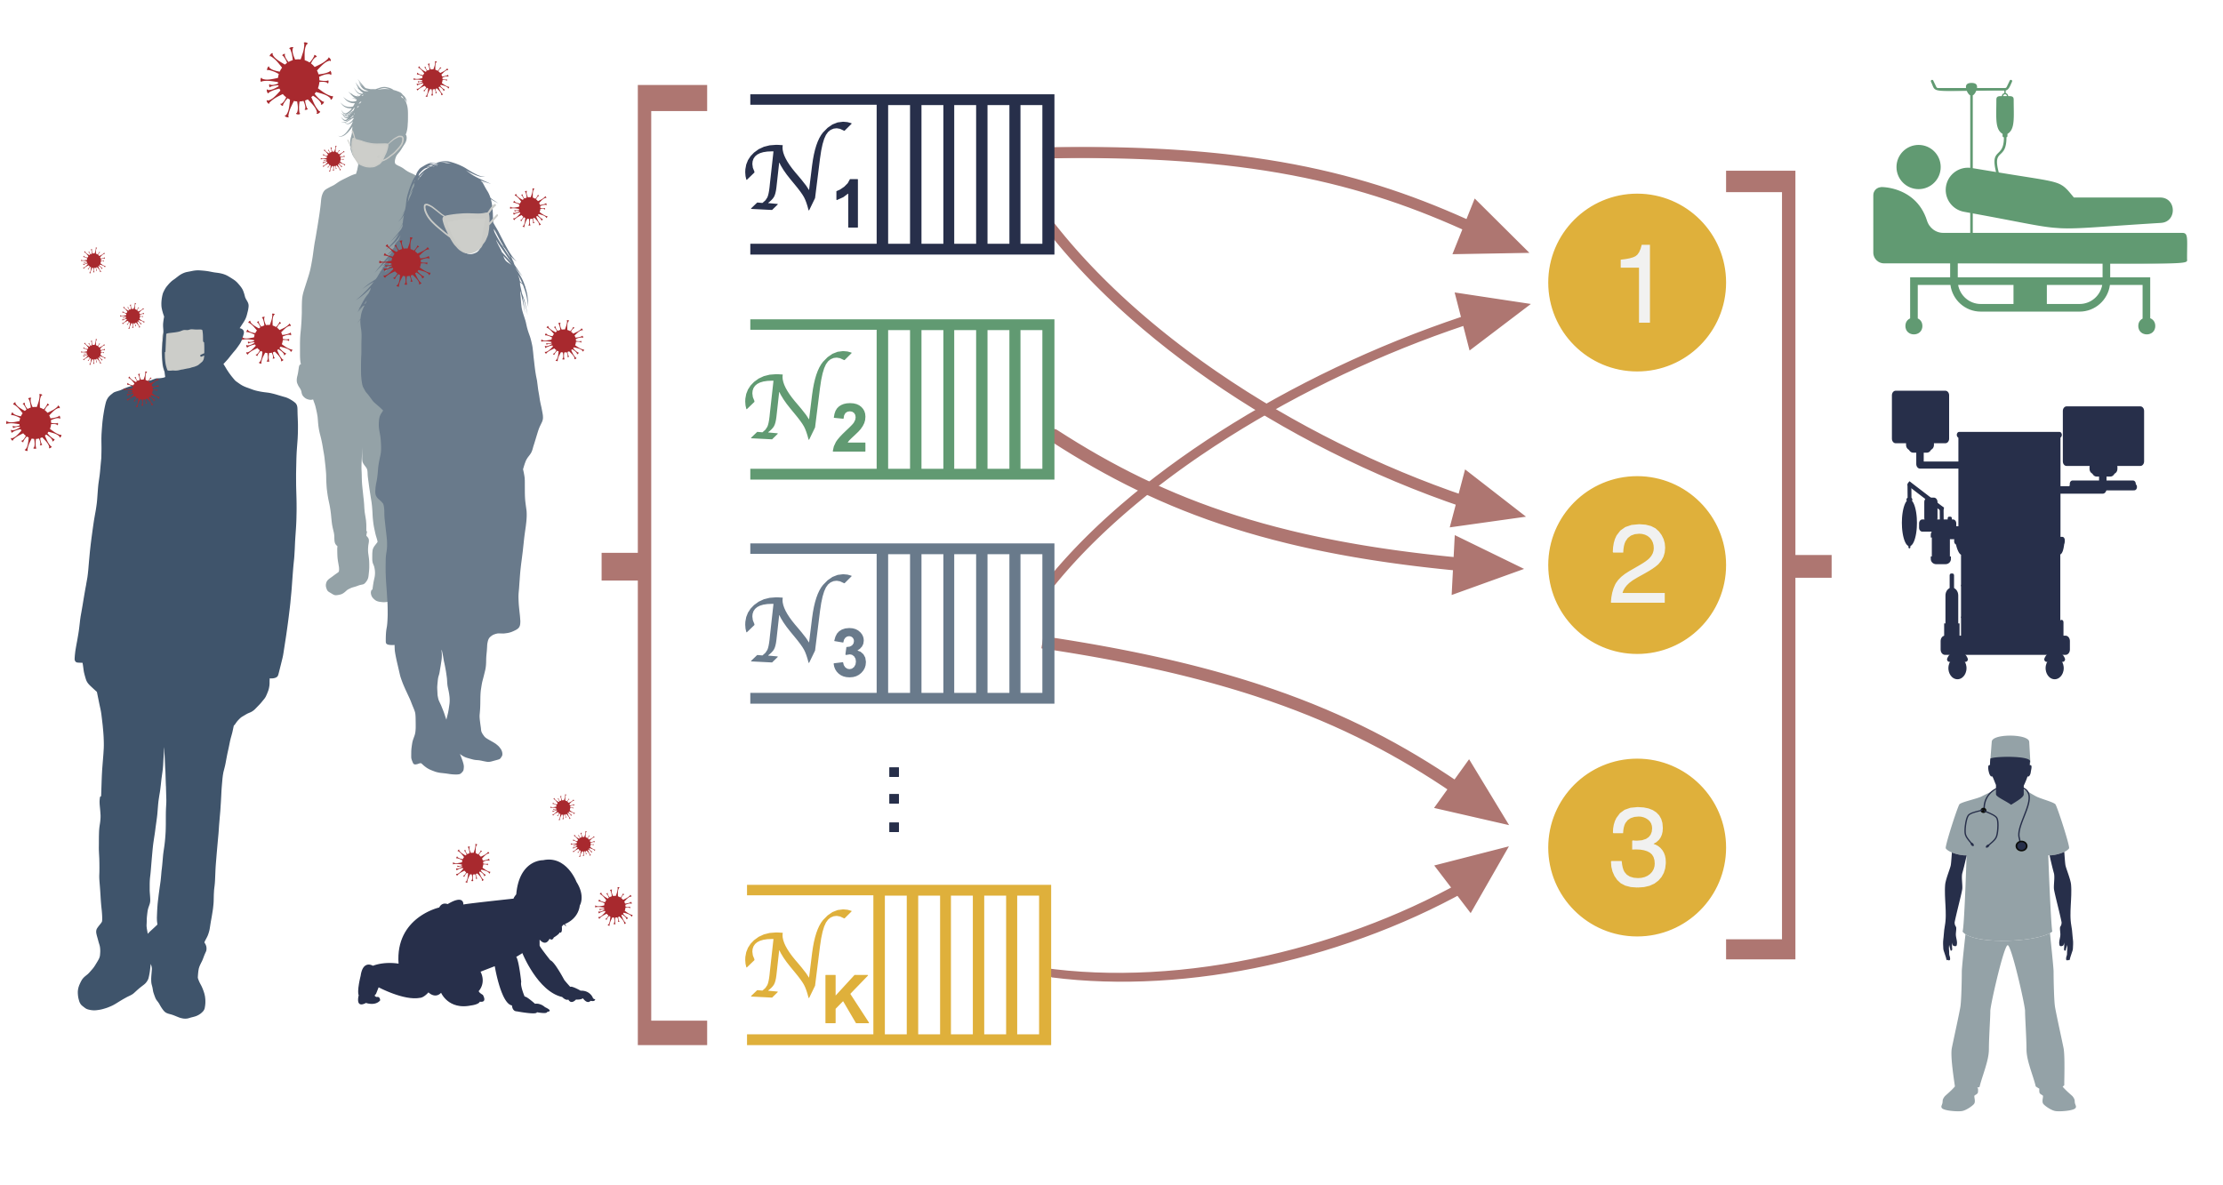
Triage during the COVID-19 pandemic
Respect for autonomy: Desire for treatment, advance directive
Justice: Avoid bias
Maximize benefits
Maximize whole lives (short-term survival = survival to discharge)
Save the most life years (long-term survival = survival 1-5 years post-discharge)
Degree of frailty
Tiebreakers
Maintain existing distribution
Prioritize pregnant women
Social Vulnerability Index (SVI)
https://cais.usc.edu/projects/allocating-scare-resources-during-the-covid-19-pandemic/

Slide 9
Distribution of COVID-19 vaccines
National distribution: National Academies of Science, Engineering, and Medicine
Phase 1
Phase 1a: High-risk health workers, workers who support the healthcare system (transportation, environmental services, facility services), and first responders at risk of exposure.
Phase 1b: People with comorbid and other underlying health conditions that put them at high risk and older adults living in crowded settings.
Phase 2: K-12 teachers, school staff (such as administrators and support staff), and childcare workers; “critical workers” in high-risk settings, such as those in the food supply system; people with comorbid or underlying conditions that put them at moderately higher risk; people in homeless shelters, group homes, prisons, and jails; and older adults not covered under Phase 1.
Phase 3: Children (under eighteen), young adults (ages eighteen to thirty), and workers in economically and socially important industries (such as universities and entertainment) who are at moderate risk of infection.
Phase 4: Anyone residing in the United States not covered by Phases 1–3.
International distribution: Fair Priority Model
Phase 1: Use Standard Expected Years of Life Lost (SEYLL) to calculate life years lost against life expectancy and then determine how many lost years would be averted with the use of a vaccine.
Phase 2: Economic impact measured by how much each dose of vaccine would reduce the absolute size of the poverty gap, measured against a uniform poverty line.
Phase 3: Countries with higher transmission rates are prioritized.

Slide 10
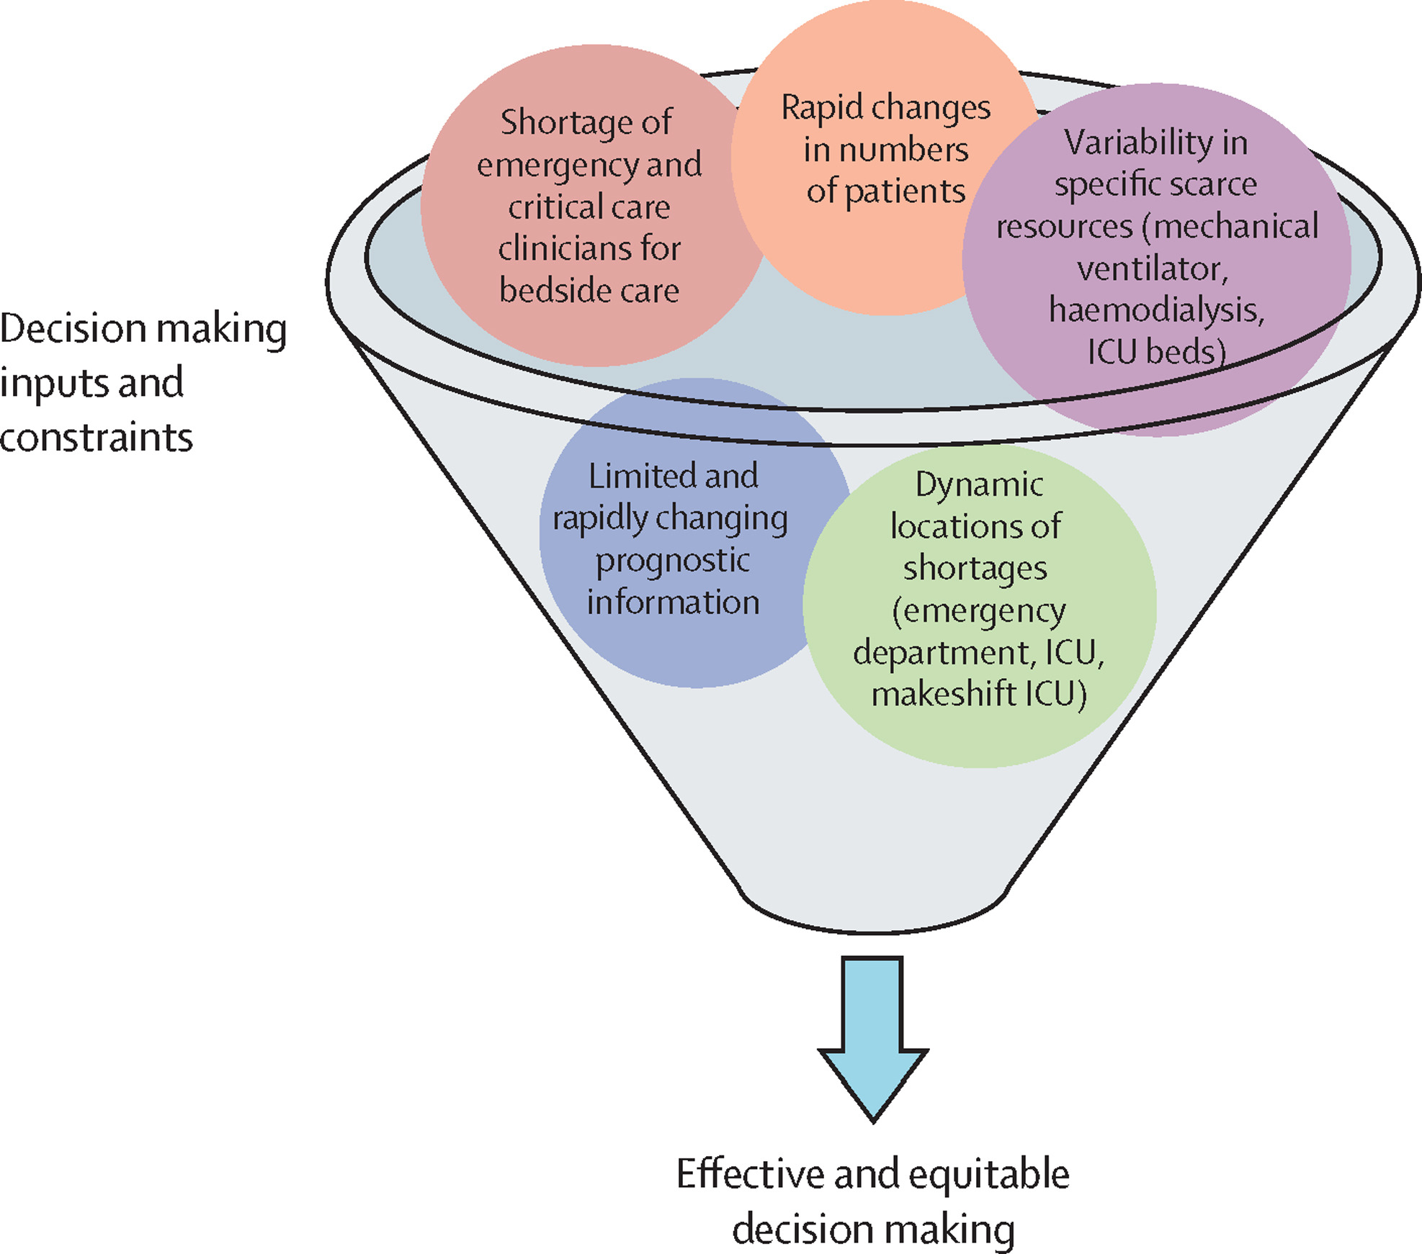
Questions?
https://www.thelancet.com/journals/lanres/article/PIIS2213-2600%2820%2930580-4/fulltext

