Slide 1
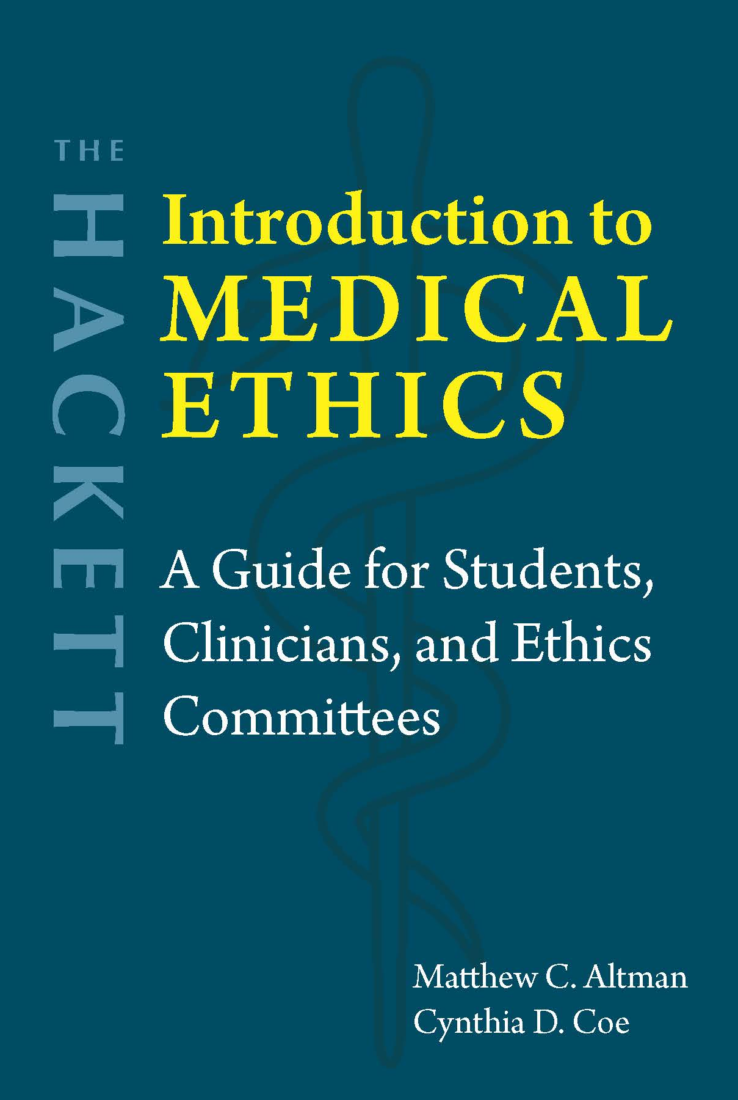
Chapter 11 Racial Disparities in Healthcare

Slide 2
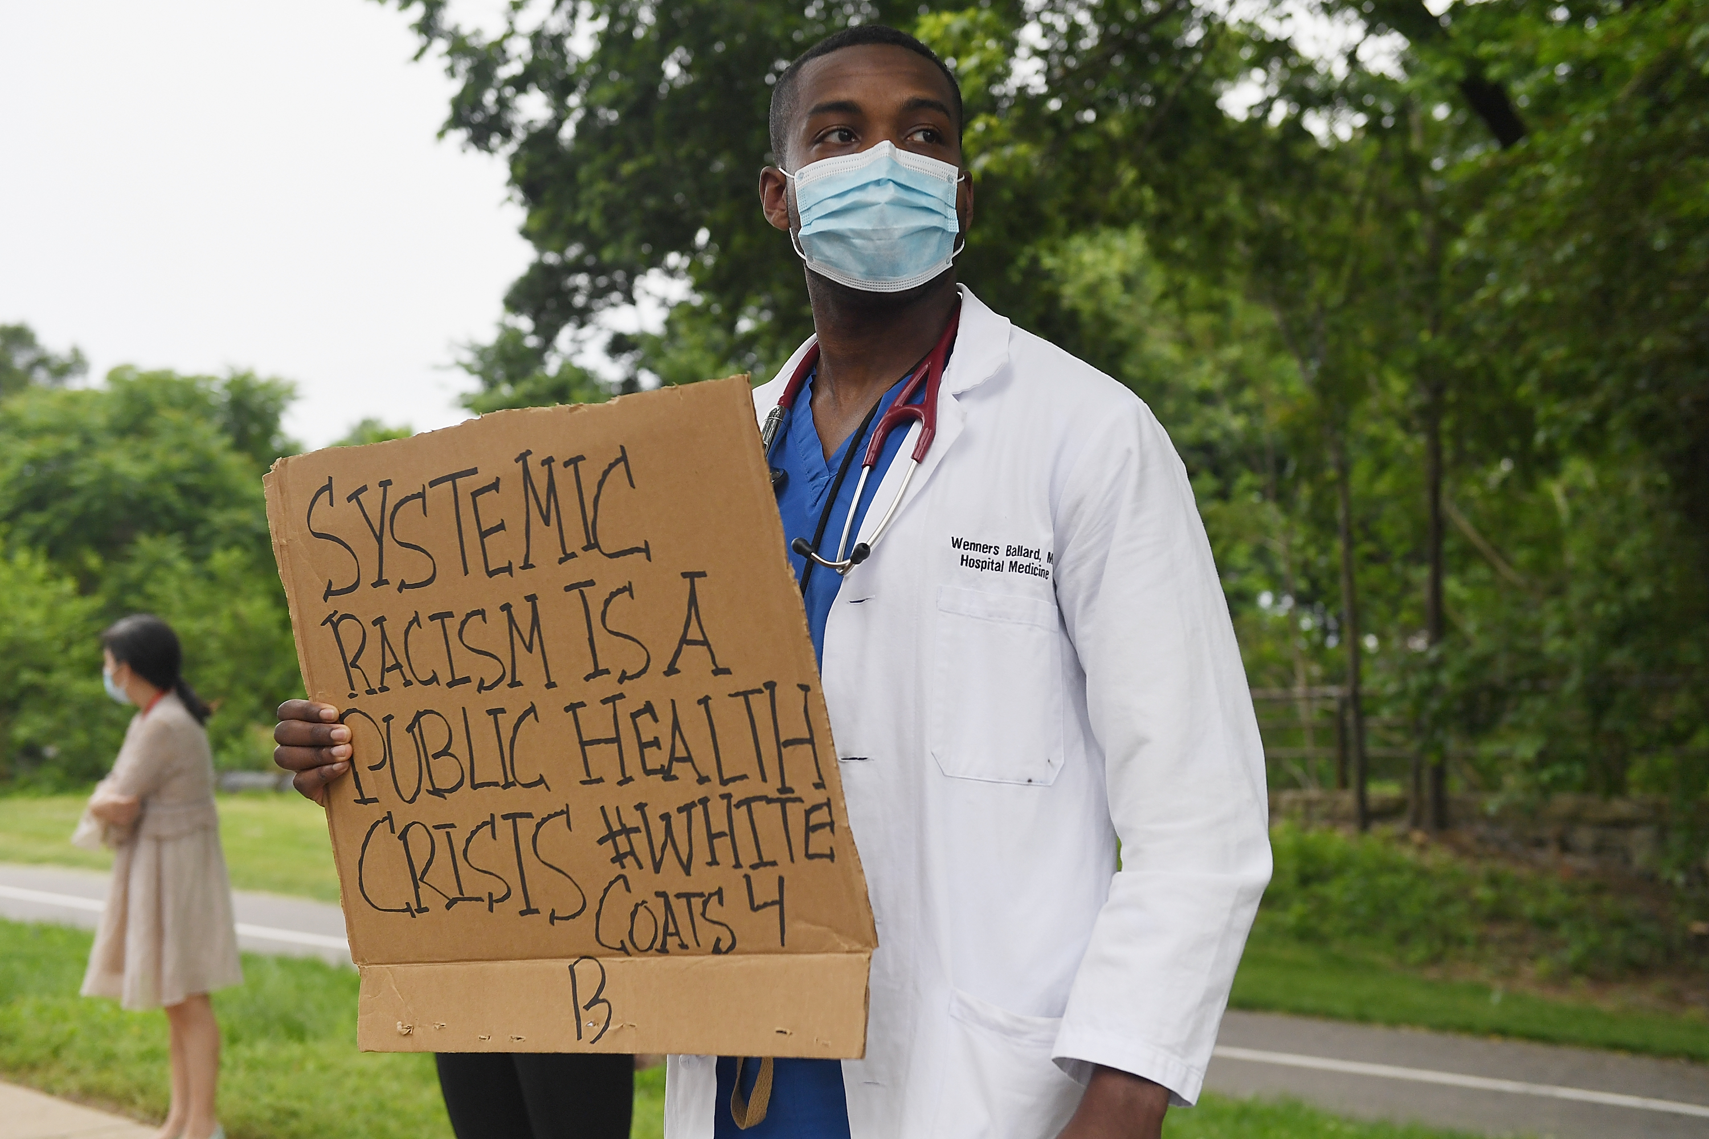
Racial disparities in health outcomes
Life expectancy, infant mortality, heart disease, cancer, asthma, diabetes, HIV/AIDS, etc.
Possible causes:
Lack of access to healthcare
Socioeconomic class? Individual choices? Even controlling for these, disparities persist.
Distrust in the medical establishment
Medical experimentation
Public health campaigns
Racial bias among clinicians
Weathering

Slide 3
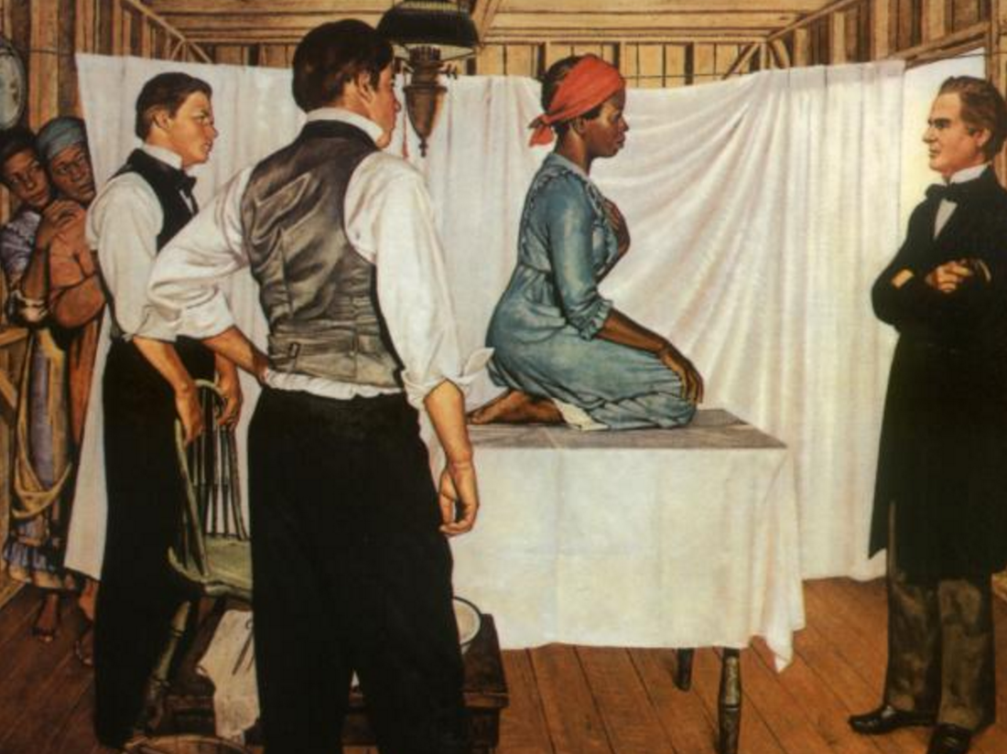
Medical experimentation
Persistent myth: Black people are less sensitive to pain
Experiments on slaves
Paradox: They are like white people biologically, but they have a lesser moral status.
Example: Gynecological experiments
Mills: The political status of subpersons
Illustration of Dr. J. Marion Sims with Anarcha, with Lucy and Betsy in the background, by Robert Thom (Southern Illinois University School of Medicine, Pearson Museum)

Slide 4
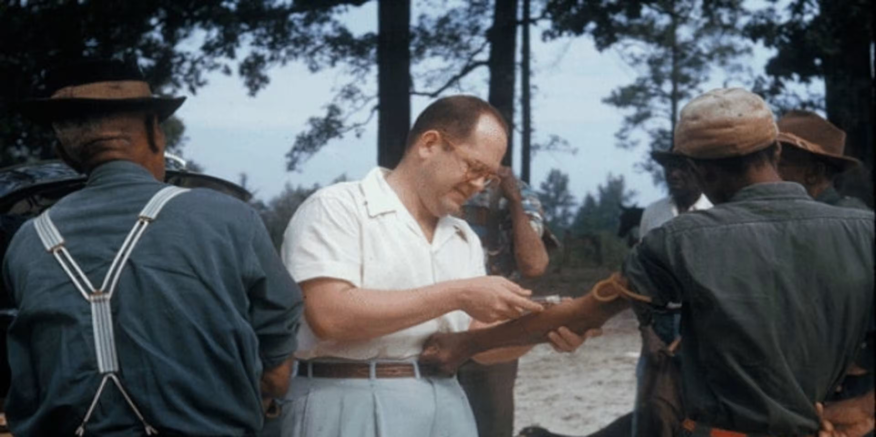
Tuskegee syphilis study (1932-1972)
600 men, 399 with advanced syphilis
Left untreated, even after penicillin was widely used to treat it
“Bad blood” → pink aspirin
“Forty-year death watch”
JanMohamed: “death-bound-subjects”

Slide 5
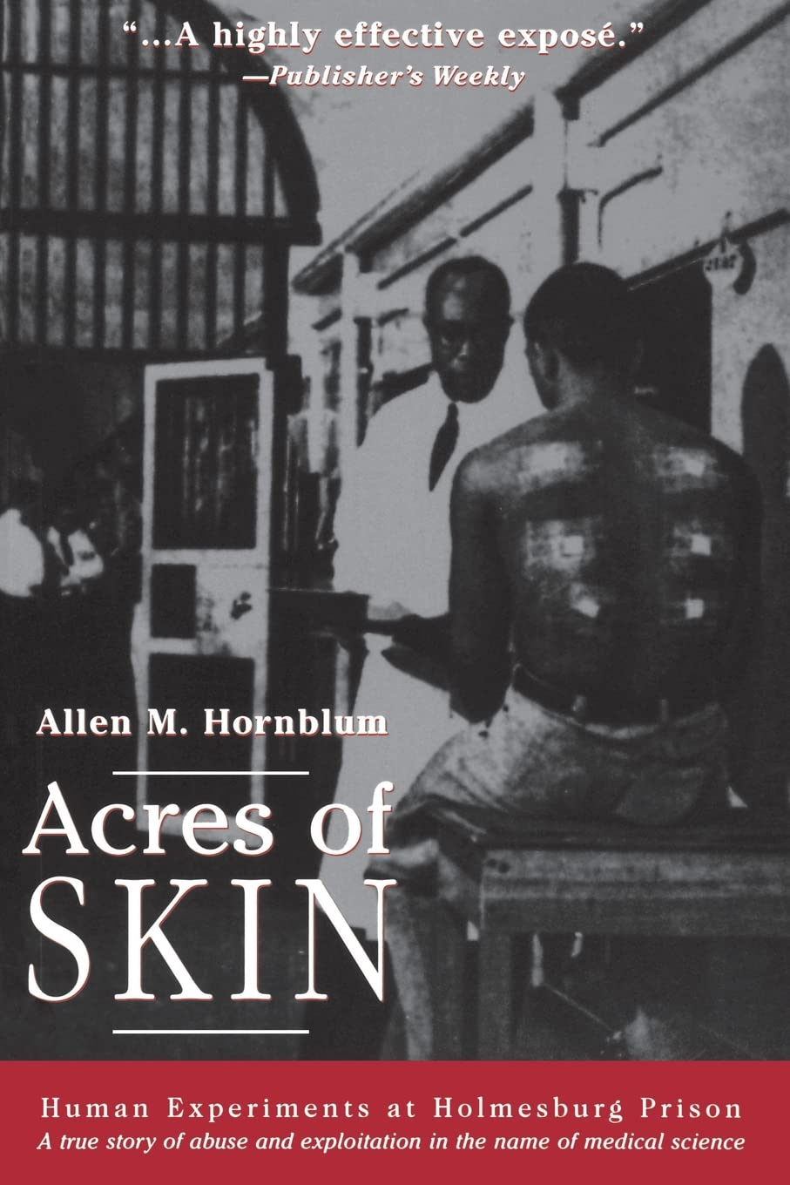
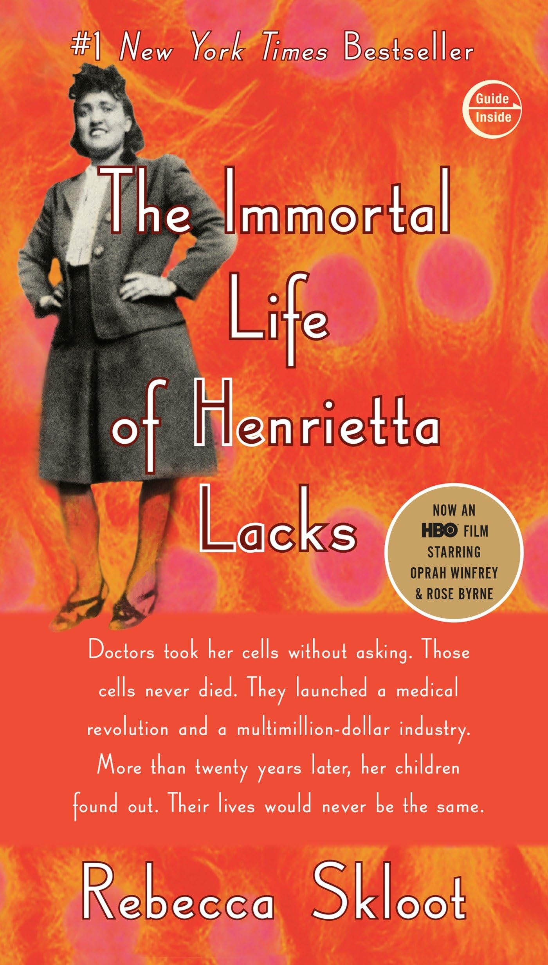
Henrietta Lacks → HeLa cell line
Holmesburg Prison experiments

Slide 6
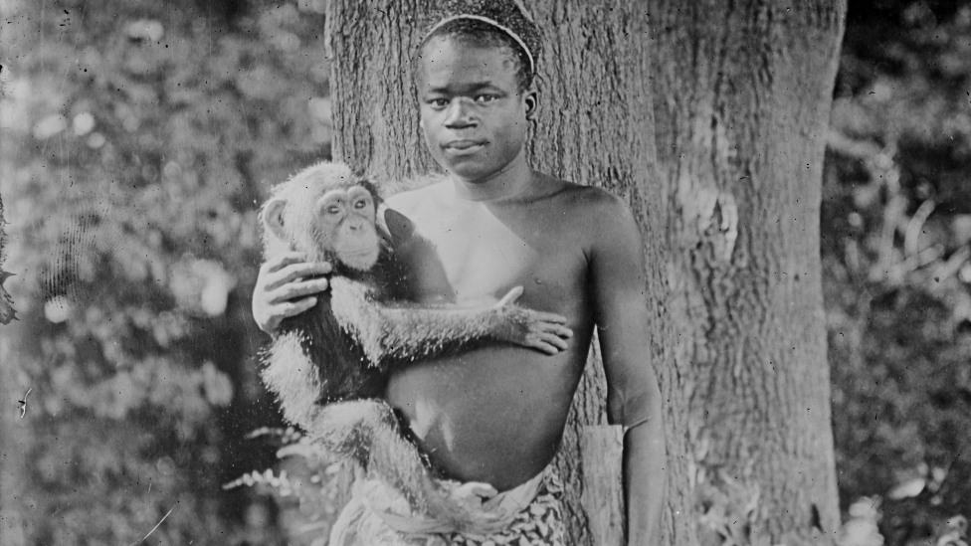
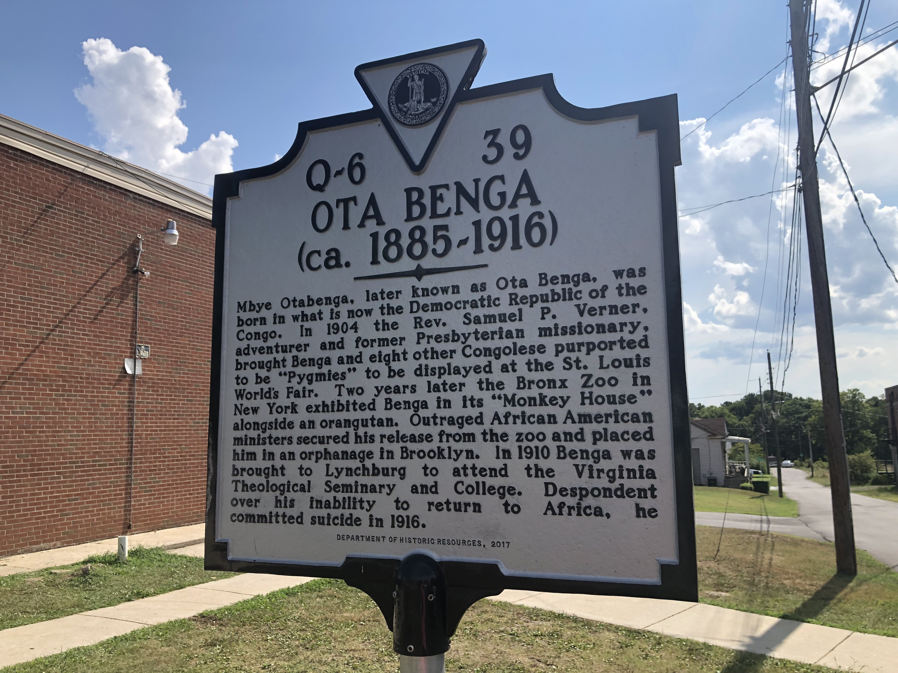
Ota Benga
Note how scientific racism is perpetuated in the above image. Are there also elements of the image that challenge its assumptions?

Slide 7
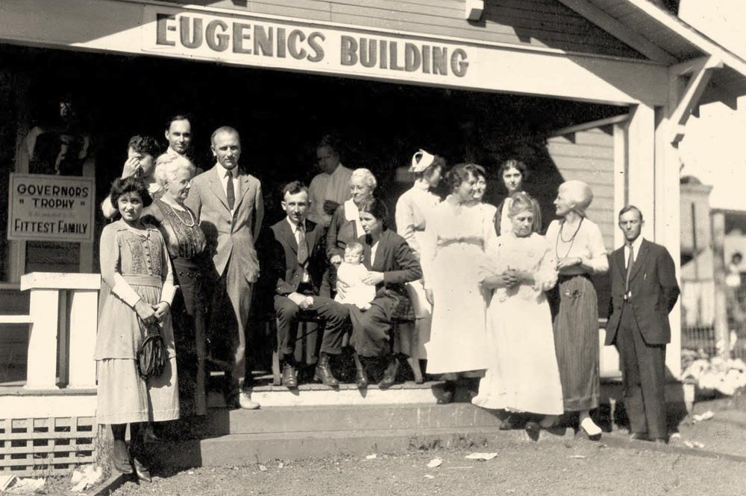
Public health campaigns
1900: Bubonic plague → Chinese residents in San Francisco
1916: Typhus outbreak → Mexican railroad workers
Forced sterilization
Buck v. Bell (1924): People with cognitive disabilities or mental illness
1930s-1970s: Women of color
2006-2010, 2020: Incarcerated women

Slide 8

Clinician-patient relationships
Ignore social determinants of health
Focus on individual choices (“individualistic paradigm”)
Myths about innate differences: e.g., Black people are less sensitive to pain
Bias: e.g., negative descriptors in EHRs
Discrimination → Stereotype threat
Flexner Report (1910) → Black people underrepresented in medical profession
Affects outcomes
Epistemic injustice

Slide 9
Weathering
“Where you don’t share the same assumptions or background, where the people you’re working with don’t appreciate all you’ve been through, where you’re having to always be on your guard and manage how you portray yourself or present yourself to try and not fulfill stereotypes that you think people you’re working with or going to school with might have about you. And that means you’re at a certain level of vigilance and looking for cues everywhere of whether you belong, whether you’re welcome, whether you’re going to be subject to what many people call microaggressions. … Those experiences themselves can cause weathering” (Geronimus 2023a).

Slide 10
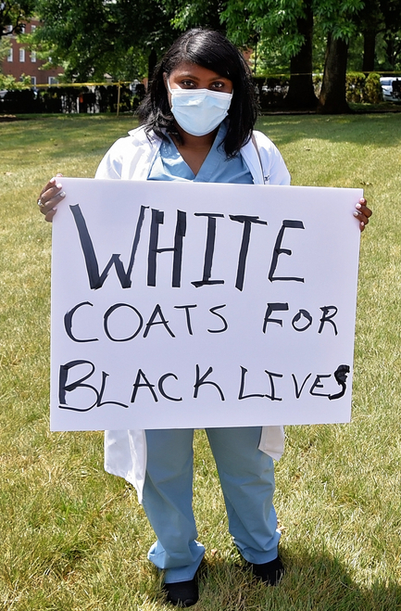
Questions?
How can we address medical racism?
Change medical education
Anti-racism training
Recruit diverse clinicians
Educating patients
Engage community leaders
Address institutional racism

