Slide 1
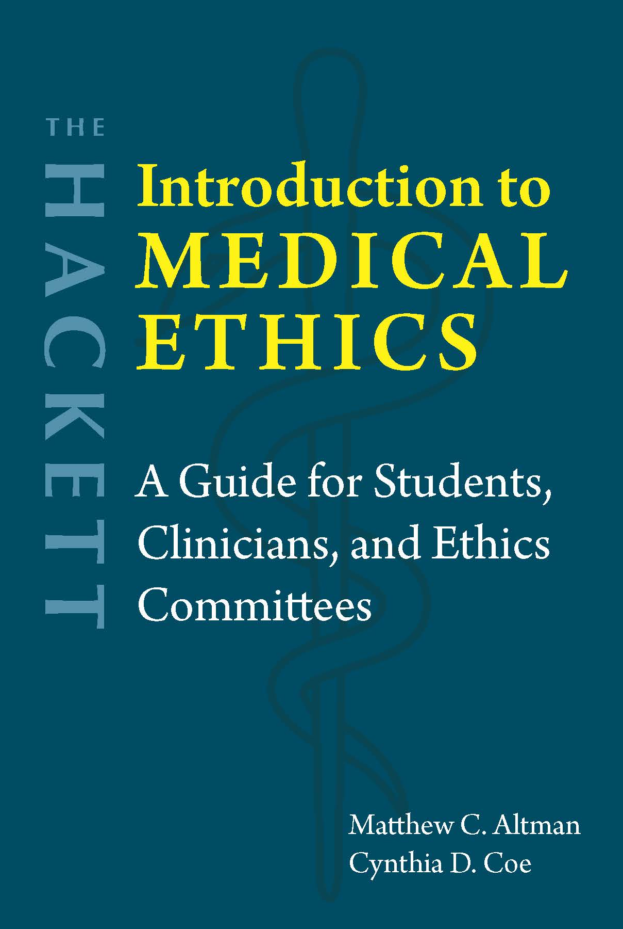
Chapter 12 Pediatric Ethics

Slide 2


Pre- or proto- competent
Autonomous
Emerging autonomy

Slide 3

Roles of parents and clinicians
Ideal: Informed permission from parents + assent from children
Things to avoid
Clinician lies to parents
Clinician lies to children
Parents lie to children
Help children understand insofar as they can
Beneficence: Support future autonomy
Typically: Empowering parents → Protect children
Rarely: Clinician advocates for the child against the parents

Slide 4

Proposed standards of beneficence
Best interests standard
Harm principle
Respect for parental autonomy (if it is rational)
There are difficult cases around undertreatment and overtreatment.

Slide 5
Standards for withholding treatment
“When treatment is clearly beneficial, it should be provided regardless of whether or not parents agree, but for cases in which the benefits of treatment are ambiguous or uncertain, parents should have the authority to determine whether treatment is provided or foregone. When treatment is considered futile, cannot provide benefit, and may only prolong or increase suffering, life-extending treatment should not be provided, even if parents insist on it” (Fleischman 2016, 66).
Treatment can be withheld only if “(A) the infant is chronically and irreversibly comatose; (B) the provision of such treatment would (i) merely prolong dying, (ii) not be effective in ameliorating or correcting all of the infant’s life-threatening conditions; or (iii) otherwise be futile in terms of survival of the infant; or (C) the provision of such treatment would be virtually futile in terms of the survival of the infant and the treatment itself under such circumstances would be inhumane” (Pub. L. 98-457).

Slide 6
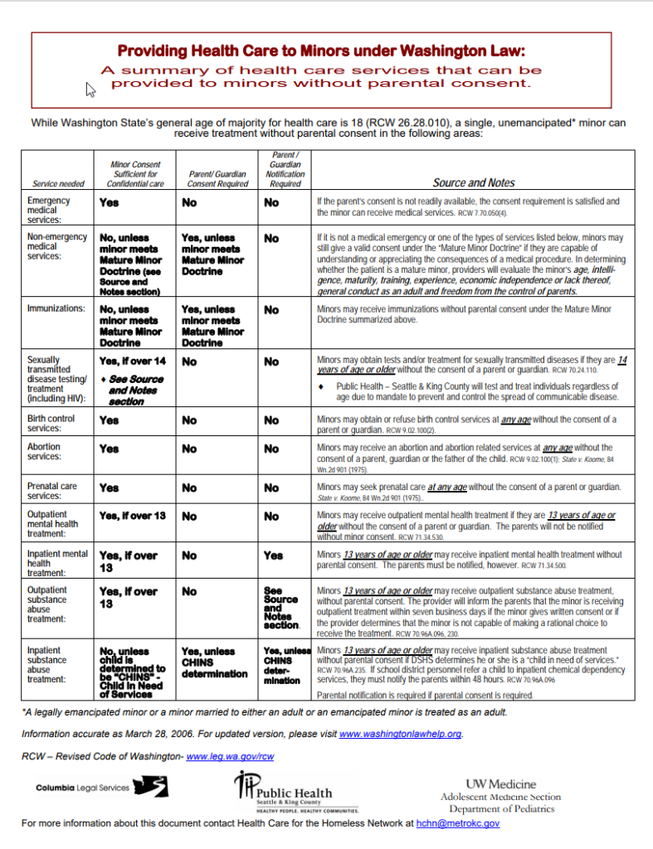
Mature minor laws
Can make decisions concerning …
Contraception
Pregnancy
Abortion (where legal)
STIs
Substance use
Smith v. Seibly (1967)
Age restrictions, other eligibility conditions, and allowable medical decisions vary by state

Slide 7

Vaccination and screening
Herd immunity
Vaccine hesitancy and refusal
Factors to consider
Parental liberty
Public good (justice)
Beneficence
What is owed to children
Mandatory newborn screening

Slide 8
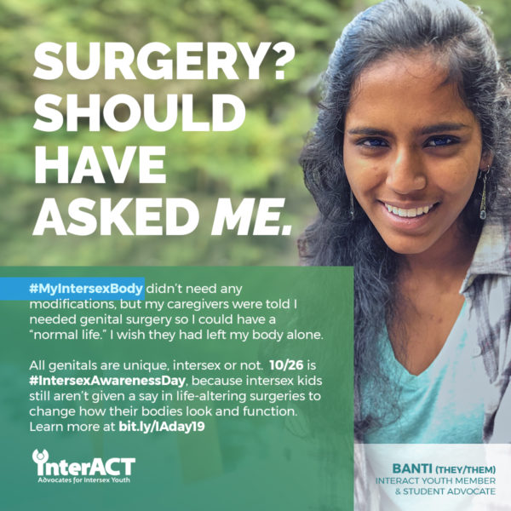
Intersex
Disorders of sex development (DSDs)
History of deception/coercion
“Corrective” surgeries and hormone treatments?
Are medical treatments imposing social norms (violating bodily autonomy) or protecting children (beneficence)?
Other elective genital surgeries
Male circumcision
Female genital cutting
Is there a moral difference?

Slide 9
Transgender care
Gender dysphoria vs. Gender incongruence
Puberty blockers vs. Gender-affirming surgery or hormone treatments
Legal prohibitions in some states
Concerns about regret (“persisters” vs. “desisters”)
Safety
Benefits
Longstanding gender incongruence and meets DSM criteria → Likely persistence
Mental health benefits

Slide 10
Pediatric research
Incapable of informed consent
But we need pediatric subjects
Therapeutic vs. Nontherapeutic research
HHS: Protection of Human Subjects (45 CFR 46), Subpart D
Nontherapeutic research is justifiable if it carries no more than minimal risk for children.
More than minimal risk is justified if there is a reasonable likelihood of direct health benefits to the child.
More than minimal risk may be justified if it does not significantly increase the medical risks the child already faces, as long as there is generalizable knowledge to be gained.
Research that poses more than a minor increase over minimal risk (that is, beyond what is covered by categories one to three) may be approved if it “presents [the] opportunity to understand, prevent, or alleviate a serious problem affecting the health or welfare of children.”

Slide 11
Racial disparities in treatment and health outcomes
“Racial/ethnic disparities in children’s health and health care are quite extensive, pervasive, and persistent. Disparities were noted across the spectrum of health and health care, including in mortality rates, access to care and use of services, prevention and population health, health status, adolescent health, chronic diseases, special health care needs, quality of care, and organ transplantation. … Mortality-rate disparities were noted for children in all 4 major US racial/ethnic minority groups, including substantially greater risks than white children of all-cause mortality; death from drowning, from acute lymphoblastic leukemia, and after congenital heart defect surgery; and an earlier median age at death for those with Down syndrome and congenital heart defects” (Flores 2010, e979).

Slide 12

End-of-life care
Treatment vs. Reduction of suffering
Denial → Medically futile treatments
Deception
Pediatric palliative care + Support family in their grief

Slide 13
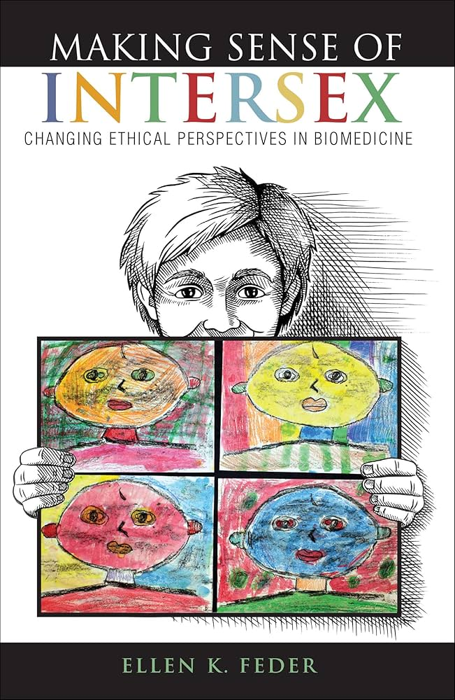

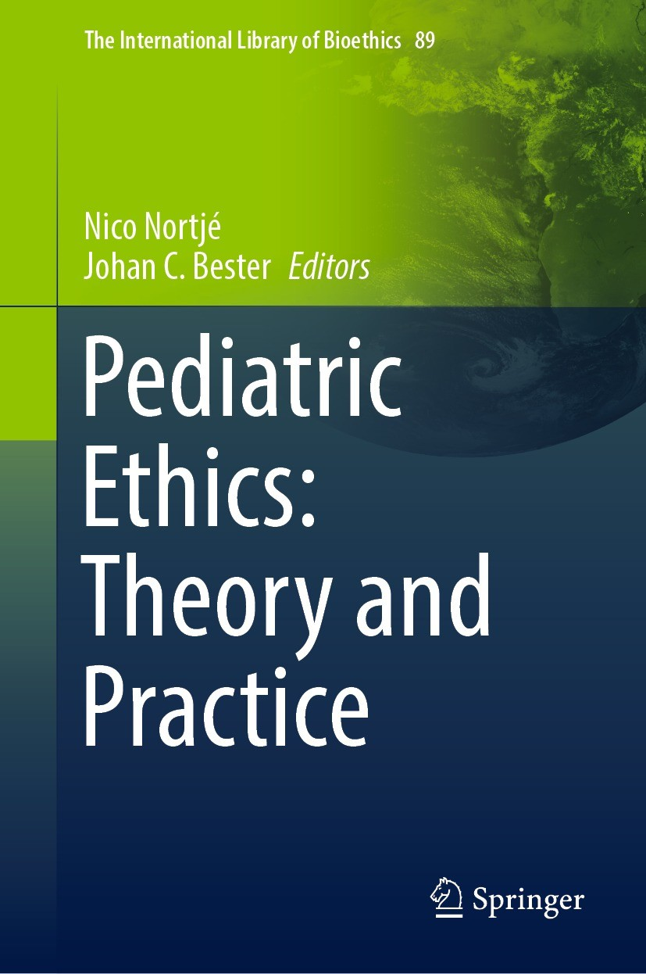
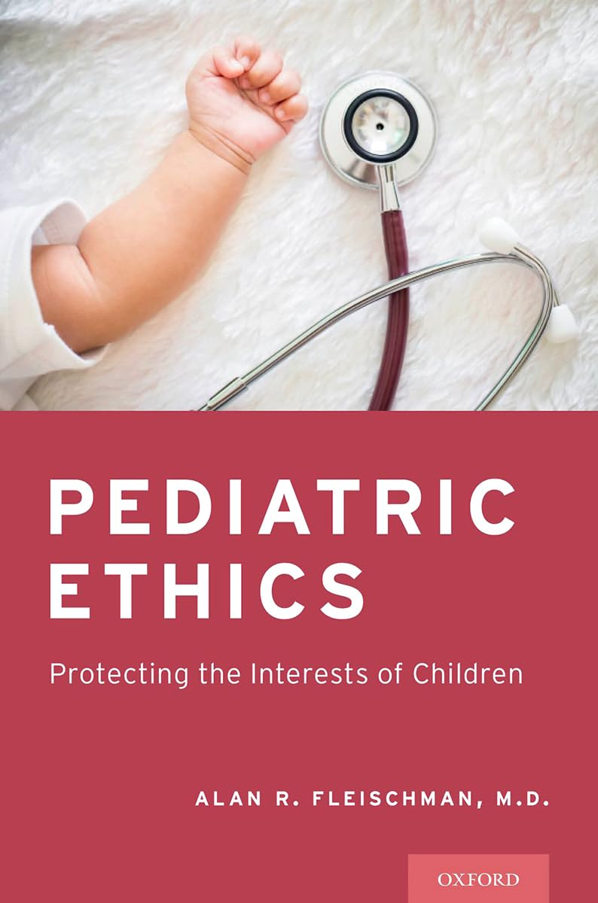
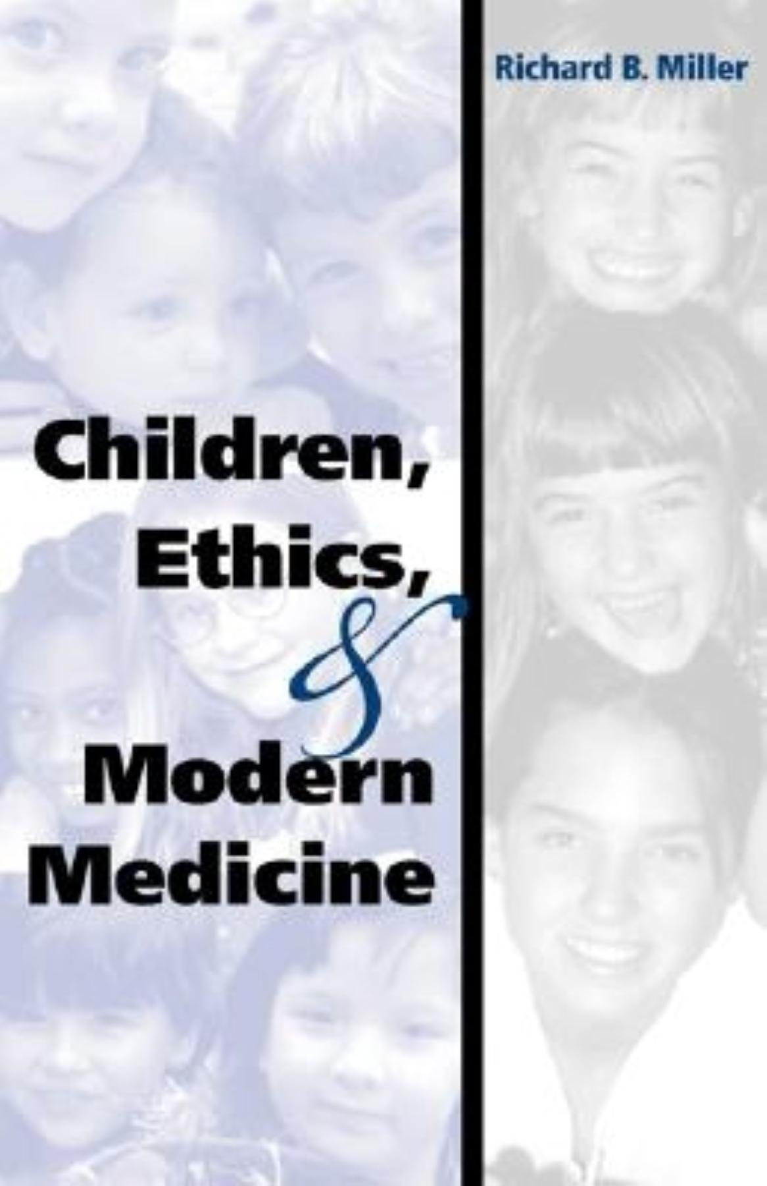
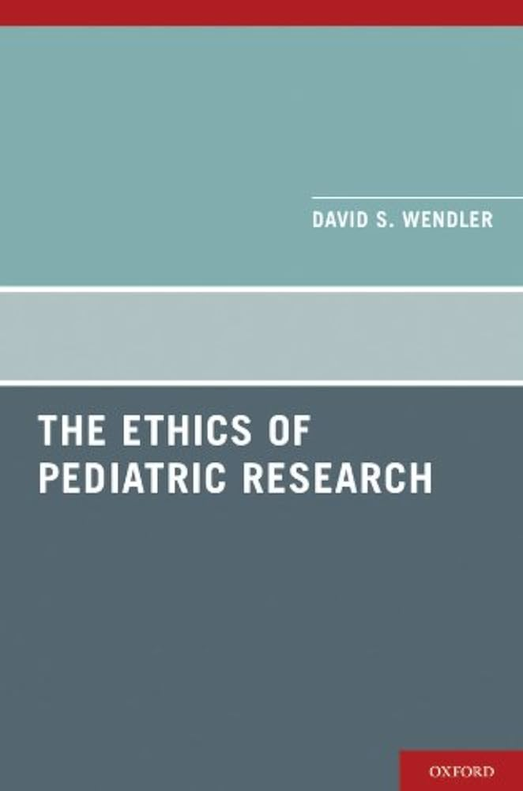
Questions?
Respect for autonomy
Nonmaleficence
Beneficence
Justice

