Slide 1

Chapter 13
Nursing Ethics

Slide 2
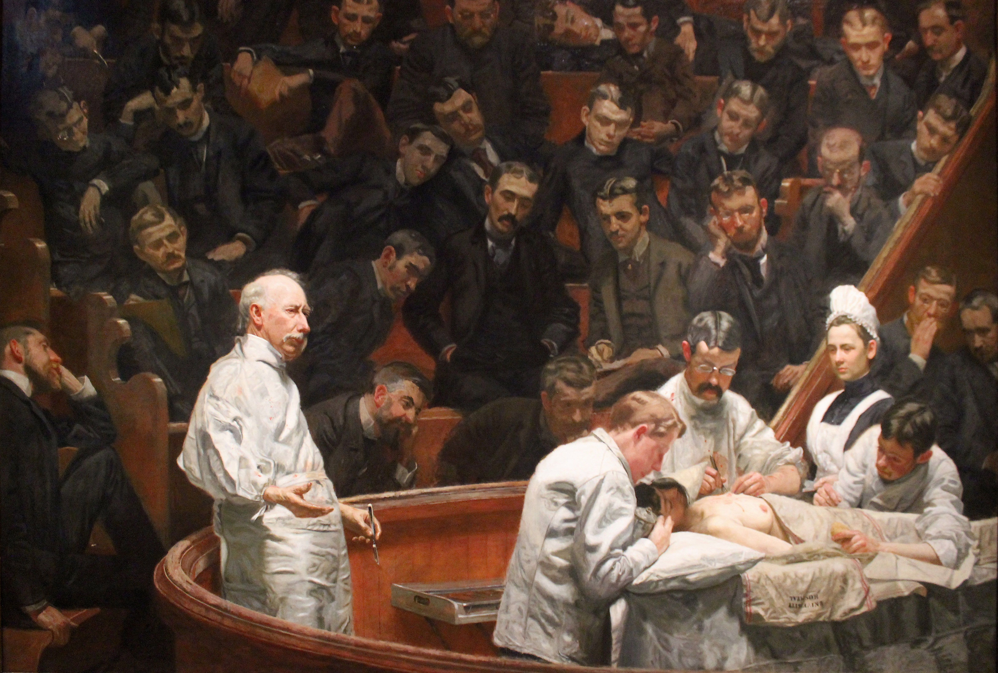
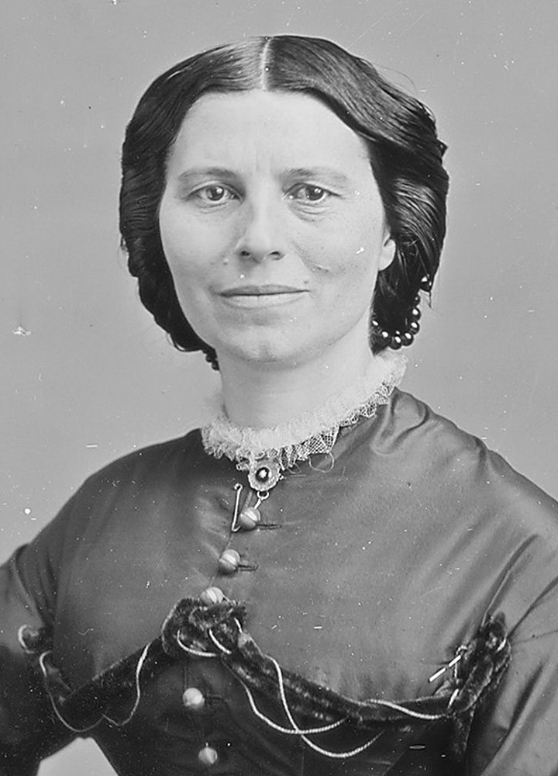
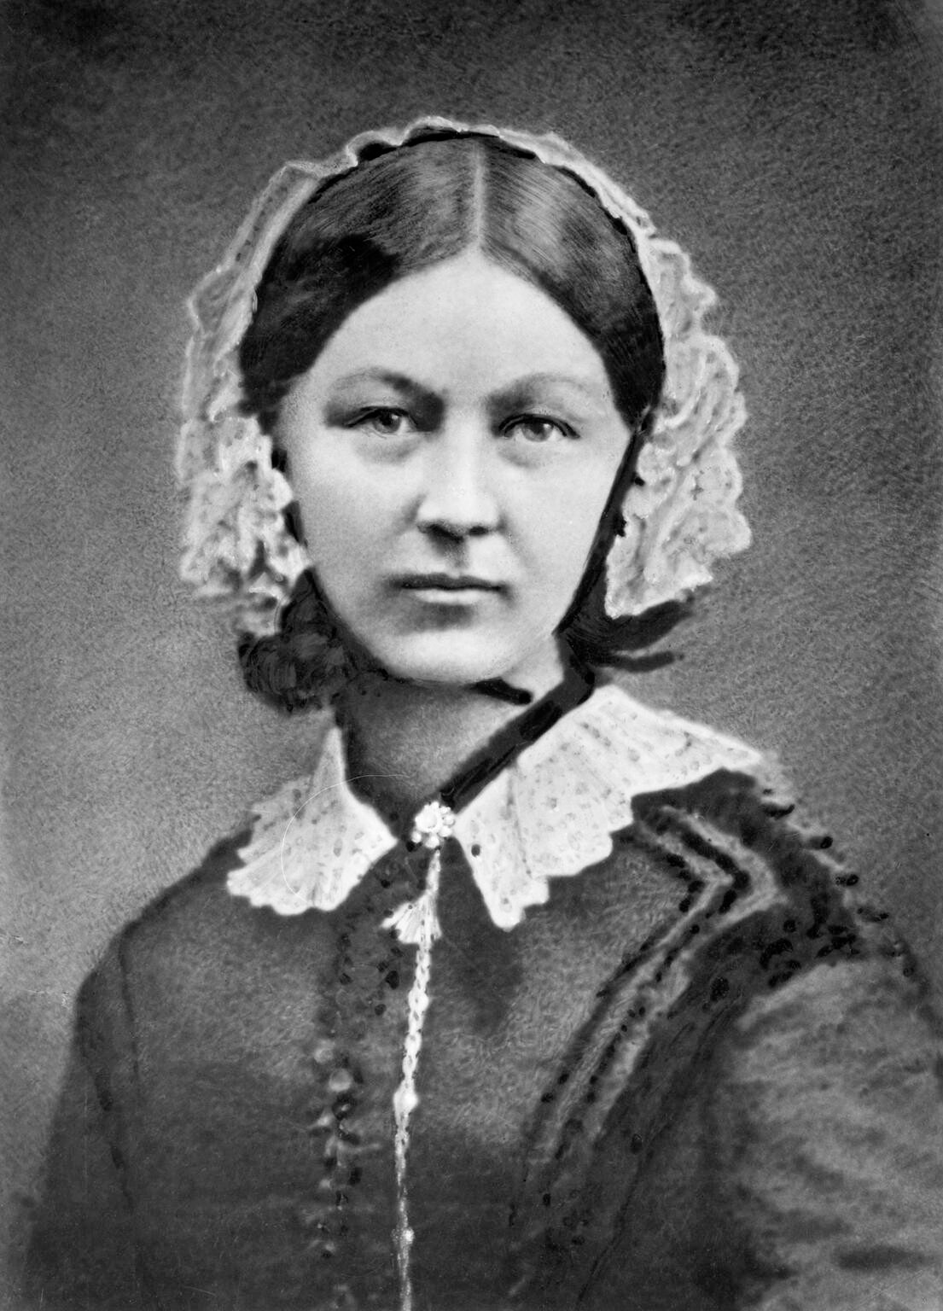
Gendered history of nursing
Assumption that women have biological, psychological, emotional instincts to care for others → Nursing as a profession
Military and religious models
Nurse/patient ≈ Mother/child
Main duty: Obey (mostly male) physicians
  “Useful parasite”
  “Intelligent machine”
The Agnew Clinic (1889), Thomas Eakins
Florence Nightingale (1820-1910)
Image: https://en.wikipedia.org/wiki/The_Agnew_Clinic
Clara Barton (1821-1912)

Slide 3
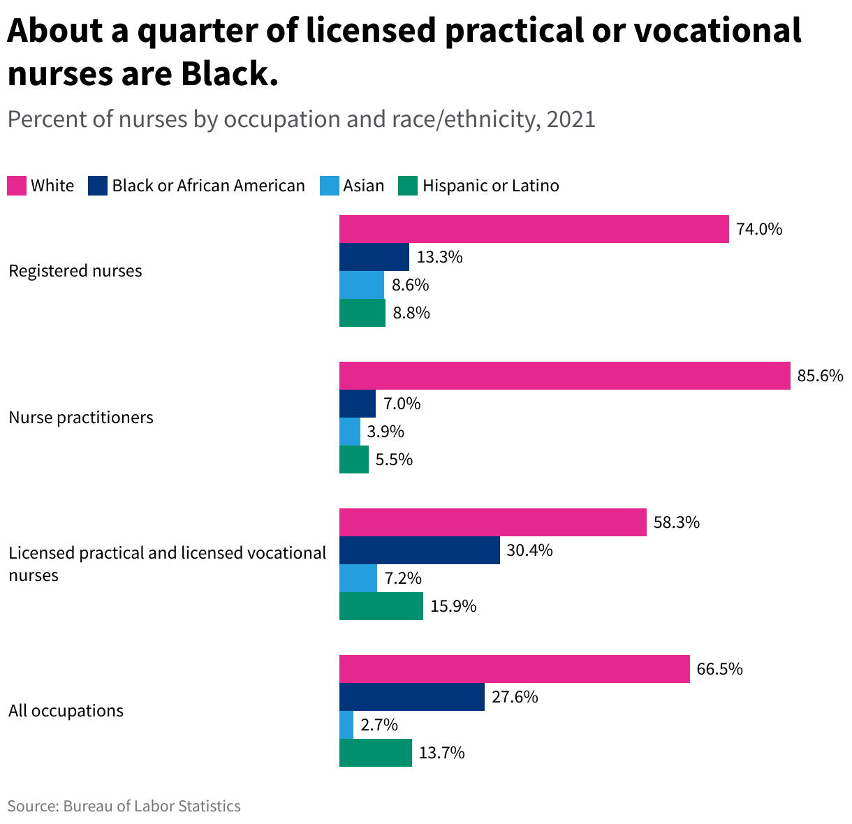
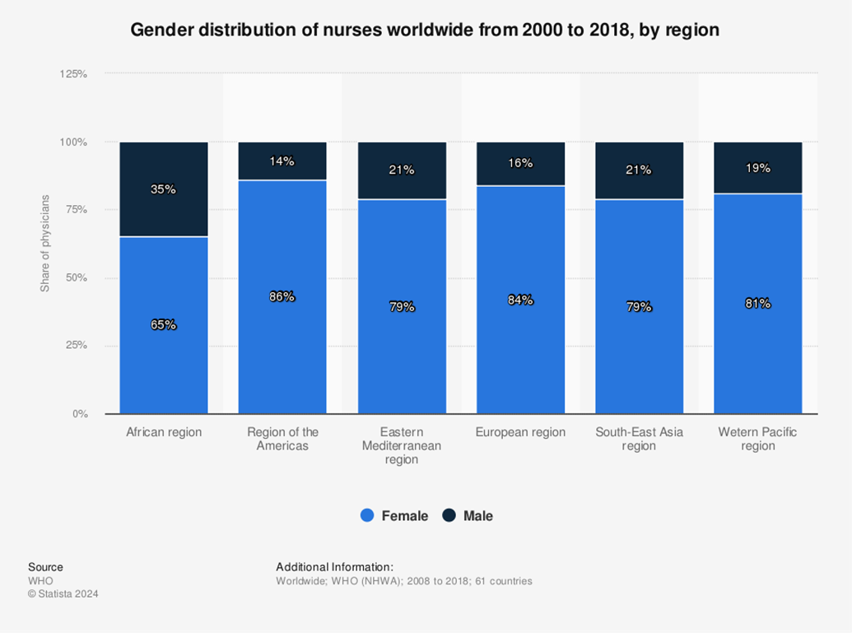
Race and gender biases → Epistemic injustice →
Nurses’ expertise devalued
Image: https://www.statista.com/statistics/1099804/distribution-of-nurses-across-regions-worldwide-by-gender/
Image: https://usafacts.org/articles/who-are-the-nations-nurses/

Slide 4

ICN Code of Ethics
Nurses have four fundamental responsibilities:
  To promote health
  To prevent illness
  To restore health
  To alleviate suffering and promote a dignified death
  → Patient advocacy

Slide 5
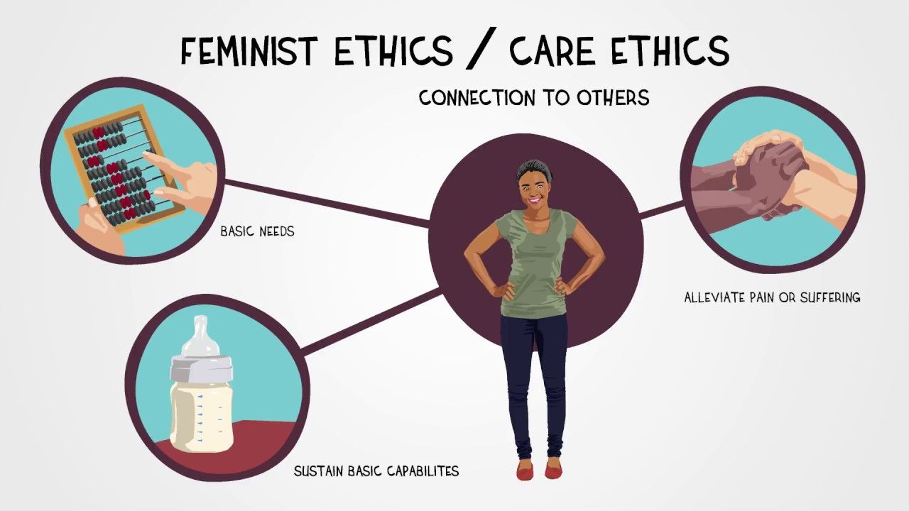
Care ethics
Alternative to ethics of justice, which focuses on impartial application of abstract rules
Instead: Interdependence, vulnerability, relationality; context, particularity, connection
Applied to patients
Tronto: Four dimensions of caring
  Attentiveness
  Responsibility
  Competence
  Responsiveness
Subjective significance of illness
Image: https://ethics.org.au/ethics-explainer-ethics-of-care/

Slide 6

Empowering nurses
Moral agency
Challenging physicians when necessary
  Tuskegee: Eunice Rivers
Redefining health and illness
Communicating with patients and families
Focusing on social determinants of health
Reflecting on the institution and the industry
Image: https://www.aspen.edu/altitude/claim-your-nursing-superpower-and-elevate-your-career/

Slide 7

Common ethical issues in nursing
Caring for multiple patients at once
Serving as intermediary between patients and physicians
Resisting paternalistic treatment of patients
Balancing respect for autonomy and beneficence
  Patients value more that just bodily health → Nurses should promote overall well-being
  Empower patients
  Respect patient autonomy while also promoting workplace safety
End-of-life care
  Hospice care

Slide 8
Moral distress: “When one knows the right thing to do, but institutional constraints make it nearly impossible to pursue the right course of action” (Jameton 1984, 6).
  Uncertainty-distress vs. Constraint-distress
  Internal vs. External constraints
  Cause: Inadequate support for moral reflection
  End-of-life care
Moral injury: Psychological harm that arises from repeatedly compromising of one’s moral values
Burnout: Long-term stress reaction to institutional conditions
  Institutional changes needed to combat burnout
Compassion fatigue: Psychological effects (e.g., numbing or anxiety) of responding to the suffering of others

Slide 9
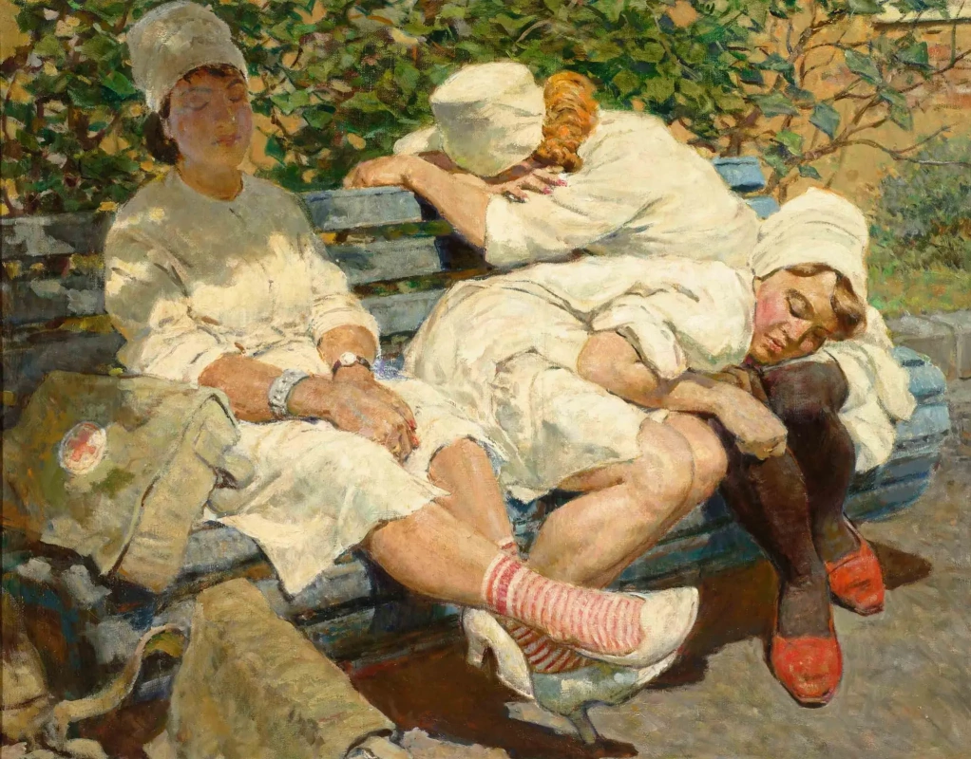
Nursing begins with care for the individual patient.
Questions?
Nurses Rest after Duty (1956), Leo Kotlyarov
Image: https://www.alternatehistory.com/forum/threads/souls-of-the-soviet-era-in-painting.422286/

