Slide 1
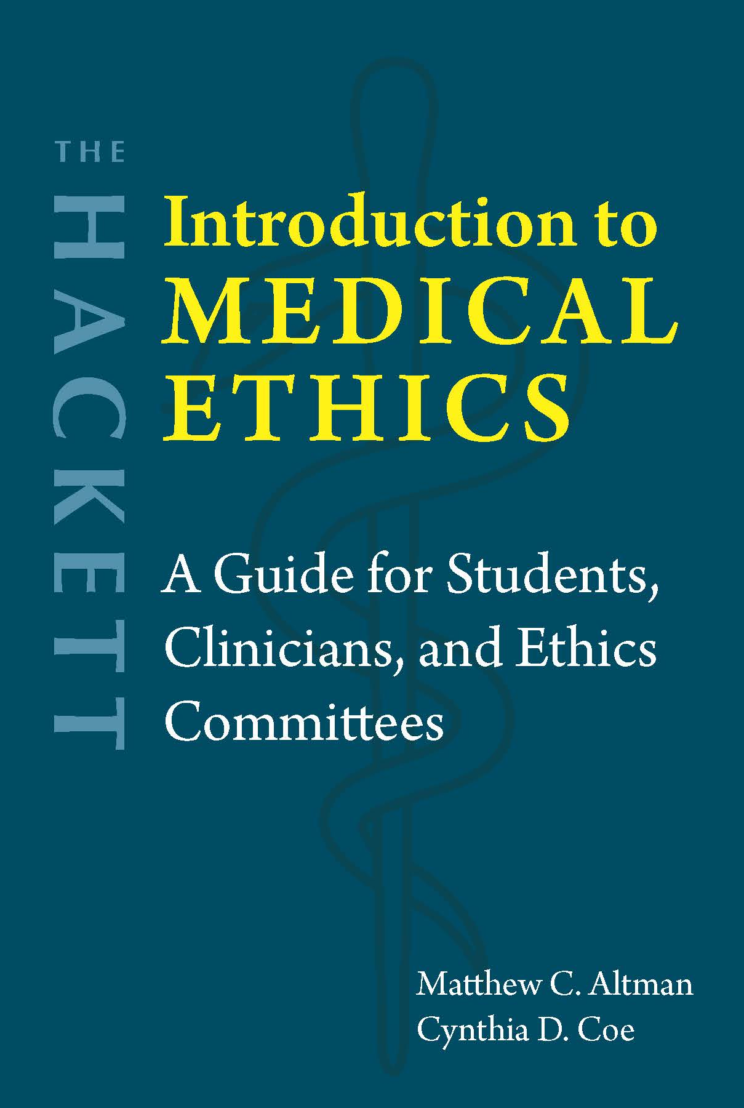
Chapter 14 Experimentation on Human Subjects

Slide 2
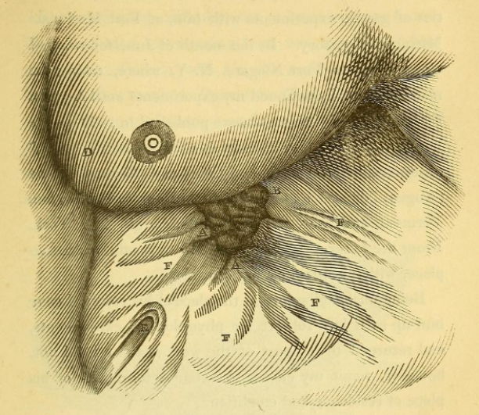
Historical background
19th century
Beneficence: Keep “the good of the patient [as] the sole object in view” (Percival 1803, 37).
Consultation with other doctors ≈ Institutional review board
Nonmaleficence: “The principle of medical and surgical morality, therefore, consists in never performing on man an experiment which might be harmful to him to any extent, even though the result might be highly advantageous to science, i.e., to the health of others” (Bernard 1949, 101).
Image: https://connecticuthistory.org/the-father-of-gastric-physiology-born-today-in-history/
Respect for autonomy: Obtain consent and stop experiment upon request (Beaumont).
However, subjects were deceived and given incentives, in coercive situations.

Slide 3
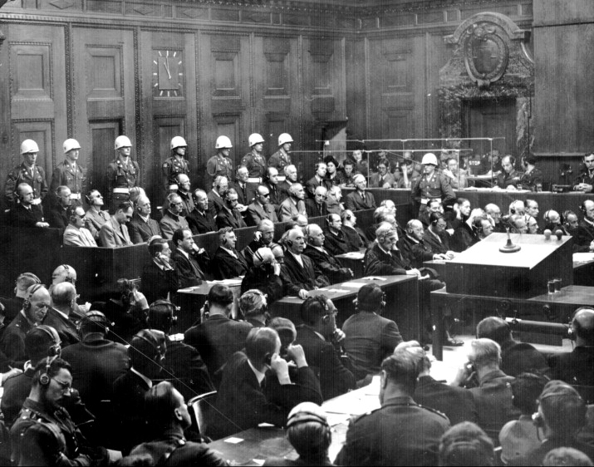
Nazi Doctors’ Trial (1946-1947)
Medical experiments conducted at concentration camps
Violations of principles of respecting autonomy, beneficence, nonmaleficence, and justice
Research subjects treated as subpersons: biological sameness (with so-called Aryans), moral dehumanization
Defense
Common practice
No existing code of research ethics
Image: https://www.thelancet.com/journals/lancet/article/PIIS0140-6736%2804%2917619-8/fulltext

Slide 4
Nuremberg Code
The voluntary consent of the human subject is absolutely essential.
The experiment should be such as to yield fruitful results for the good of society, unprocurable by other methods or means of study, and not random and unnecessary in nature.
The experiment should be so designed and based on the results of animal experimentation and a knowledge of the natural history of the disease or other problem under study that the anticipated results will justify the performance of the experiment.
The experiment should be so conducted as to avoid all unnecessary physical and mental suffering and injury.
No experiment should be conducted where there is an a priori reason to believe that death or disabling injury will occur; except, perhaps, in those experiments where the experimental physicians also serve as subjects.
The degree of risk to be taken should never exceed that determined by the humanitarian importance of the problem to be solved by the experiment.
Proper preparations should be made and adequate facilities provided to protect the experimental subject against even remote possibilities of injury, disability, or death.
The experiment should be conducted only by scientifically qualified persons. The highest degree of skill and care should be required through all stages of the experiment of those who conduct or engage in the experiment.
During the course of the experiment the human subject should be at liberty to bring the experiment to an end if he has reached the physical or mental state where continuation of the experiment seems to him to be impossible.
During the course of the experiment the scientist in charge must be prepared to terminate the experiment at any stage, if he has probable cause to believe, in the exercise of the good faith, superior skill and careful judgment required of him that a continuation of the experiment is likely to result in injury, disability, or death to the experimental subject.

Slide 5
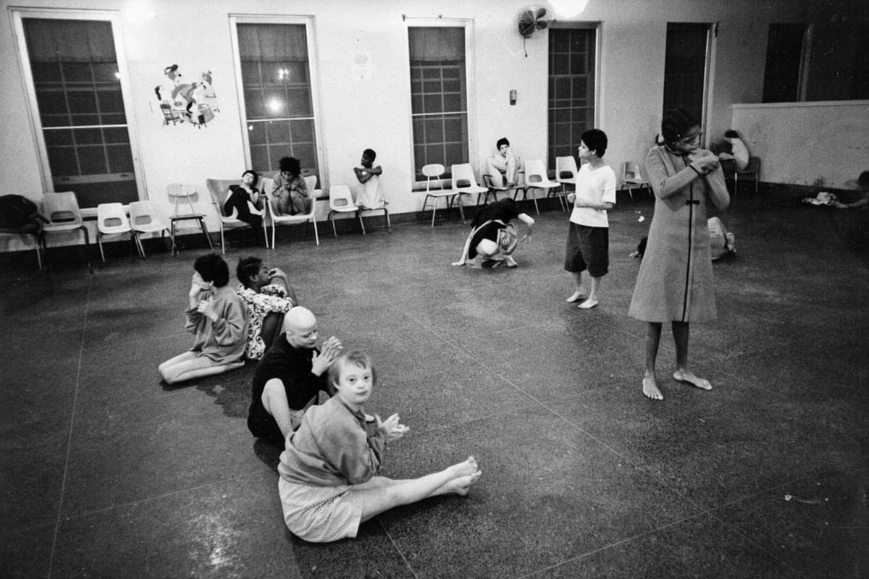
Post-war experiments in the U.S.
Tuskegee syphilis study (1932-1972)
Willowbrook hepatitis study (1956-1971)
Jewish Chronic Disease Hospital cancer study (1963)
Other unethical research
Conducted by military on soldiers, prisoners, other civilians
Research in prisons
Research in developing countries
Violations of the Nuremberg Code
Public outcry in early 1970s
Willowbrook State School
Image: http://www.preservepennhurst.org/default.aspx?pg=1647

Slide 6
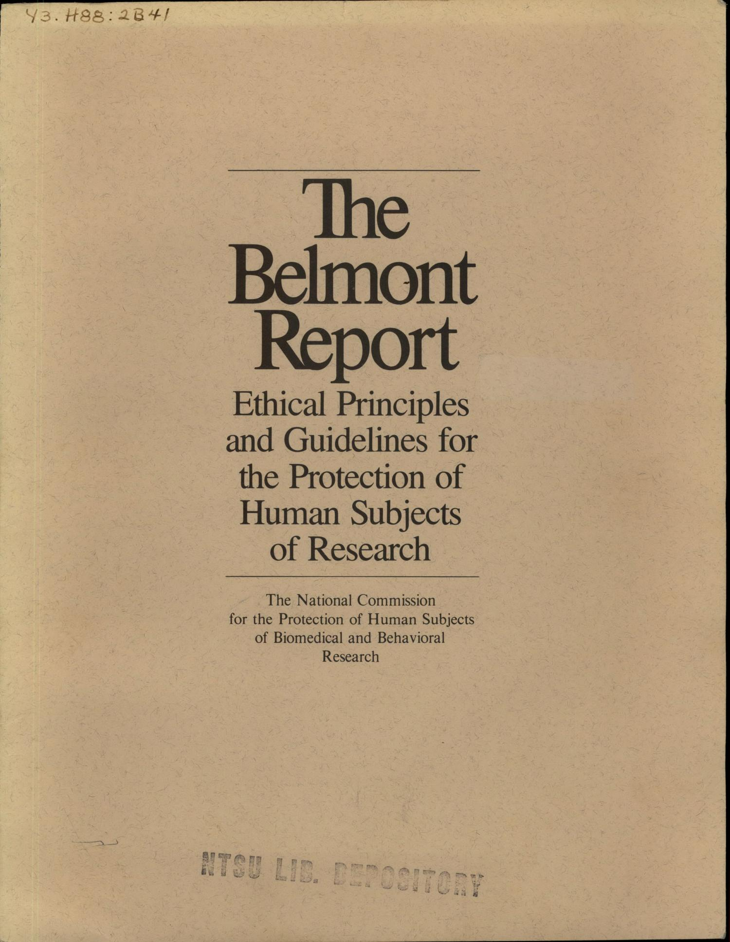
Three principles
Respect for persons: Obtain informed consent
Autonomy
Deception or coercion
Consent
Confidentiality
Beneficence: Assess risks and benefits
Kinds of harms
Who benefits?
“Do no harm”
Scientific validity
Justice: Equitably select and recruit research subjects
Distribution of benefits and burdens
Institutional Review Boards (IRBs)
Levels of review
Full board review
Expedited review
Exempt from review

Slide 7
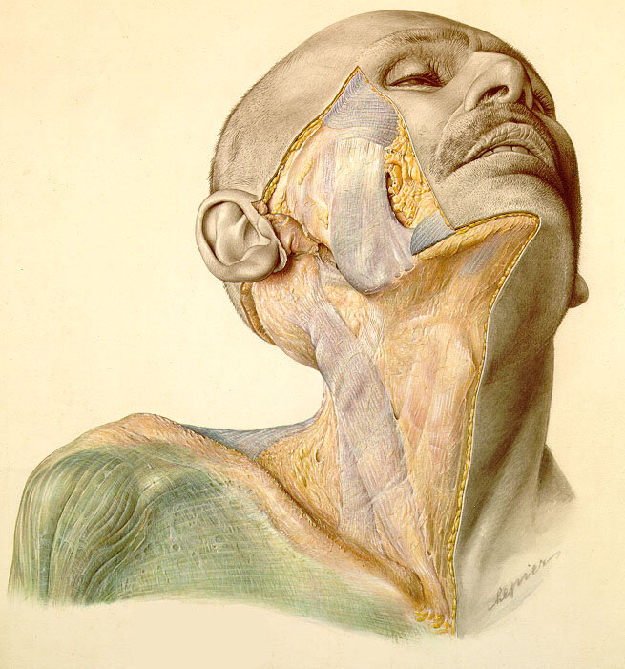
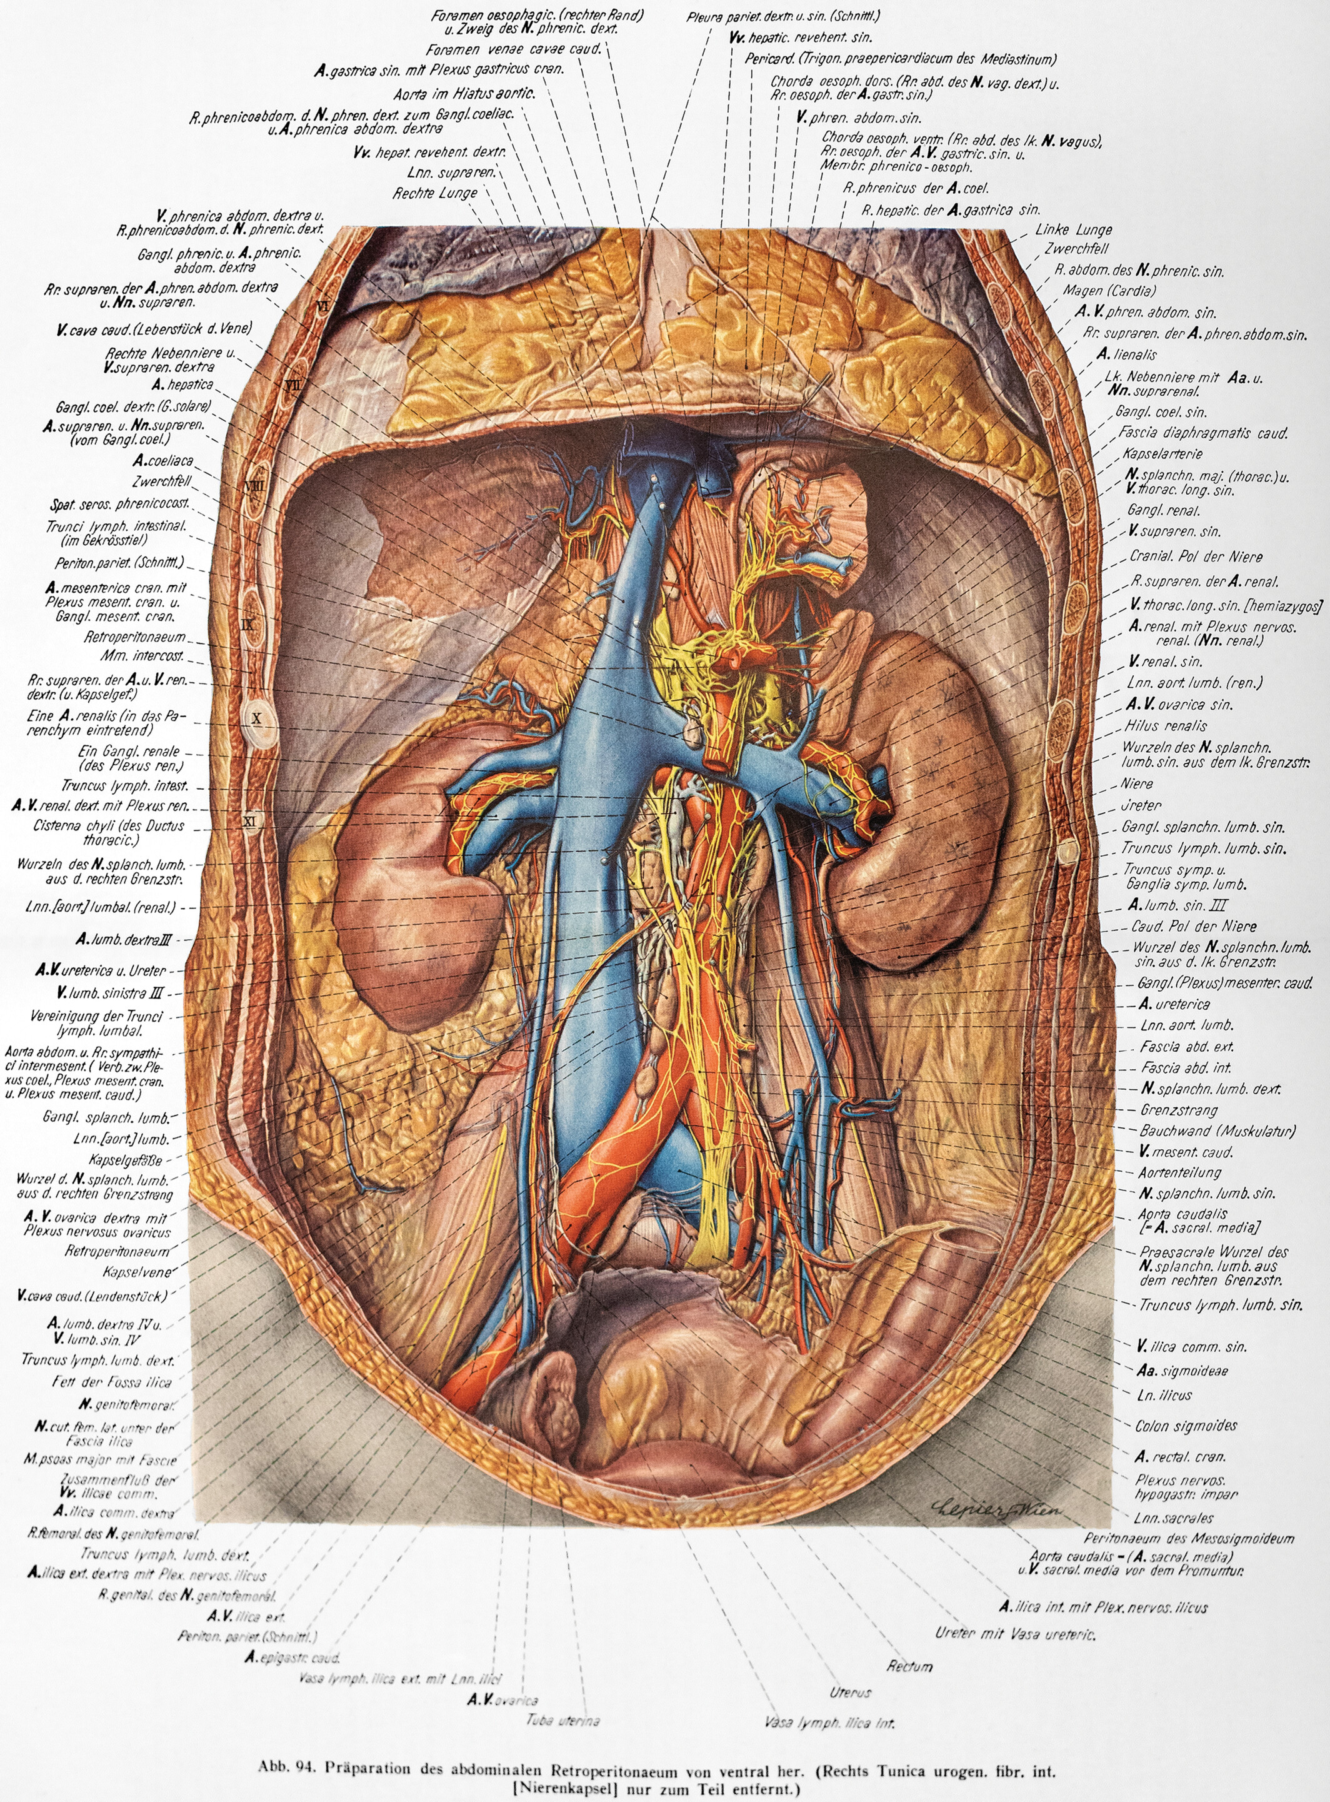
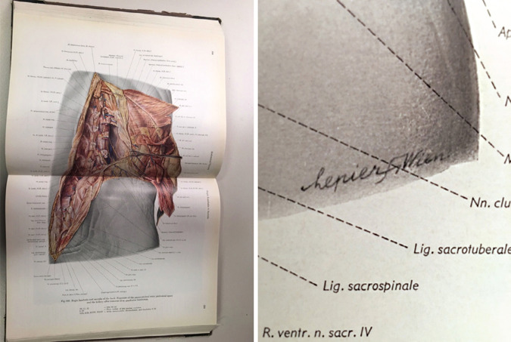
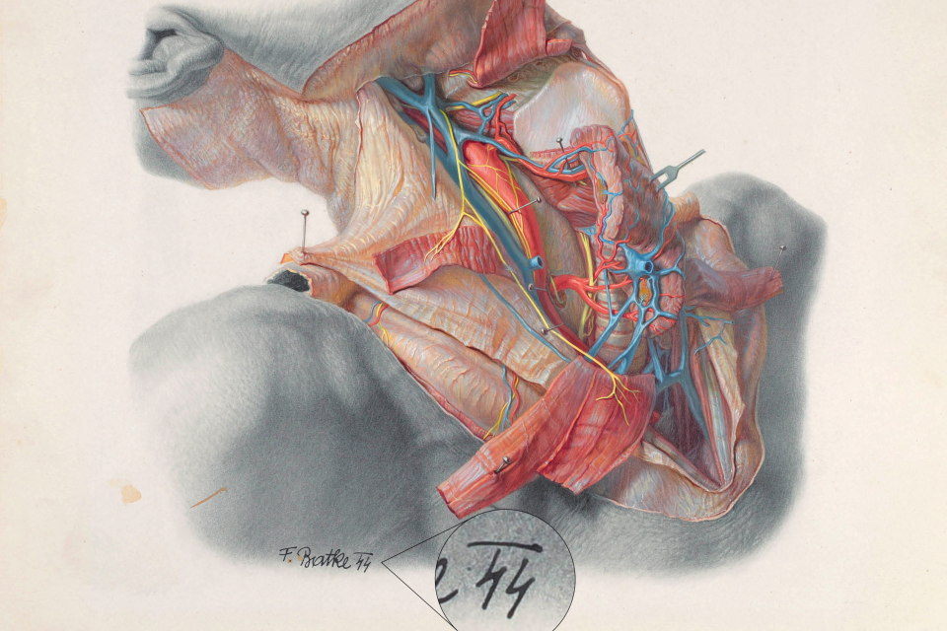
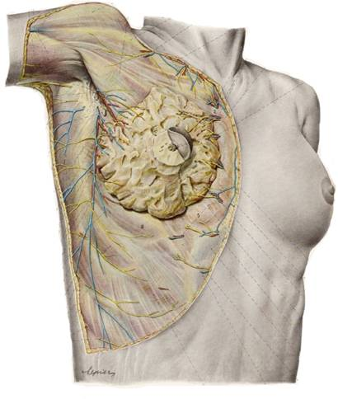
Pernkopf Atlas (1937-1957)
https://anatomypubs.onlinelibrary.wiley.com/doi/10.1002/ase.70001
Image: https://europepmc.org/article/MED/36407933
https://streetanatomy.com/blog/2007/04/01/vanessa-3
https://as.vanderbilt.edu/koepnick/Beauty_f06/materials/thoughtpapers/valencic.htm
https://www.uclahealth.org/news/publication/human-anatomy-atlas-has-horrific-history-one-doctor-aims

Slide 8
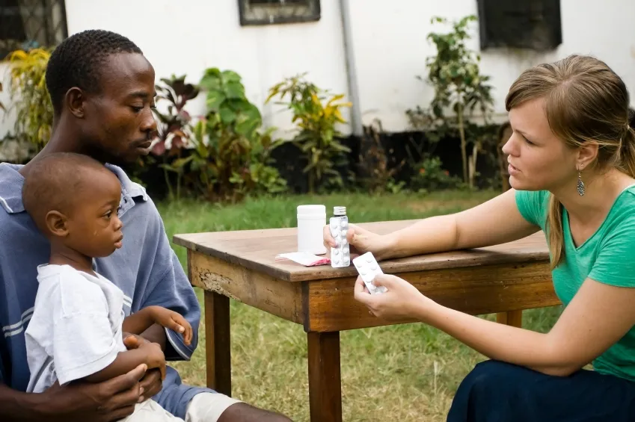
Corporate funding for international research
Compensation for research subjects
Hard to enforce ethical standards
Justice: Distribution of benefits and burdens
Sometimes warranted, but may be coercive
What compensation?
Some patients need the experimental treatment
Randomized controlled trial
Placebo → Little/no benefit
Standard treatment → Potentially less benefit
Compassionate use
Equipoise

Slide 9
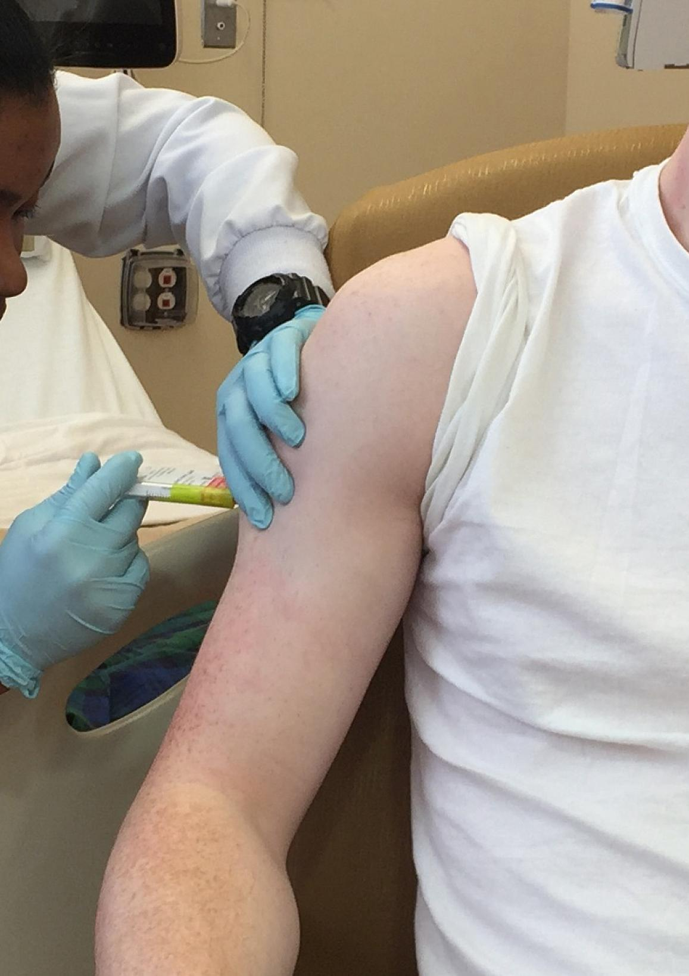
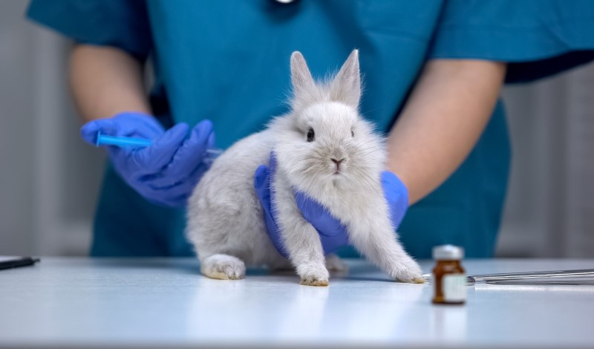
Questions?
Animal experimentation
Deontological = Animal rights (Regan)
Utilitarian = Animal welfare (Singer)

