Slide 1
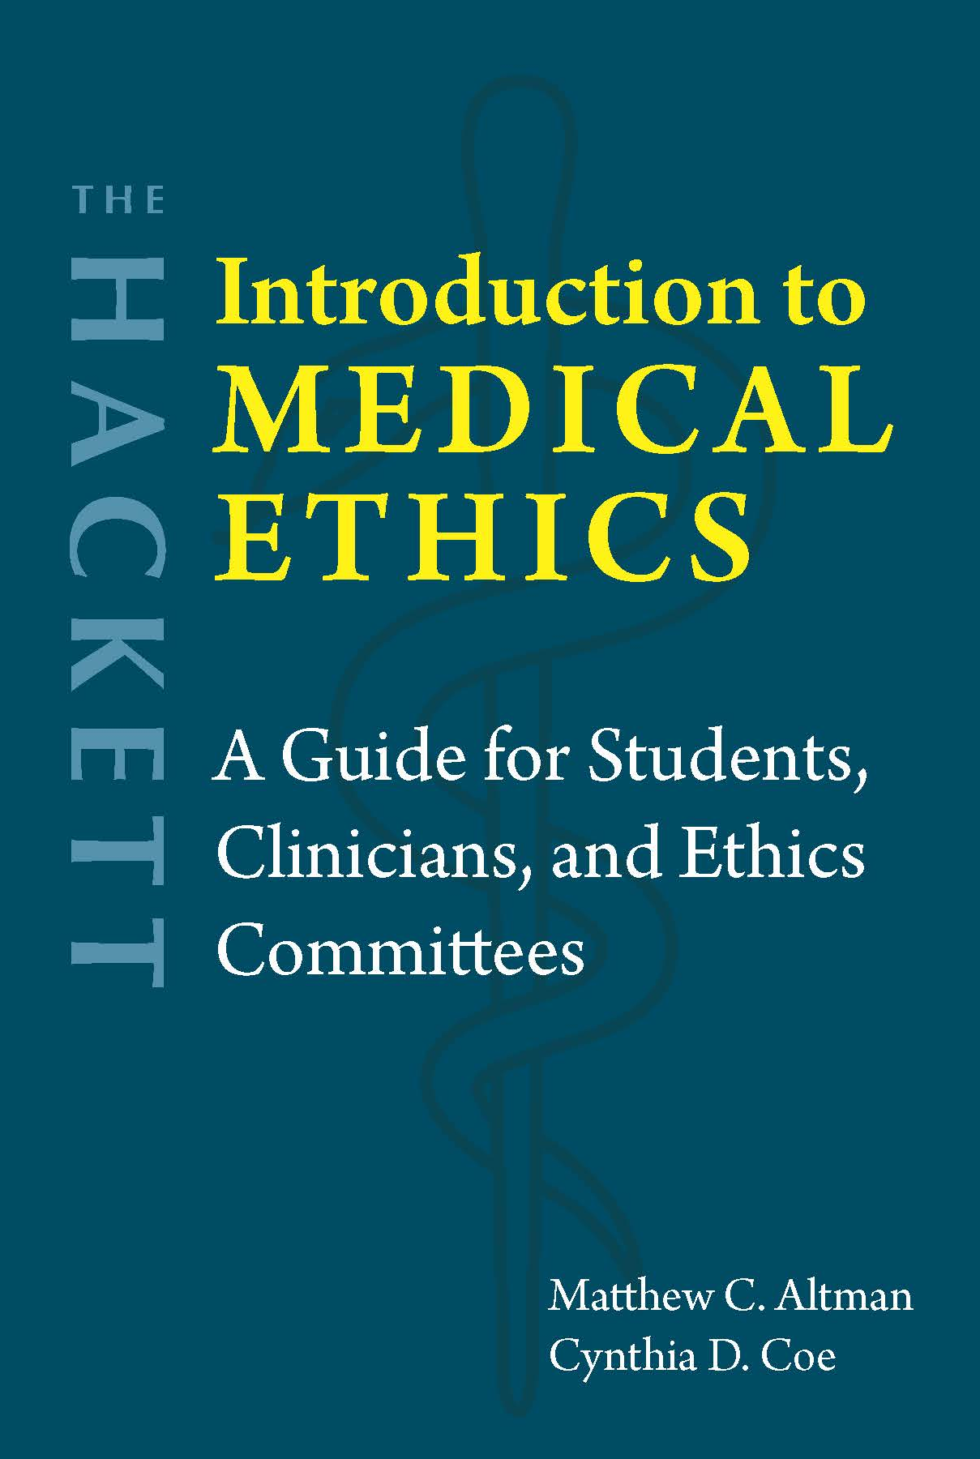
Chapter 2
Collective Responsibility in Medicine

Slide 2

What is collective responsibility?
Single person makes decision
Single person acts
Single person carries responsibility for the outcome of that action
How does this apply to groups or organizations?

Slide 3

Why is there collective responsibility?
Peter French
  Corporate internal decision (CID) structure
  Healthcare: Laws and regulations, licensing and accreditation, professional standards, employer expectations
David Luban, Alan Strudler, and David Wasserman
  Bureaucracy → Diffusion of responsibility
  Healthcare: Team-based approach, just culture

Slide 4
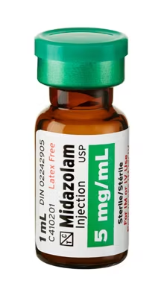
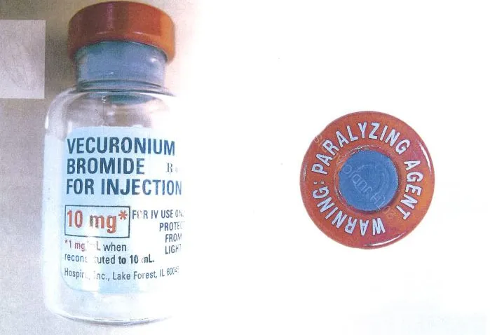
RaDonda Vaught and VMC
Charlene Murphy: PET scan
Versed → “VE” → vecuronium
Ignored five warnings/pop-ups + other red flags
No barcode verification
Left patient unattended
Death certificate: Natural death

Slide 5

Fallout
Vaught fired from VMC
Tennessee DOH investigates Vaught → No discipline
CMS investigates VMC → Plan of correction
Criminal charges: Reckless homicide and abuse of an impaired adult
Tennessee DOH → Vaught charged with wrongdoing
Nursing Board → Revokes Vaught’s nursing license
Guilty verdict

Slide 6

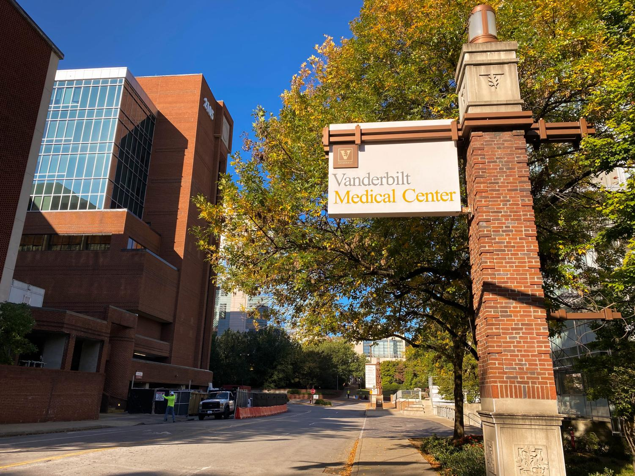
Vaught’s individual errors
VMC’s system errors
Ignoring warnings
Not reconciling the medication
Not monitoring the patient
Common use of override function
Insufficient ADM restrictions
No barcode scanning
No policy for monitoring patients on high-alert medications

Slide 7
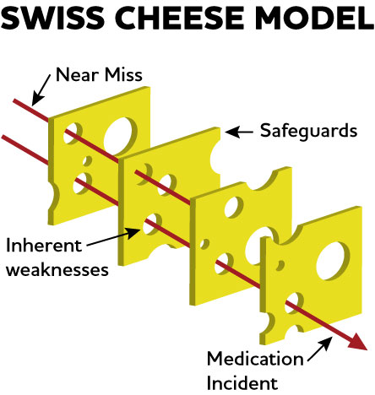
Questions?
Just culture: Reporting errors → Improve processes
Individual actions occur in a system of constraints
Image: https://pharmacyconnection.ca/how-swiss-cheese-can-help-visualize-medication-safety-risks/

