Slide 1
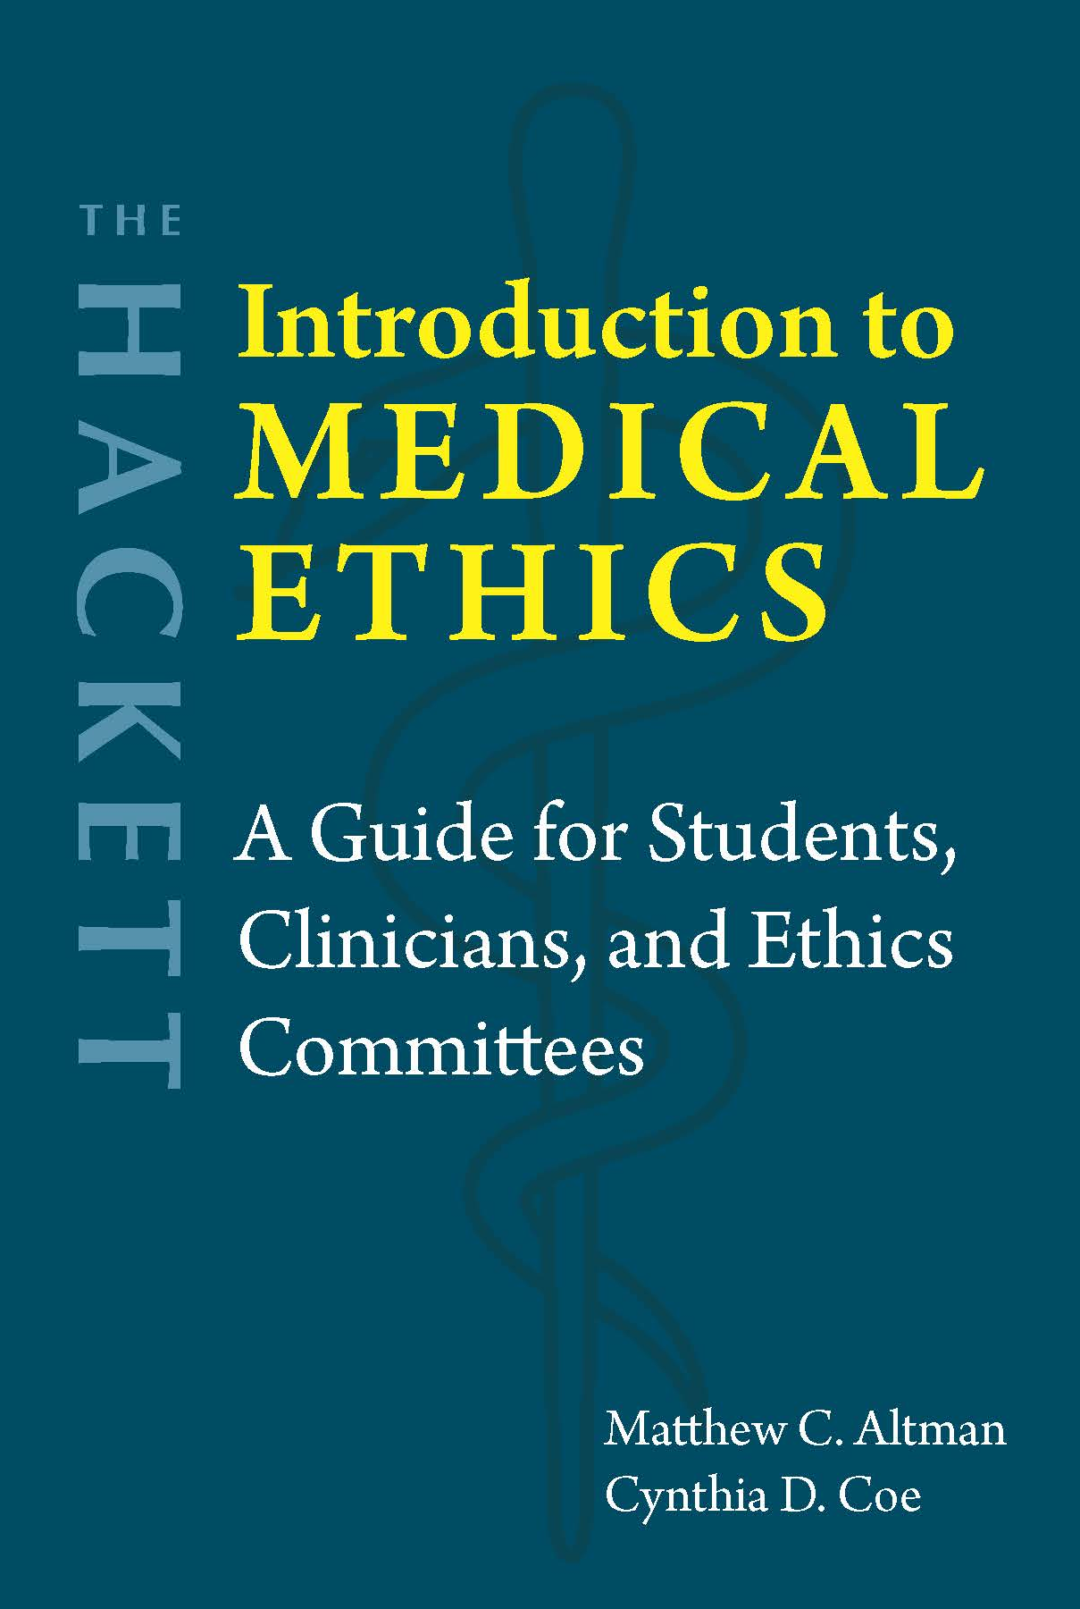
Chapter 3 Paternalism and Patient Autonomy

Slide 2
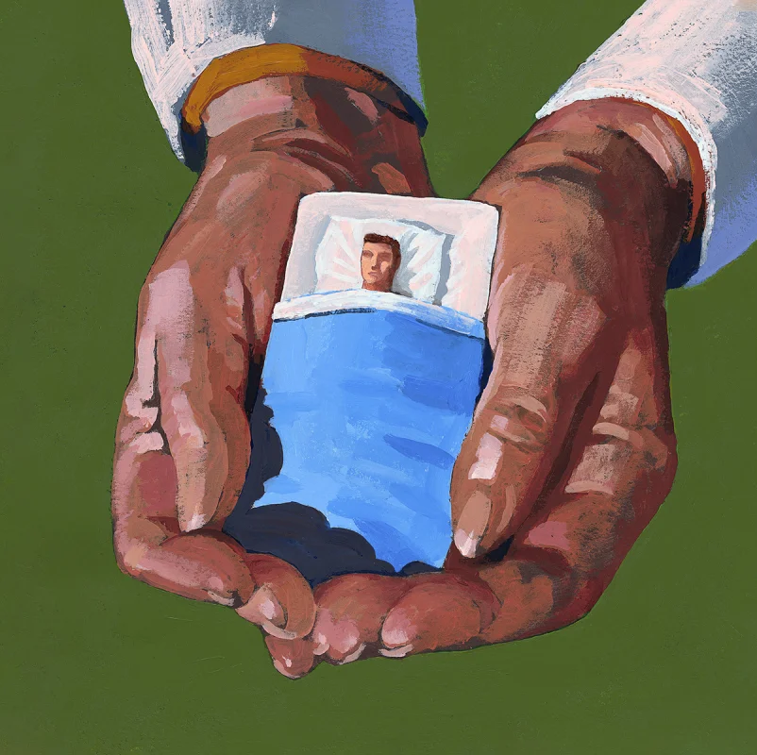
Medical paternalism
Hippocratic Oath: Restricted knowledge
Doctors make decisions; patients trust their authority
Argument for paternalism (Goldman)
Doctor knows best how to promote health
Patient wants to be healthy

Slide 3

Forms of paternalism
Hard
Soft
Clinician decides what treatment is best
Even when patient is capable of deciding for themselves
Clinician decides how to treat a patient who may not be capable of deciding for themselves
In shock
Intoxicated
Only as a way to stop patient from hurting themselves, temporarily

Slide 4

Value of autonomy
Argument against paternalism
Clinicians may be corrupt or make mistakes
Patients may prioritize other things over maximum health and life
Autonomy vs. Heteronomy
Negative liberty
Right to make medical decisions for oneself → Informed consent
Merely formal procedure
Deference to the clinician (“reasonable care”)
Overtreatment → Rising cost of healthcare
Informative/engineering/legalistic model

Slide 5
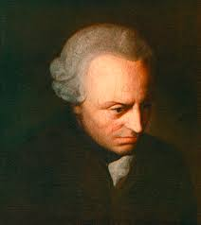
Liberty vs. Autonomy
Autonomy: Rational self-control
First-order vs. Second-order desires (Frankfurt)
Four kinds of constraints (Ackerman)
Physical
Cognitive
Psychological
Social
Interpretive model
Immanuel Kant

Slide 6
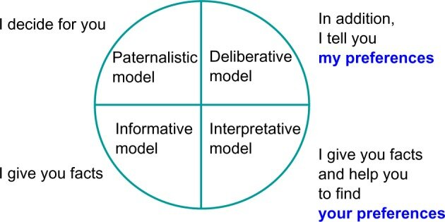
Four models of the clinician-patient relationship
Image: https://www.researchgate.net/figure/Four-models-of-the-physician-patient-relationship-definitions-from-Emanuel-and-Emanuel_fig2_259492109

Slide 7
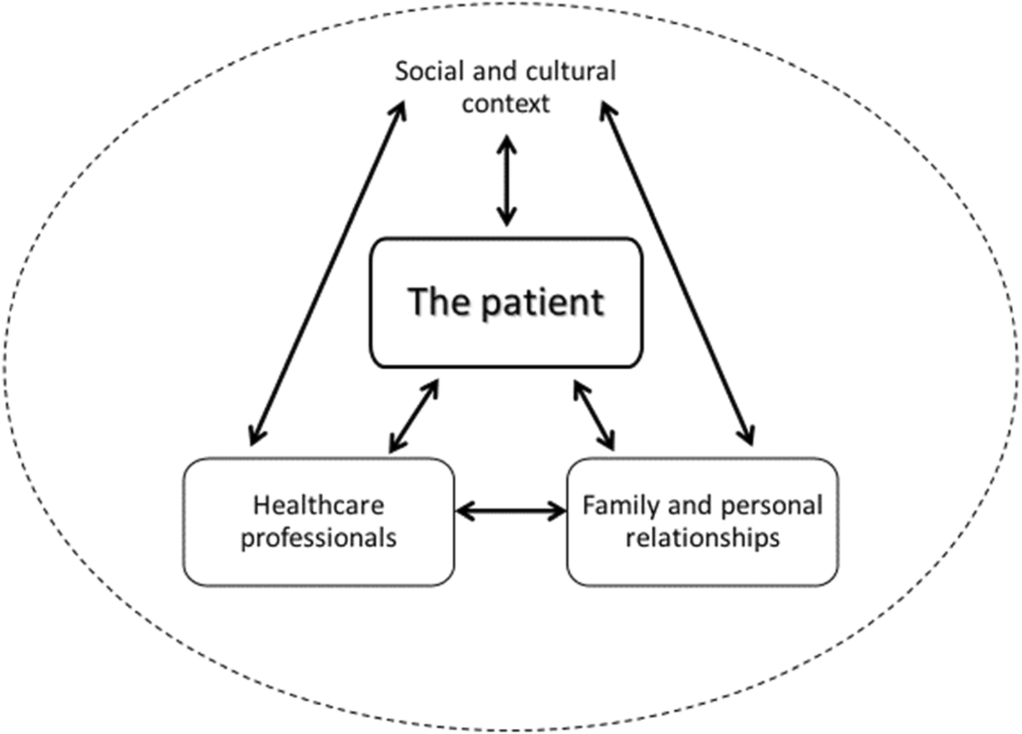
Relational autonomy
Social conditions → Restricted options
Subtle forms of coercion
Gradations of autonomy
Image: https://bmcmedethics.biomedcentral.com/articles/10.1186/s12910-020-00495-1

Slide 8

Questions?
Limit cases of autonomy – e.g., voluntary amputation
Autonomy over beneficence?

