Slide 1
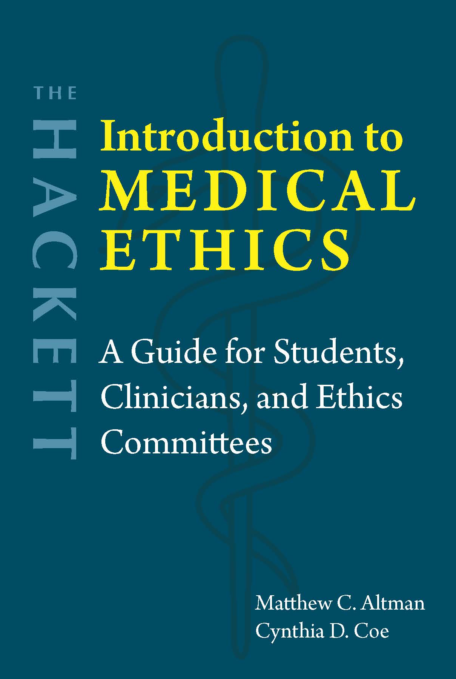
Chapter 4
Clinicians’ Obligations to Patients and Themselves

Slide 2
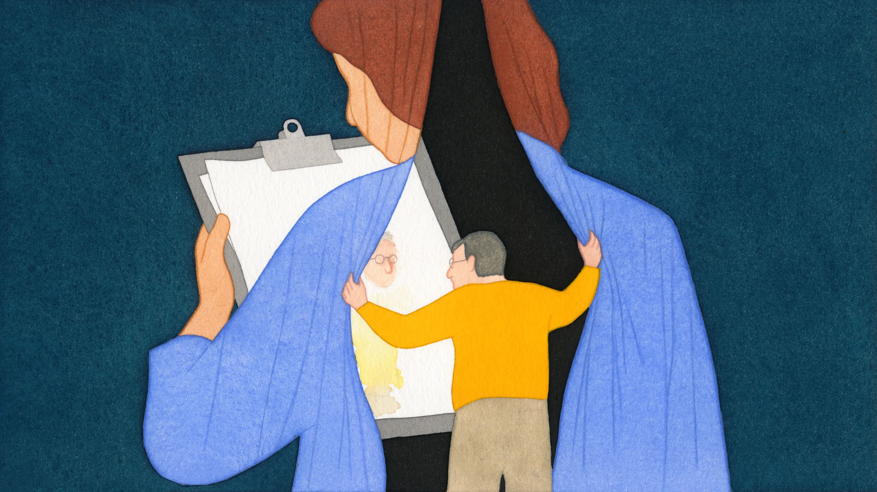
Duty of transparency
Disclosure of medical errors
Deontological justification
Consequentialist justification
Professional standards
Prima facie obligation
  Beneficence
  Cultural variation
Professional standards
Legal obligations
Deontological justification
Consequentialist justification
Virtue-based justification

Slide 3
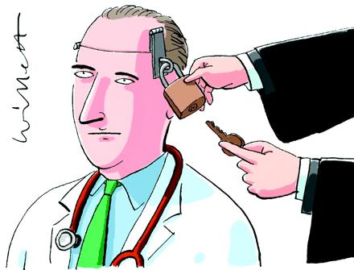
Confidentiality
Hippocratic Oath
HIPAA
Deontological justification – e.g., right to privacy
Consequentialist justification
Modern healthcare → Information shared
Outside the U.S.: No uniform standard

Slide 4

Case study: Tarasoff v. Regents of the University of California (1974/1976)
Patient discloses to his psychologist that he was going to kill Tatiana Tarasoff (someone that he thought of as his girlfriend)
Psychologist informs campus police and his superior, but no one warns Tarasoff herself
Patient kills Tarasoff
California Supreme Court: “The protective privilege [of patient confidentiality] ends where the public peril begins.”
Clinicians have a “duty to warn” the threatened individual, when there is a foreseeable and imminent threat to a clearly identifiable person (1974)
Clinicians have a “duty to protect” the threatened individual (1976)

Slide 5

Conscientious refusal
Clinician’s autonomy → May opt out
  Example: Medical aid in dying
  Example: Abortion
Conflict of rights
  Example: Emergency contraception
  Example: Treating transgender adults

Slide 6
Pressures on clinicians
Understaffing
Little control over their work
EHR use
Patients in distress
Moral distress
Moral injury
Burnout
Solutions
Reduce administrative obligations
EHR use
Team-based care

Slide 7
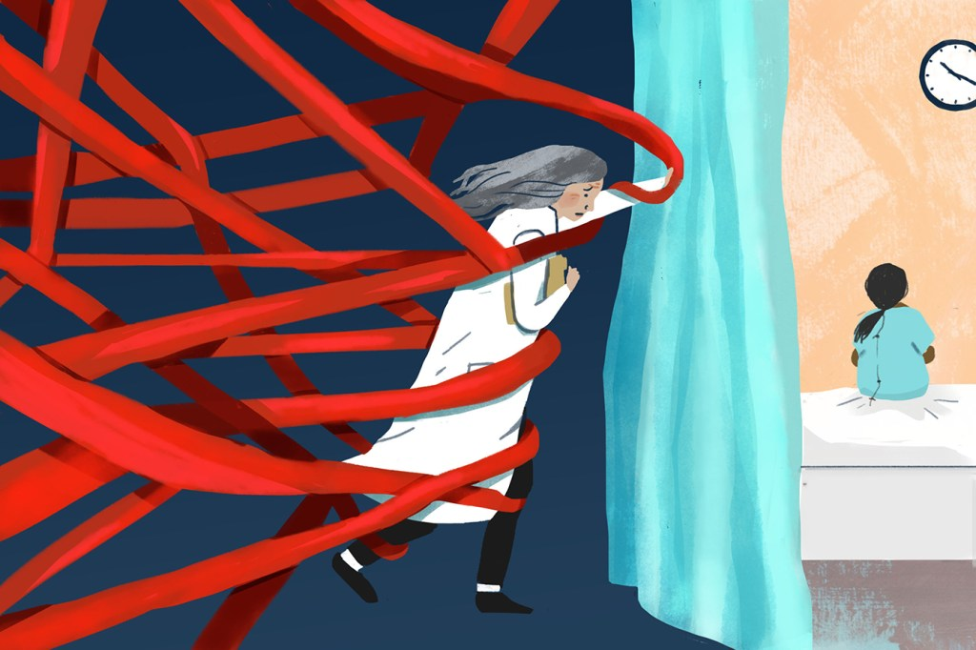
Burnout vs. Moral distress vs. Moral injury
Burnout
  Stress reaction to overwork
  Physical, psychological, and emotional exhaustion
Moral distress
  Framework developed within healthcare
  Clinicians not being able to act in accordance with their moral values, in a particular situation
  Due to organizational policies or other factors they cannot control
Moral injury
  Framework developed within military psychology
  Erosion of moral integrity, from observing or participating in accumulated acts that violate moral values
  Moral distress and moral injury can lead to burnout
Image: https://kffhealthnews.org/news/beyond-burnout-docs-decry-moral-injury-from-financial-pressures-of-health-care/

Slide 8

Questions?
Patients’ rights + Patients’ well-being + Clinicians’ rights

