Slide 1
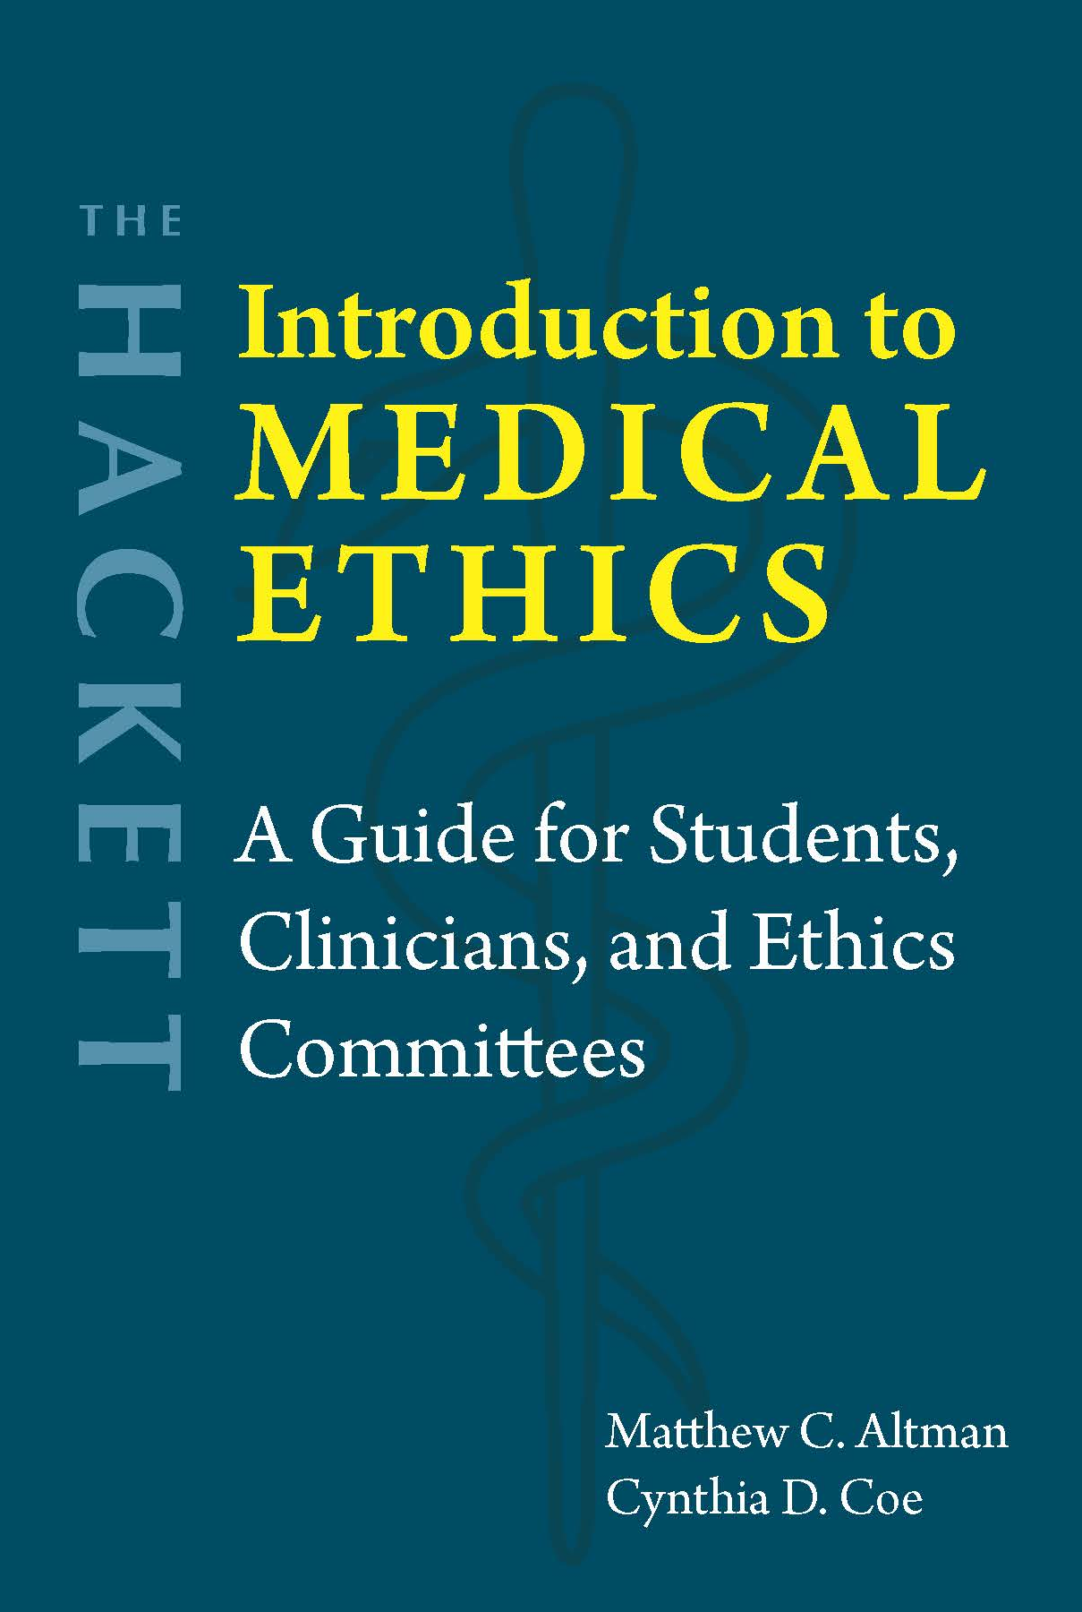
Chapter 5 The Ethics and Legality of Abortion

Slide 2
The traditional anti-abortion argument
P1 The fetus is a person from the moment of conception.
P2 Every person has a right to life.
P3 The pregnant woman is a person.
P4 Every person has a right to control what happens in and to their own body.
C1 Therefore, the fetus has a right to life, and the pregnant woman has a right to control what happens in and to her own body.
P5 These rights come into conflict if the woman seeks an abortion.
P6 The right to life is stronger than the right to decide what happens in and to one’s own body.
C2 Therefore, the fetus’s right to life is stronger than the pregnant woman’s right to bodily self-control.
P7 If an action involving a rights claim violates a stronger rights claim, then the action is immoral.
C3 Therefore, abortion is immoral.

Slide 3
The traditional anti-abortion argument
P1 The fetus is a person from the moment of conception.
P2 Every person has a right to life.
P3 The pregnant woman is a person.
P4 Every person has a right to control what happens in and to their own body.
C1 Therefore, the fetus has a right to life, and the pregnant woman has a right to control what happens in and to her own body.
P5 These rights come into conflict if the woman seeks an abortion.
P6 The right to life is stronger than the right to decide what happens in and to one’s own body.
C2 Therefore, the fetus’s right to life is stronger than the pregnant woman’s right to bodily self-control.
P7 If an action involving a rights claim violates a stronger rights claim, then the action is immoral.
C3 Therefore, abortion is immoral.
Anti-abortion:
Fetus is a human (Lee and George)
Fetal heartbeat/personhood laws
Pro-abortion rights:
Fetus is not a person (Warren)
“My body, my choice”

Slide 4
The traditional anti-abortion argument
P1 The fetus is a person from the moment of conception.
P2 Every person has a right to life.
P3 The pregnant woman is a person.
P4 Every person has a right to control what happens in and to their own body.
C1 Therefore, the fetus has a right to life, and the pregnant woman has a right to control what happens in and to her own body.
P5 These rights come into conflict if the woman seeks an abortion.
P6 The right to life is stronger than the right to decide what happens in and to one’s own body.
C2 Therefore, the fetus’s right to life is stronger than the pregnant woman’s right to bodily self-control.
P7 If an action involving a rights claim violates a stronger rights claim, then the action is immoral.
C3 Therefore, abortion is immoral.
Pro-abortion rights:
Violinist analogy; right not to be killed unjustly (Thomson)
Anti-abortion:
Fetus has a future like ours (Marquis)

Slide 5
Dworkin’s argument for abortion rights
P1 A woman has a right over her own body.
P2 A right can only be overridden by a competing right or a compelling state interest.
P3 A fetus is not a constitutional person.
C1 Therefore, a fetus does not have competing rights that restrict a woman’s control over her body (derivative view).
P4 The government has an obligation to promote respect for the intrinsic value of human life (detached view).
P5 The state can promote respect for the intrinsic value of human life without prohibiting abortion.
P6 Prohibiting abortion out of respect for the intrinsic value of human life would violate our First Amendment rights.
C2 There is no compelling state interest that would justify prohibiting abortion.
C3 Therefore, the state would violate a woman’s right over her own body if it outlawed abortion.
Conflict of rights?
Compelling state interest?

Slide 6
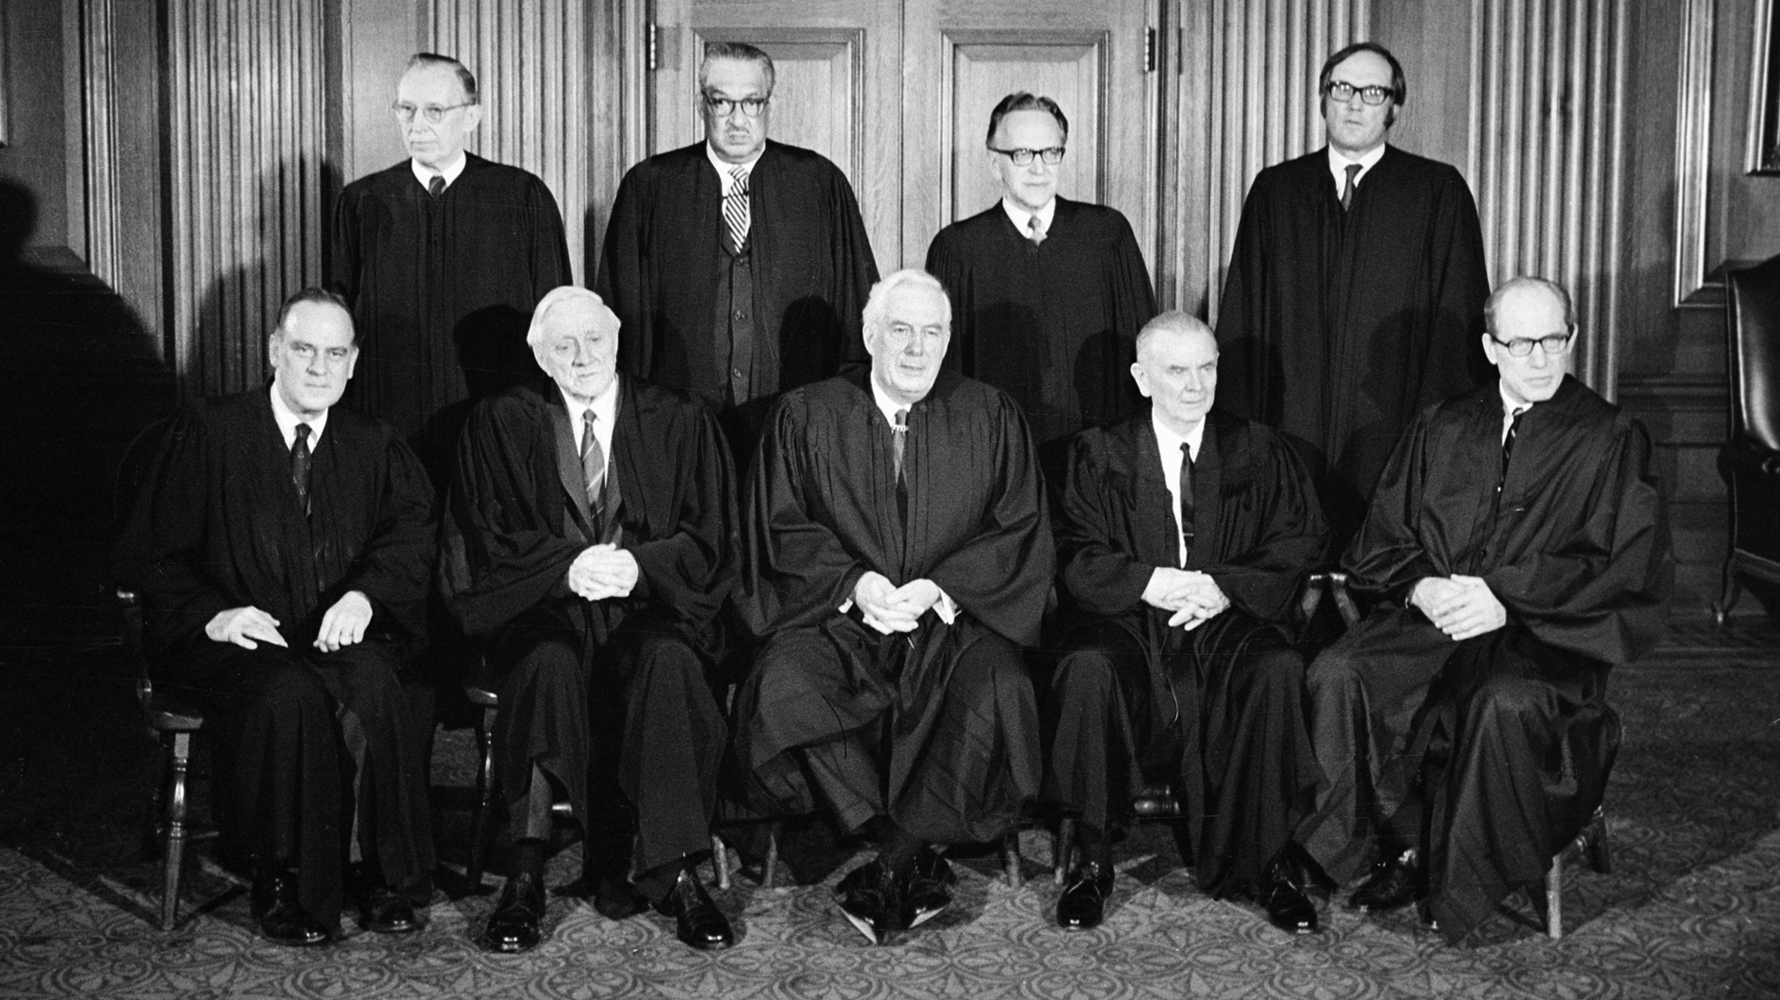
Roe v. Wade (1973)
Right to privacy implied by …
14th Amendment: “nor shall any State deprive any person of life, liberty, or property, without the due process of law” (Due Process Clause).
9th Amendment: “The enumeration in the Constitution, of certain rights shall not be construed to deny or disparage others retained by the people.”
Government can limit privacy rights when there is a “compelling state interest”
First trimester: No/little regulation
Second trimester: Regulation to protect mother’s life
Point of viability (24-28 weeks): Regulation to protect fetus
Planned Parenthood v. Casey (1992)
Reaffirmed “essential holding” of Roe
Strict scrutiny test → Undue burden standard

Slide 7
Scalia’s argument for textualism and originalism
P1 We need a rule for interpreting laws and the Constitution.
P2 Options for interpreting laws and the Constitution include appeals to judicial discretion, legislative history, legislative intent, and textualism and originalism.
P3 Judicial discretion does not provide a rule.
P3 Legislative history does not provide a rule.
P4 Legislative intent does not provide a rule.
C1 Only textualism and originalism provide a rule.
C2 Therefore, we need textualism and originalism to interpret laws and the Constitution.
Abortion? “The Constitution says absolutely nothing about it.”

Slide 8
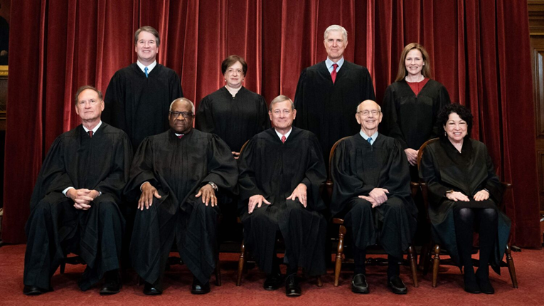
Dobbs v. Jackson Women’s Health Organization (2022)
No right to privacy/abortion in the Constitution
“Roe … held that the abortion right, which is not mentioned in the Constitution, is part of the right to privacy, which is also not mentioned.”
Due Process Clause of the 14th Amendment?
“Not deeply rooted in the Nation’s history and traditions”
Not essential to the country’s “scheme of ordered liberty”

Slide 9
Clinicians’ obligations
Hippocratic Oath: Unclear
American Medical Association
“Abortion is a safe and common medical procedure, about which thoughtful individuals hold diverging, yet equally deeply held and well-considered perspectives. Like all health care decisions, a decision to terminate a pregnancy should be made privately within the relationship of trust between patient and physician in keeping with the patient’s unique values and needs and the physician’s best professional judgment” (Code of Medical Ethics, 4.2.7).
What counts as a threat to the pregnant woman’s life?
Vague standards where abortion is outlawed
Zurawski v. State of Texas
Other health risks

Slide 10
Legality of abortion outside the U.S.
Allowed in many countries (e.g., most of Europe, Australia, Russia, etc.)
Different gestational limits
Prohibited with exceptions in many countries (e.g., India, Great Britain, Thailand)
Economic and social circumstances
Fetal abnormalities
Preserve a woman’s physical or mental health
Save a woman’s life
Completely prohibited in some countries (e.g., El Salvador, Dominican Republic, Angola)

Slide 11

Questions?
Respect autonomy for the woman
vs.
Beneficence for the fetus

