Slide 1
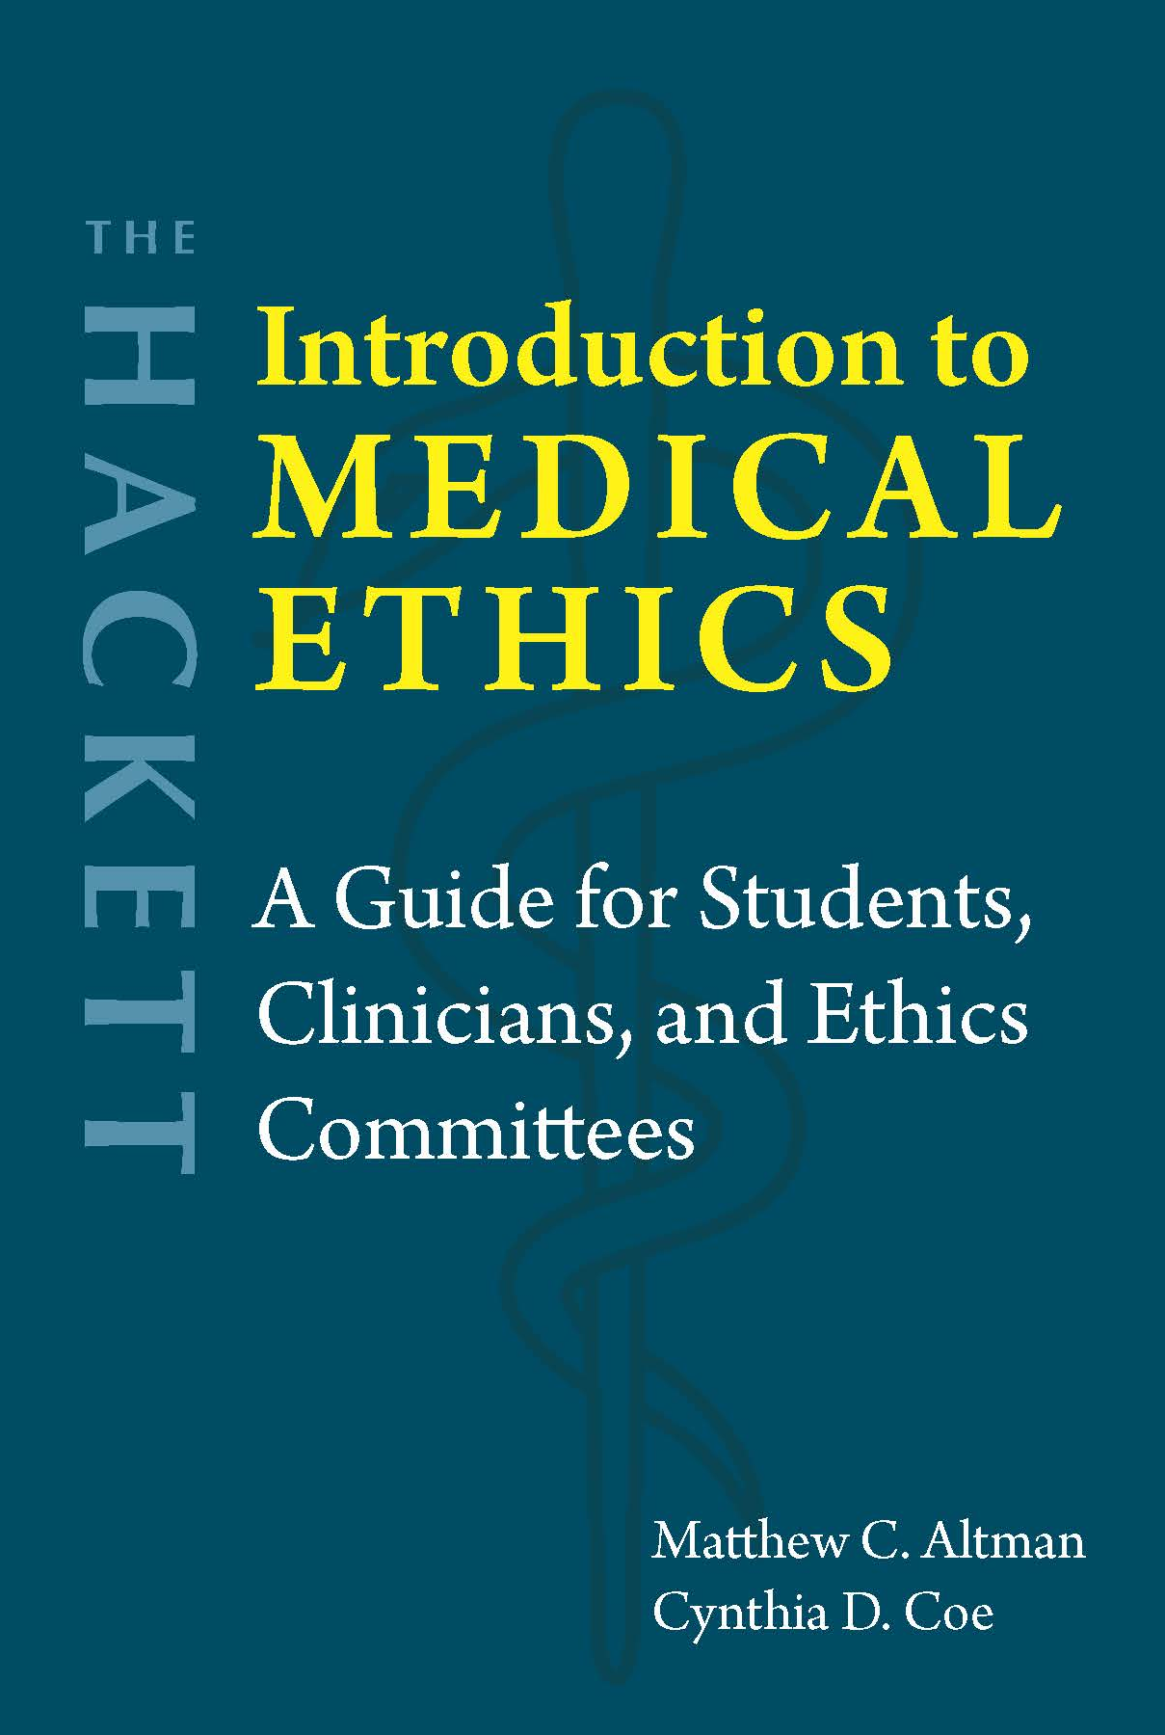
Chapter 6
Pregnancy and Reproductive Technologies

Slide 2
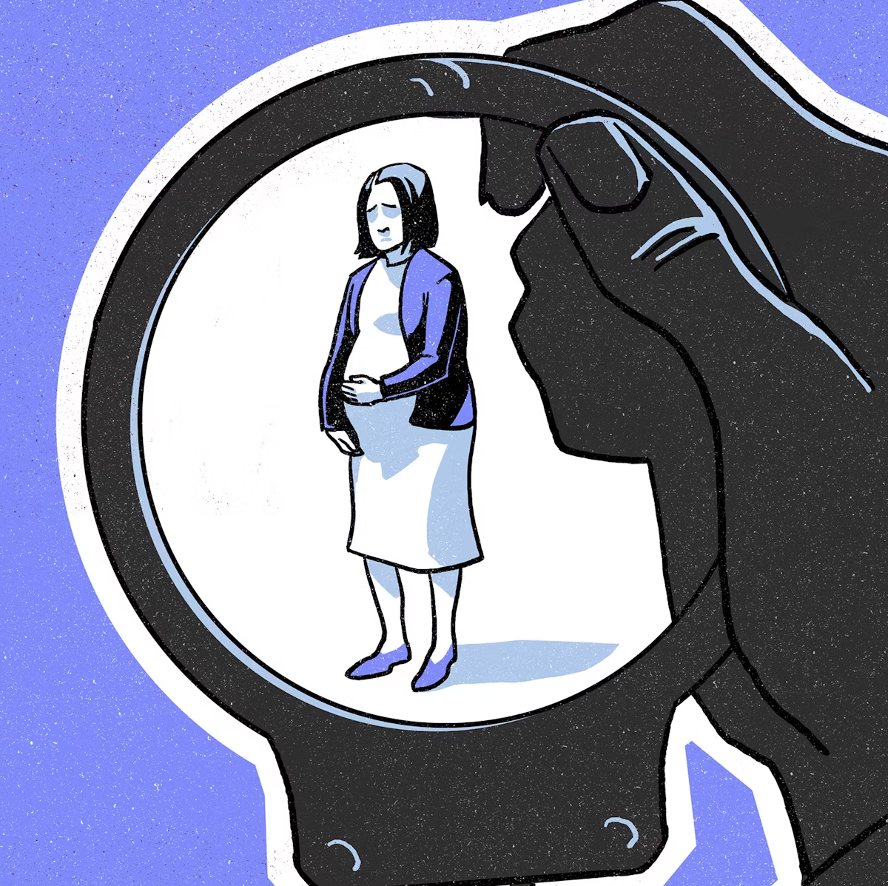
Legal shift toward criminalizing pregnancy
Pro-life/anti-abortion movement
Domestic violence laws → Increase penalties for fetal harm
War on Drugs
  “Crack babies”

Slide 3
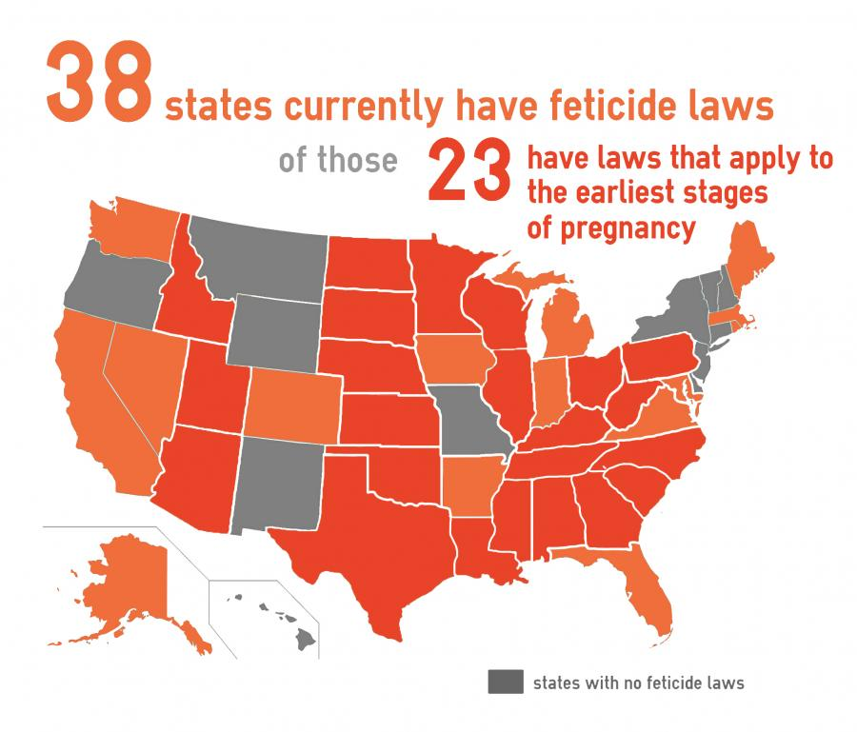

Slide 4

Prosecutions
Drug use → Fetal endangerment
Accidents
Attempted suicide
Intimate partner violence
Considering medical options, including abortion or vaginal birth
Refusing a C-section
“When physicians’ concerns about fetal well-being are allowed to supersede both a woman’s judgment about what is best for her family and her right to safeguard her bodily integrity, then there is no principled limitation on state power to police pregnancy and punish pregnant women” (Minkoff and Paltrow 2004, 1235).

Slide 5

Arguments against criminalization
Factors to consider
Respect autonomy → Improve overall outcomes
Does not prevent harm or promote well-being
Justice
  Pregnant women treated unequally
  Discriminatory application
Extent of woman’s obligations/fetal personhood
Medical evidence

Slide 6
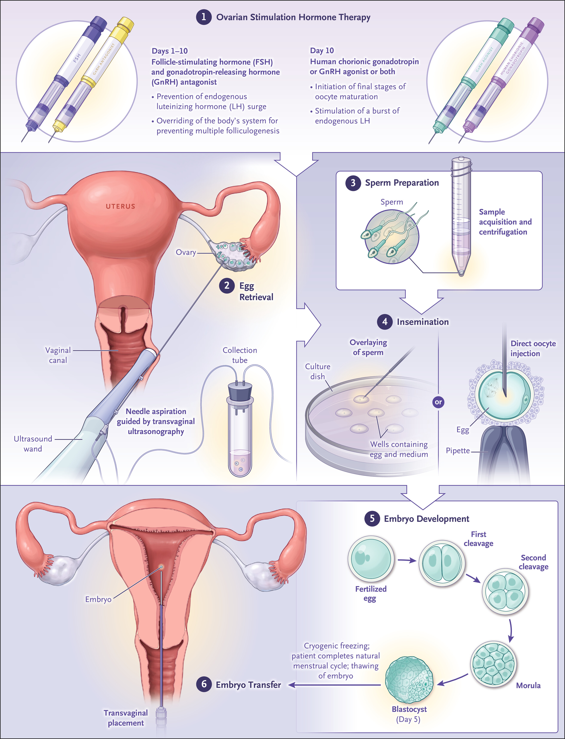
In vitro fertilization
(IVF)
Image: https://www.nejm.org/doi/full/10.1056/NEJMcp2311150

Slide 7
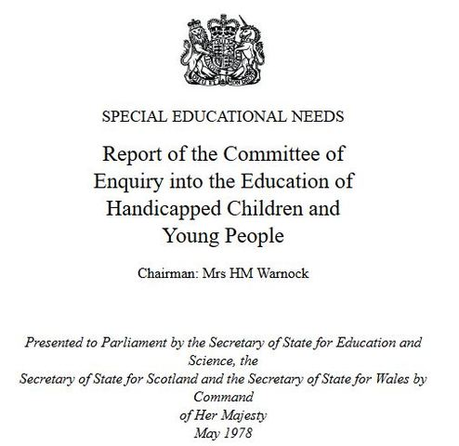
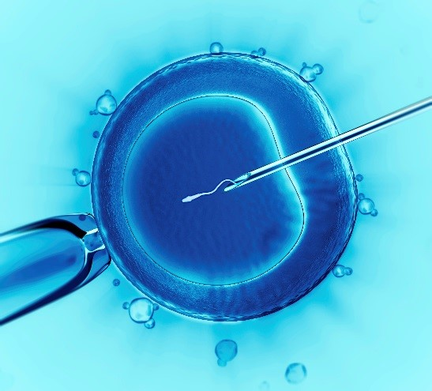
Moral objections to IVF
Warnock Report (1984):
14-day rule
Destruction of unused embryos → Killing a person/potential person
  Fetal personhood laws
  Potential personhood → Morally considerable?
  Cryopreserved embryos → Active potency?
Disabilities
  Selecting against disabled embryos
  Selecting for disabled embryos

Slide 8
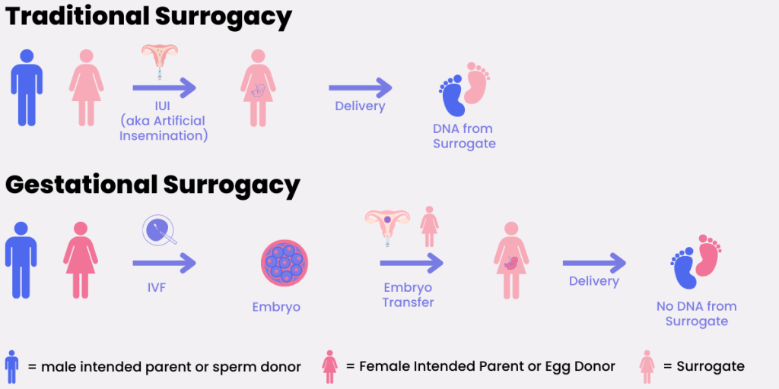
Surrogate motherhood
Image: https://surrogatesteps.com/surrogate-baby-dna/

Slide 9
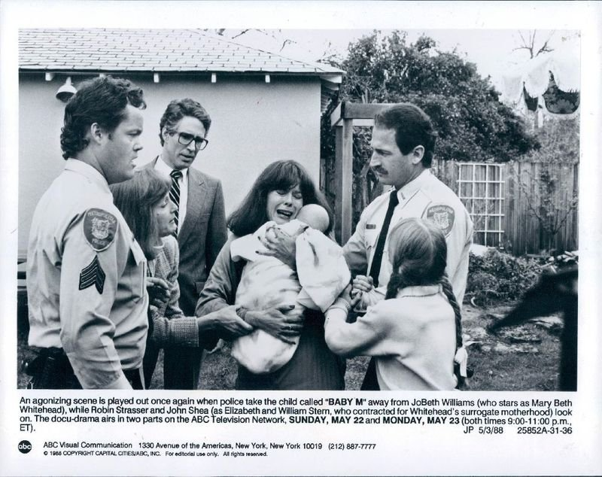
The Case of Baby M
Custody not based on child’s best interests
Baby-selling
Economic desperation
Concern for well-being → Profit motive
Degrading to women

Slide 10
Warnock Report
“To introduce a third party into the process of procreation … is an attack on the value of the marital relationship.”
“It is inconsistent with human dignity that a woman should use her uterus for financial profit and treat it as an incubator for someone else’s child.”
To deliberately become pregnant with “the intention of giving up the child” distorts “the relationship between mother and child.”
It may harm the child, who has natural bonds with the birth mother.
It is degrading to the child because it is being sold for money.
“Since there are some risks attached to pregnancy, no woman ought to be asked to undertake pregnancy for another, in order to earn money.”

Slide 11

For surrogacy
Against surrogacy
Respect for autonomy → Liberal model → Reproductive labor
Can’t understand the outcomes → Not informed
Economic coercion → Not consent
Commodification of babies
Objectification of women
Harm to children?

Slide 12
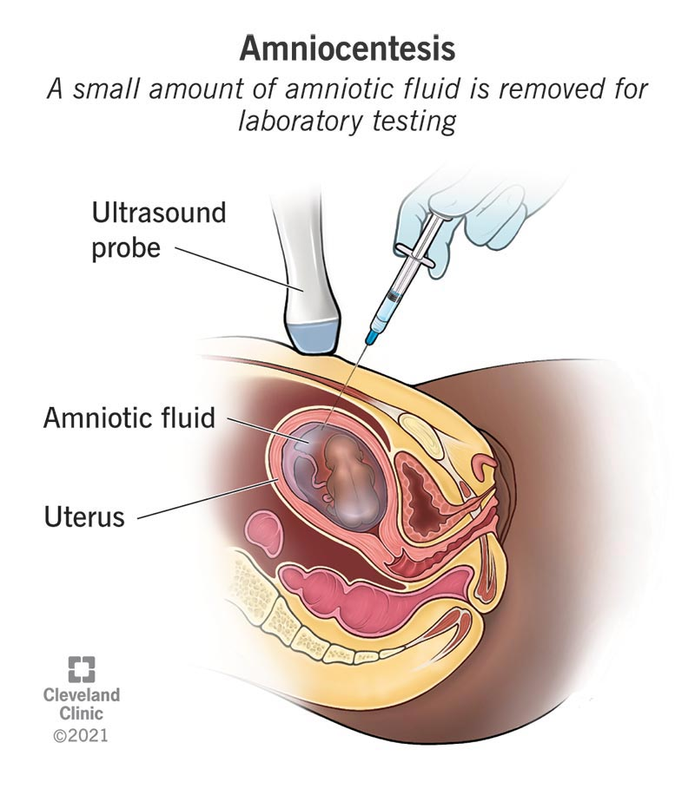
Kinds of prenatal screening
Ultrasound
Chorionic villus sampling (CVS)
Amniocentesis
Noninvasive prenatal testing (NIPT)

Slide 13

Against disability-selective abortion
For disability-selective abortion
Disability as variation
  Disability paradox
  Disability vs. Handicap
Expressivist argument
  Eugenics
Parental attitude argument
Parental attitude argument (maternalist conception) = False dichotomy
  Projectivist conception
  Familial conception
Consequences for families
Disability as limitation
  Prevention of disability
Reproductive liberty

Slide 14
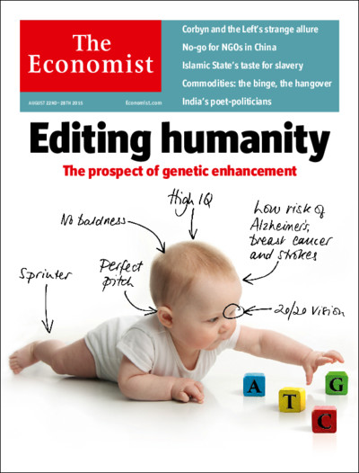
Genetic enhancement
CRISPR
Therapy vs. Enhancement
Somatic vs. Germline genetic editing

Slide 15

Against genetic enhancement
For genetic enhancement
  Natural variation
  Effects on human existence
  Parents dictating children’s future
  Inequality → Injustice
  Unnatural
  Procreative beneficence/liberal eugenics
  Transhumanism
Image: https://medium.com/@mariochamorro/transhumanism-101-everything-you-need-to-know-about-the-world-without-death-41cf11d264f9

Slide 16
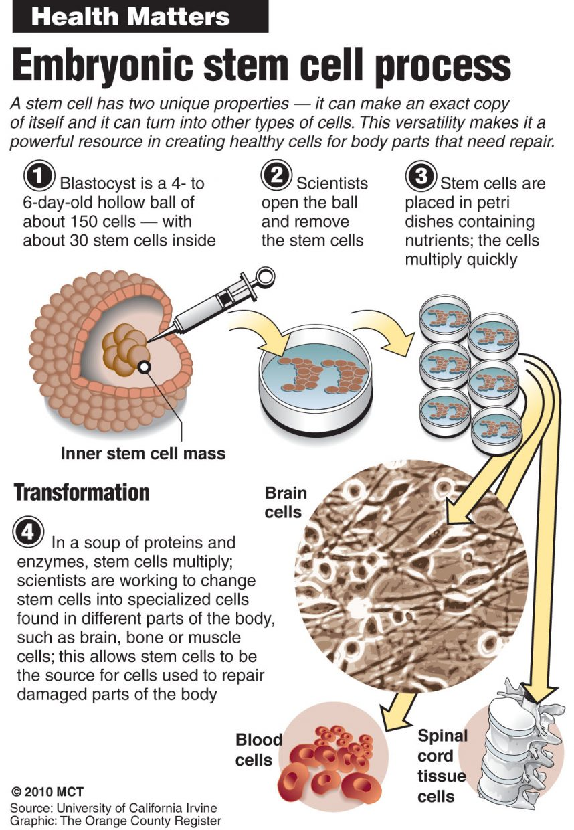
Stem cell research
Controversy over embryonic stem cells
U.S. Code of Federal Regulations
  1974 v. 1993
  Dickey-Wicker Amendment (1995) → 2011 appeal
Clinton → Bush → Obama
Different laws in …
  Different U.S. states
  Different countries

Slide 17

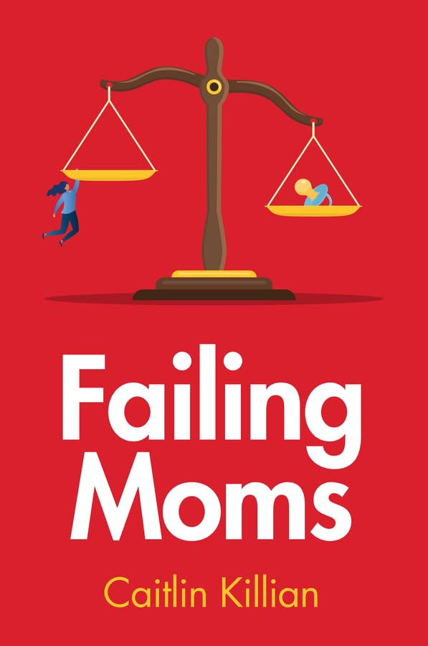

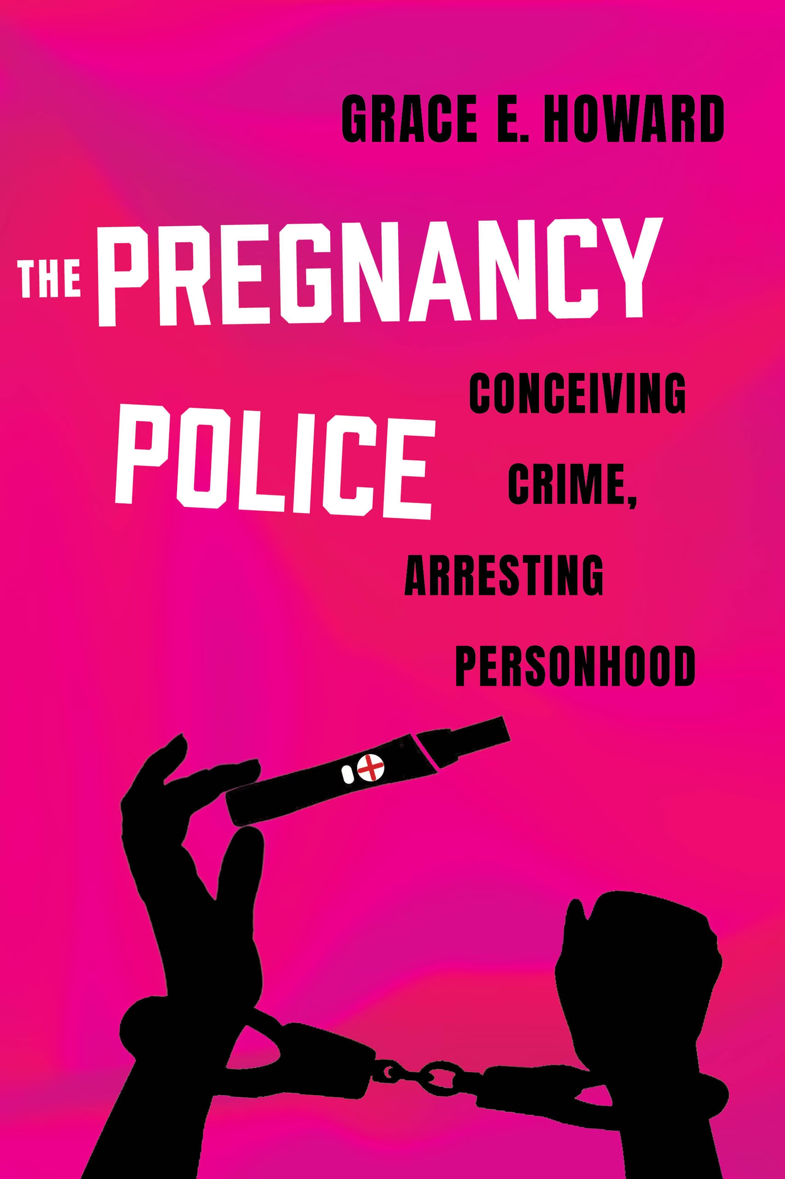
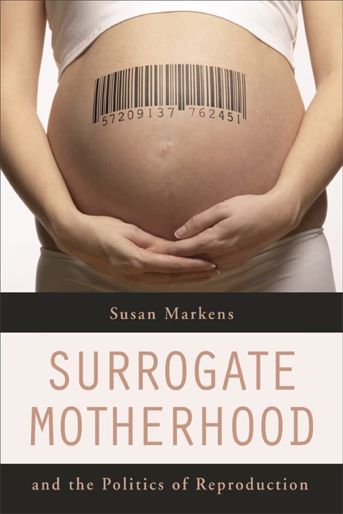
Questions?
Woman’s body = Political and legal battleground

