Slide 1
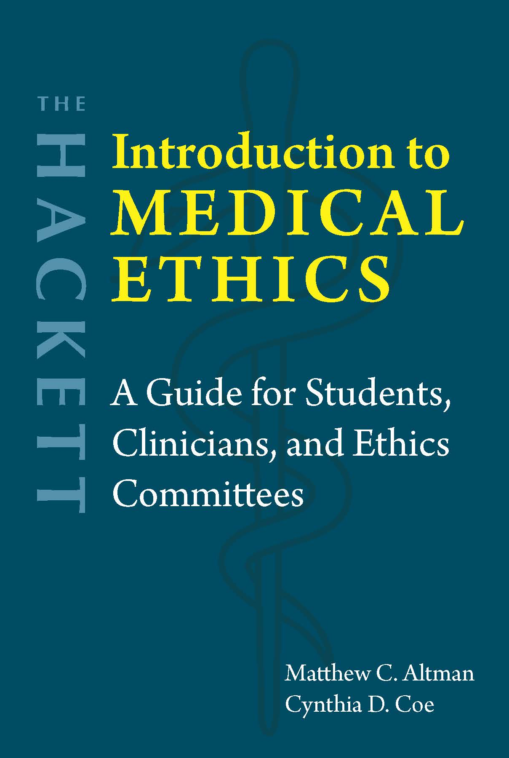
Chapter 7 Advance Directives and Decision-Making for Incapacitated Patients

Slide 2

Legal competence vs. Medical capacity
Legal determination
Binary (yes or no)
Presumed
Clinical assessment
Spectrum
Communicate
Understand alternatives
Appreciate their significance
Reason about risks and benefits
Lack capacity: Infants, severely disabled, PVS patients, etc.
MacCAT-T or ACE

Slide 3
Conroy case
Substituted judgment
Best interests
Subjective standard
Limited-objective standard
Pure-objective standard
Focus on respecting person’s autonomy (previously stated preferences)
Focus on protecting person’s well-being

Slide 4
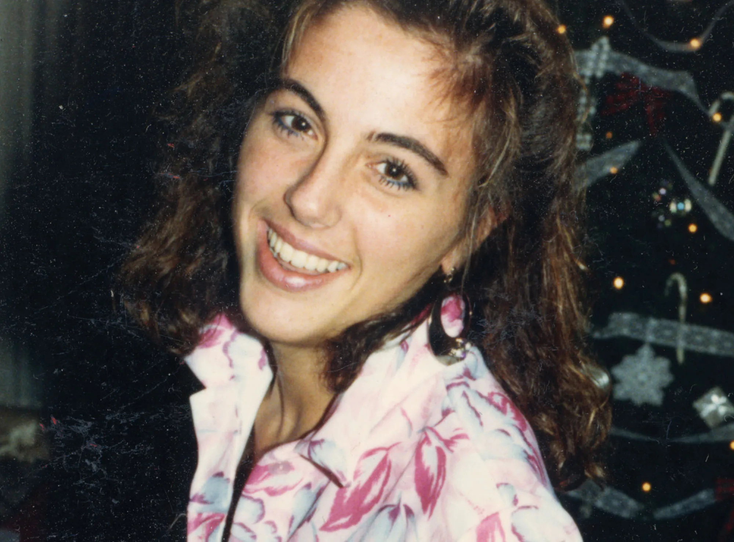
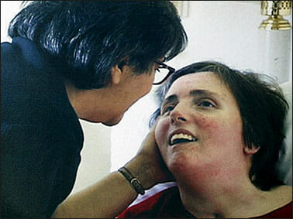
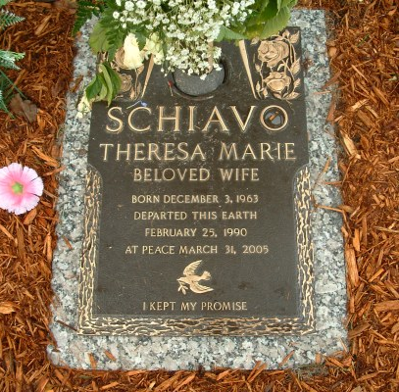
Case study: Terri Schiavo
1990: Cardiac arrest → Anoxia → PVS
What did Terri say she wanted?
1998: Michael petitions to remove feeding tube
Ordinary vs. Extraordinary care
Challenged by Terri’s parents
March 2005: Court order to remove feeding tube
U.S. Congress → Transferred to federal court, which denies parents’ request → U.S. Supreme Court declines to review
March 31, 2005: Terri pronounced dead
Whole-brain vs. Higher brain criteria

Slide 5
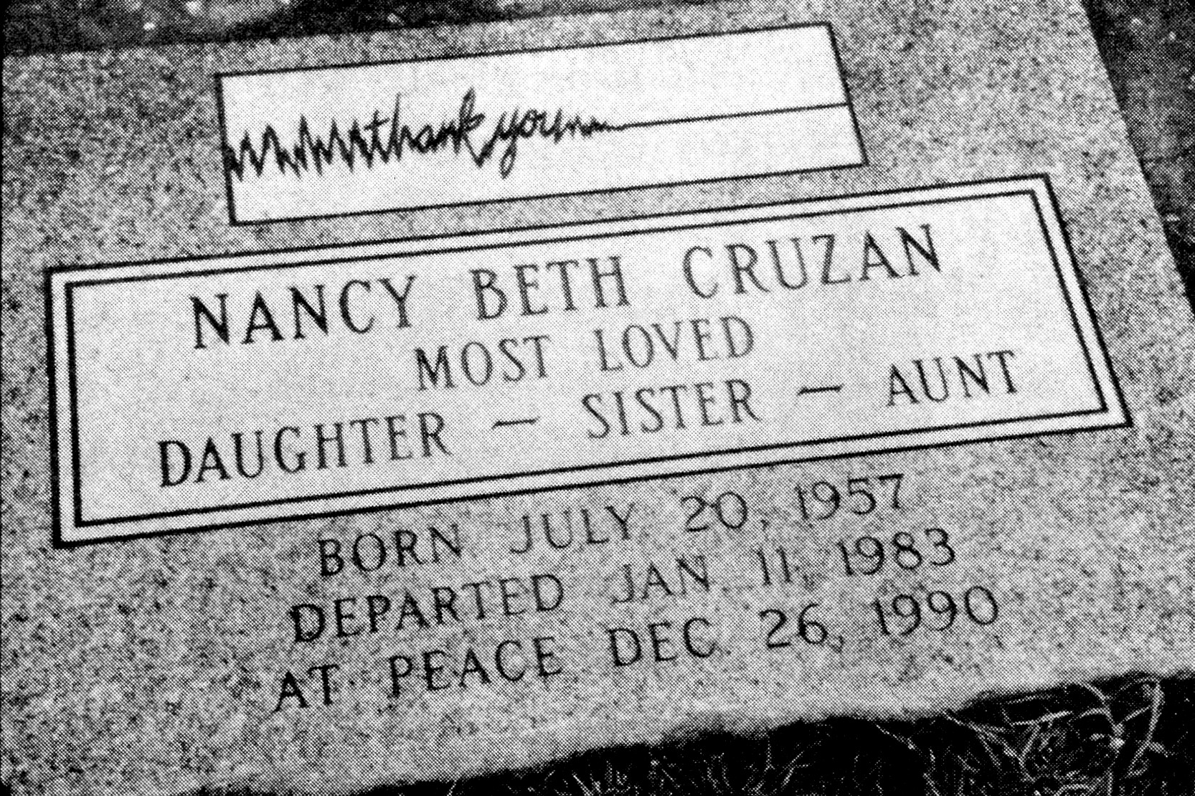
History of advance directives
Pre-20th century: Advance directives mostly unnecessary
20th century: Medical technology can keep more people alive for longer
1960s: Kutner proposes a “living will”
1976 and following: U.S. states adopt living will laws
Mid-1970s: Quinlan, Cruzan
1990: Cruzan case
Competent patients can refuse treatment
Incompetent patients: proxies can refuse treatment if there is “clear and convincing” evidence that patients wouldn’t want it
1990: Patient Self-Determination Act
States must offer advance directives

Slide 6
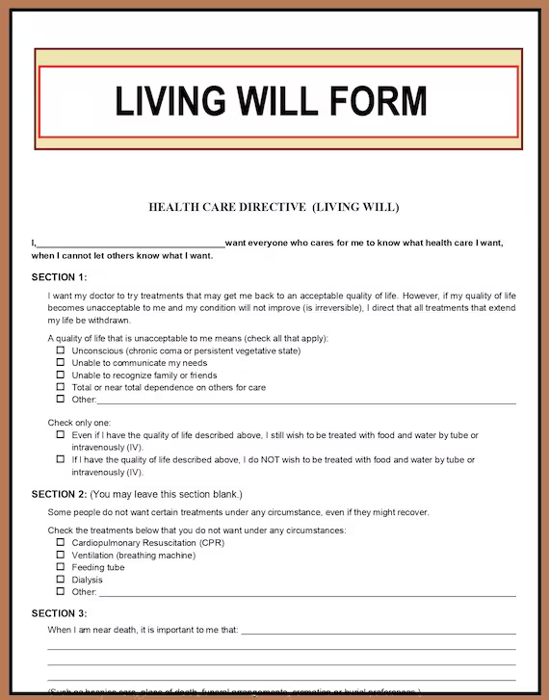
1. Substantive directives
Written instructions, usually structured by hypotheticals
Emphasize clarity and specificity
Legal documents, not medical orders like DNR or POLST
Respect patient autonomy
Drawbacks
Uncommunicated or unclear
Time lag → Changing views
Use best interests standard?
Only takes effect when dying
May be overridden by proxy

Slide 7
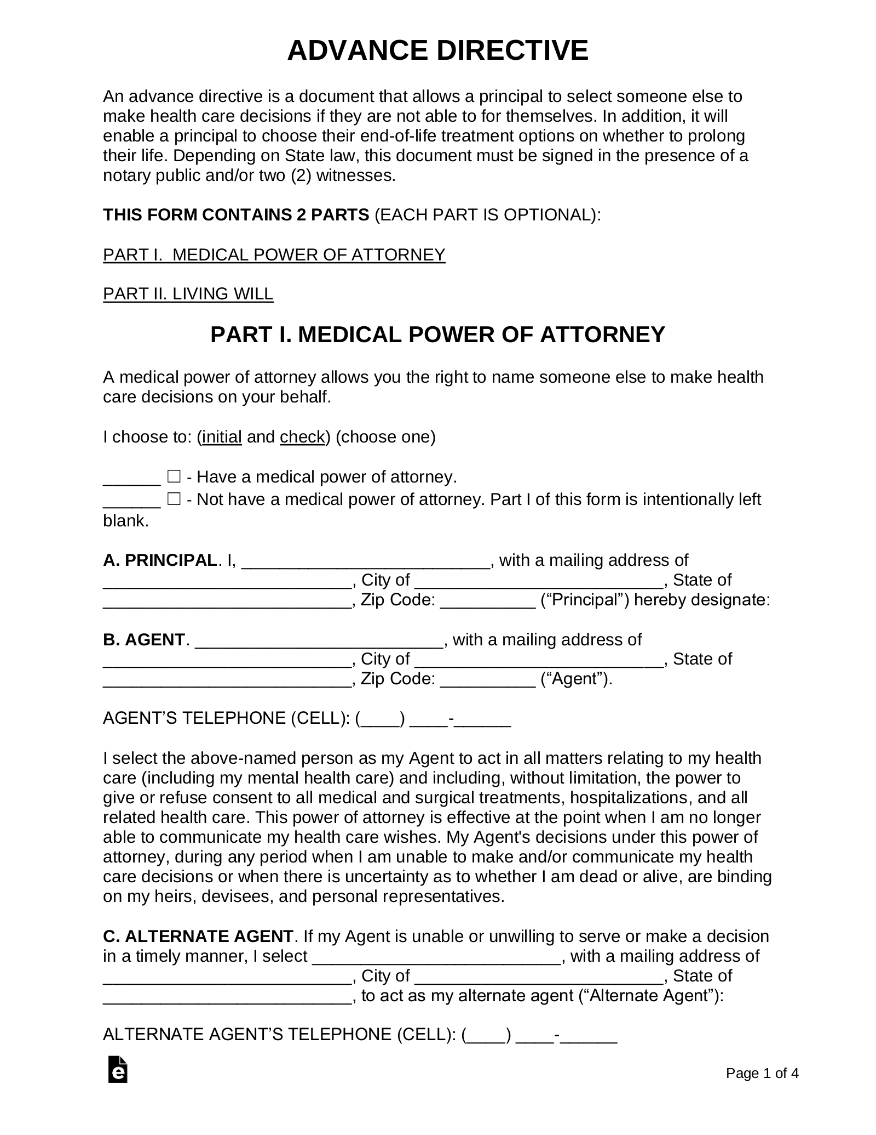
2. Proxy directives (or durable power of attorney for healthcare)
Surrogate decision-maker: Represents the patient in the moment
Beneficence
Drawbacks:
Proxy may misinterpret what the patient wants (willfully or accidentally)
Not sure how to weigh previous wishes
Hard to know what’s in their best interests
Hard to know when life is worth living

Slide 8
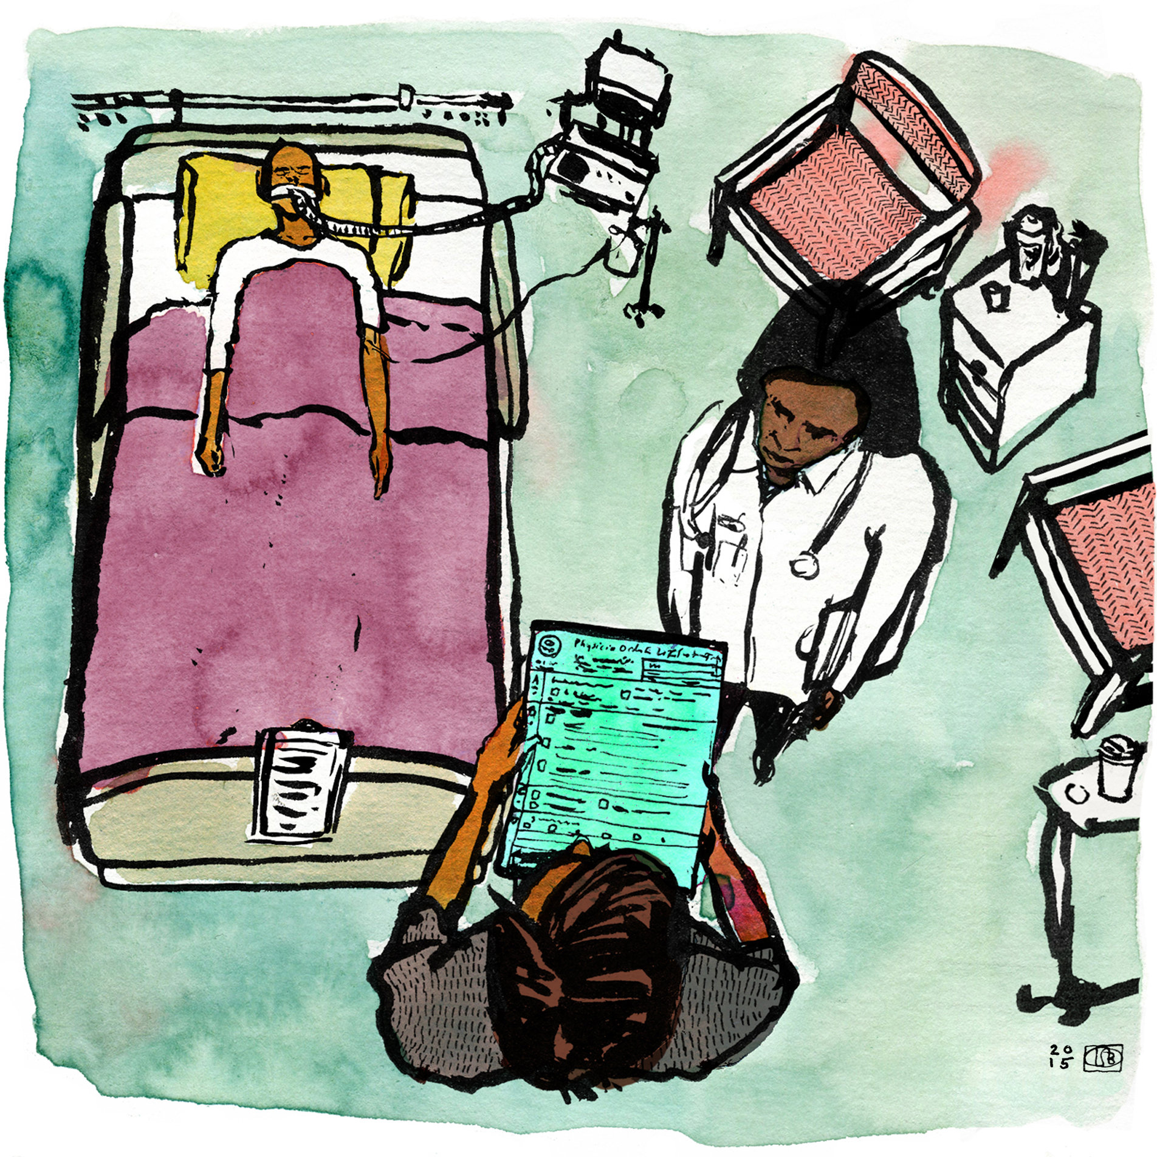
Questions?
“Living wills are for everyone. They are analogous in many ways to a safety belt. They don’t solve everything, but they certainly minimize the damage” (L. Emanuel).
Image: https://www.nytimes.com/2015/03/17/health/the-trouble-with-advance-directives.html

