Slide 1
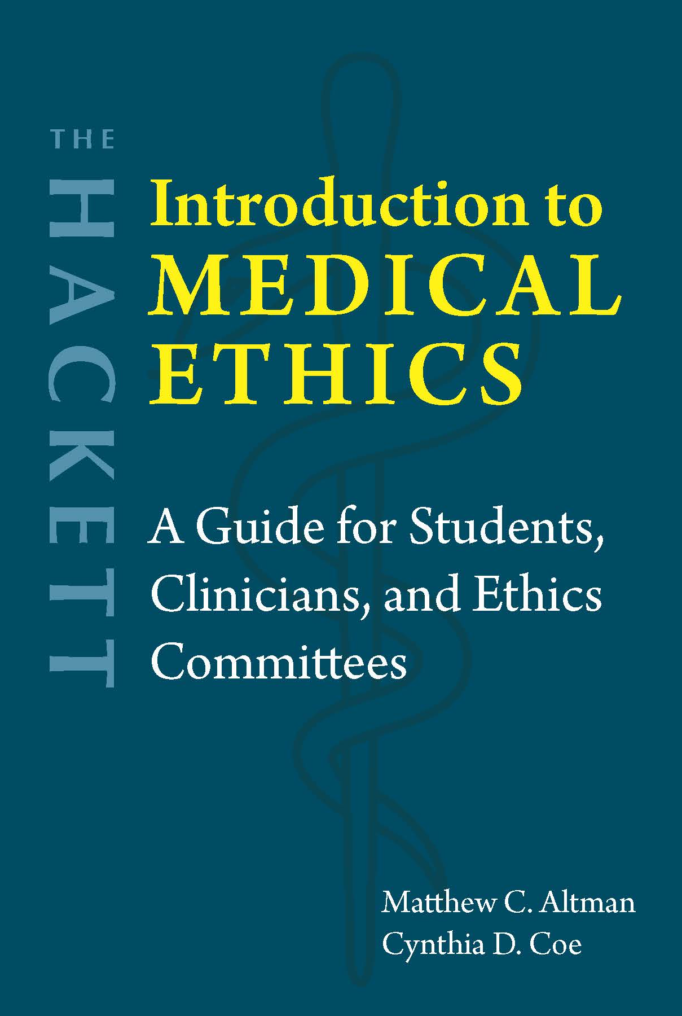
Chapter 8 Medical Aid in Dying

Slide 2

Terminology
Physician-assisted suicide or …
Medical aid in dying
Physician-aided dying
Physician aid in dying
Death with dignity
When a doctor provides the patient with the means to end their own life (prescribing life-ending medication).
Euthanasia
Active vs. Passive
Voluntary vs. Nonvoluntary vs. Involuntary

Slide 3
Provisions of U.S. Death with Dignity laws
Patient must be:
At least 18 years old
A resident of the state in which MAiD is legal (except in Vermont and Oregon)
Diagnosed with a terminal condition: one that will end the person’s life within six months (as far as two doctors can ascertain)
Capable of making and communicating medical decisions on their own
Not suffering from a psychiatric disorder
Physically capable of taking the medication themselves (able to swallow a pill, for instance)

Slide 4
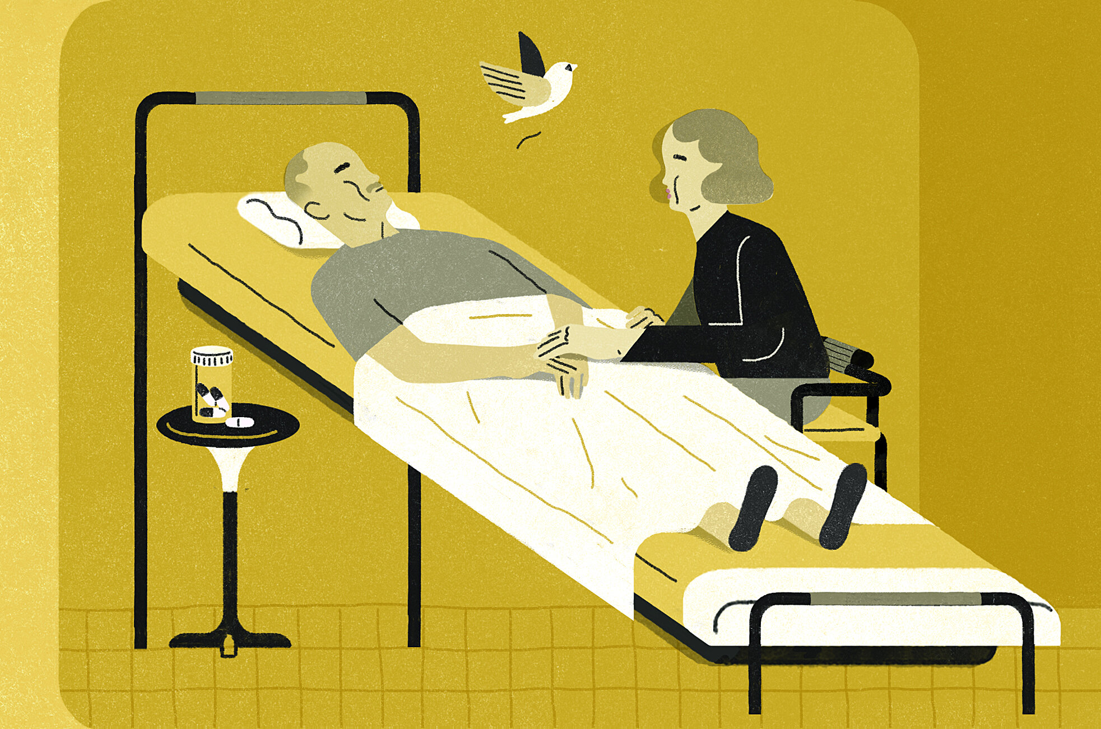
Process
Patient makes a verbal request to a physician.
After at least 15 days, patient makes a second verbal request to the same physician.
Patient makes a written request in front of two witnesses (one of whom cannot be a relative or anyone who works in the physician’s office).
After 48 hours, the prescription can be written. The patient decides whether, where, and when to use it.
The physician must inform the patient of alternative treatments, including hospice.
The patient gets the medication from a pharmacist.
The patient may or may not take the medication.

Slide 5
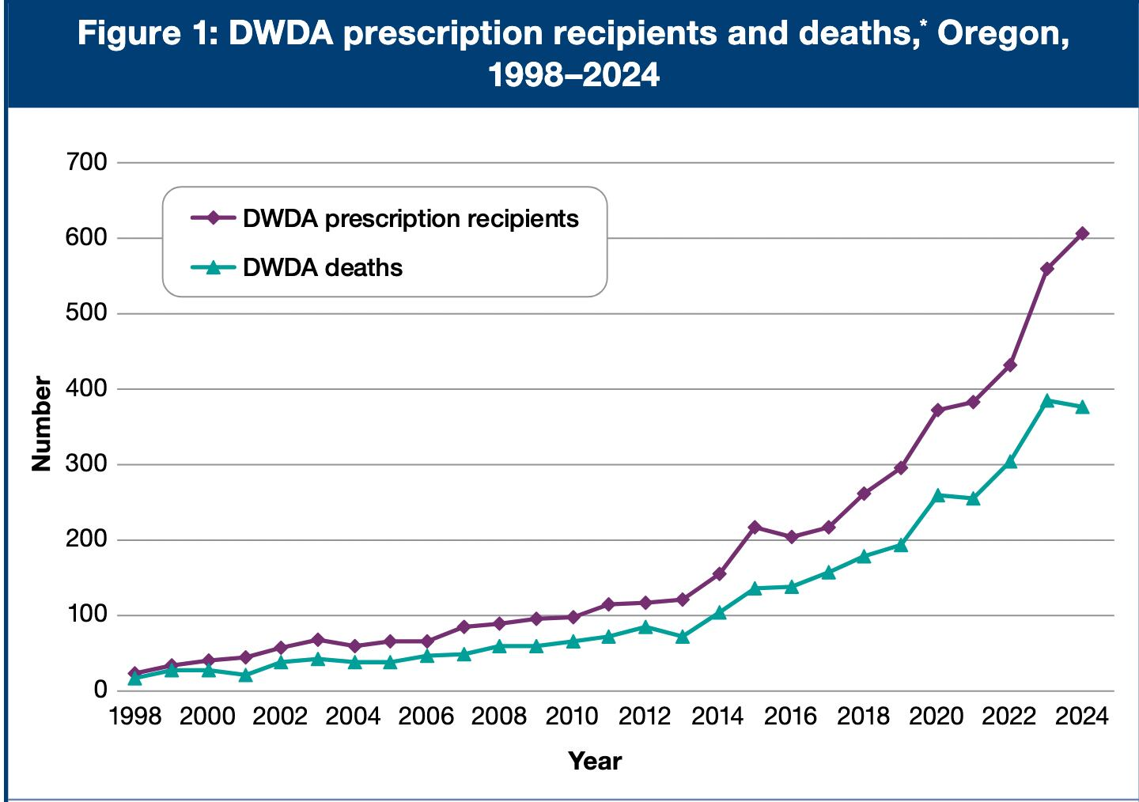
Image: https://www.salemreporter.com/2025/03/31/number-of-people-ending-their-lives-under-death-with-dignity-act-declines/

Slide 6

Right to die?
Fourteenth Amendment: “nor shall any State deprive any person of life, liberty, or property, without due process of law.”
Planned Parenthood v. Casey (1992): People can make their own decisions “involving the most intimate and personal choices a person may make in a lifetime, choices central to personal dignity and autonomy.”
Analogical reasoning: “Just as a blanket prohibition on abortion would involve the improper imposition of one conception of the meaning and value of human existence on all individuals, so too would a blanket prohibition on assisted suicide” (Dworkin et al. 1997, 44).
U.S. Supreme Court: The right to die is “not a not a fundamental liberty interest protected by the Due Process Clause” because it is not “deeply rooted in this Nation’s history and tradition” (Washington v. Glucksberg, 1997).

Slide 7

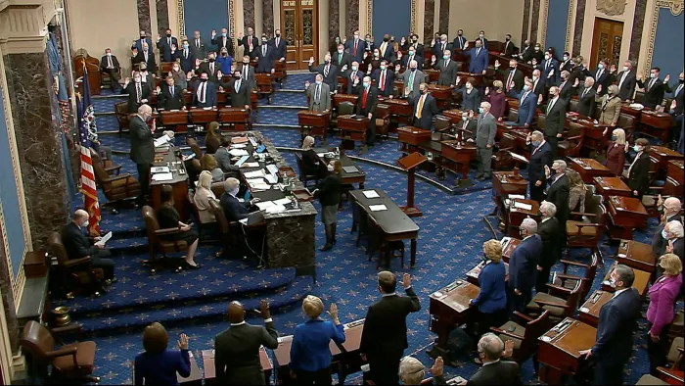
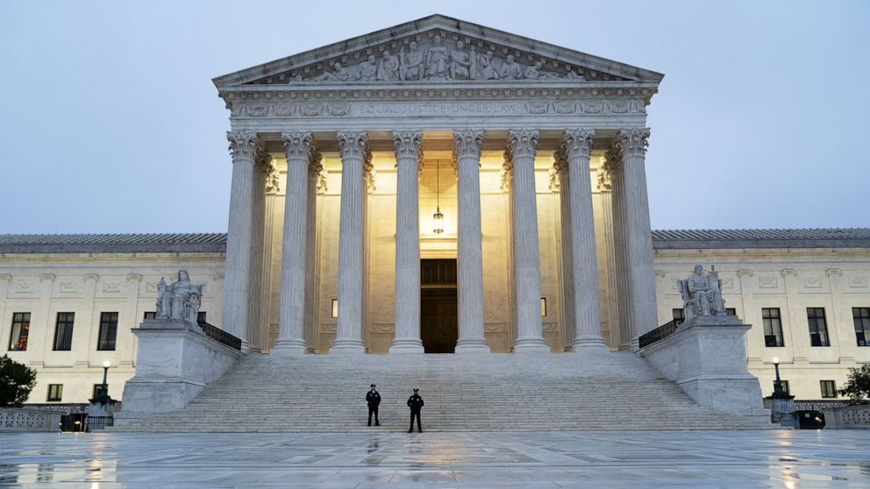
History of the Oregon Death with Dignity Act
Ballot Measure 16 (Death with Dignity Act)
1994: Passes 51% to 49%
Lee v. Oregon
1994: District Court strikes it down, violates equal protection
1997: Appeals court lets it stand
Ballot Measure 51
1997: OR legislature tries (unsuccessfully) to repeal the law
Lethal Drug Abuse Prevention Act
1998: US House and Senate
Gonzales v. Oregon
2001: AG Ashcroft: Controlled Substances Act
2006: U.S. Supreme Court: It’s up to the states

Slide 8
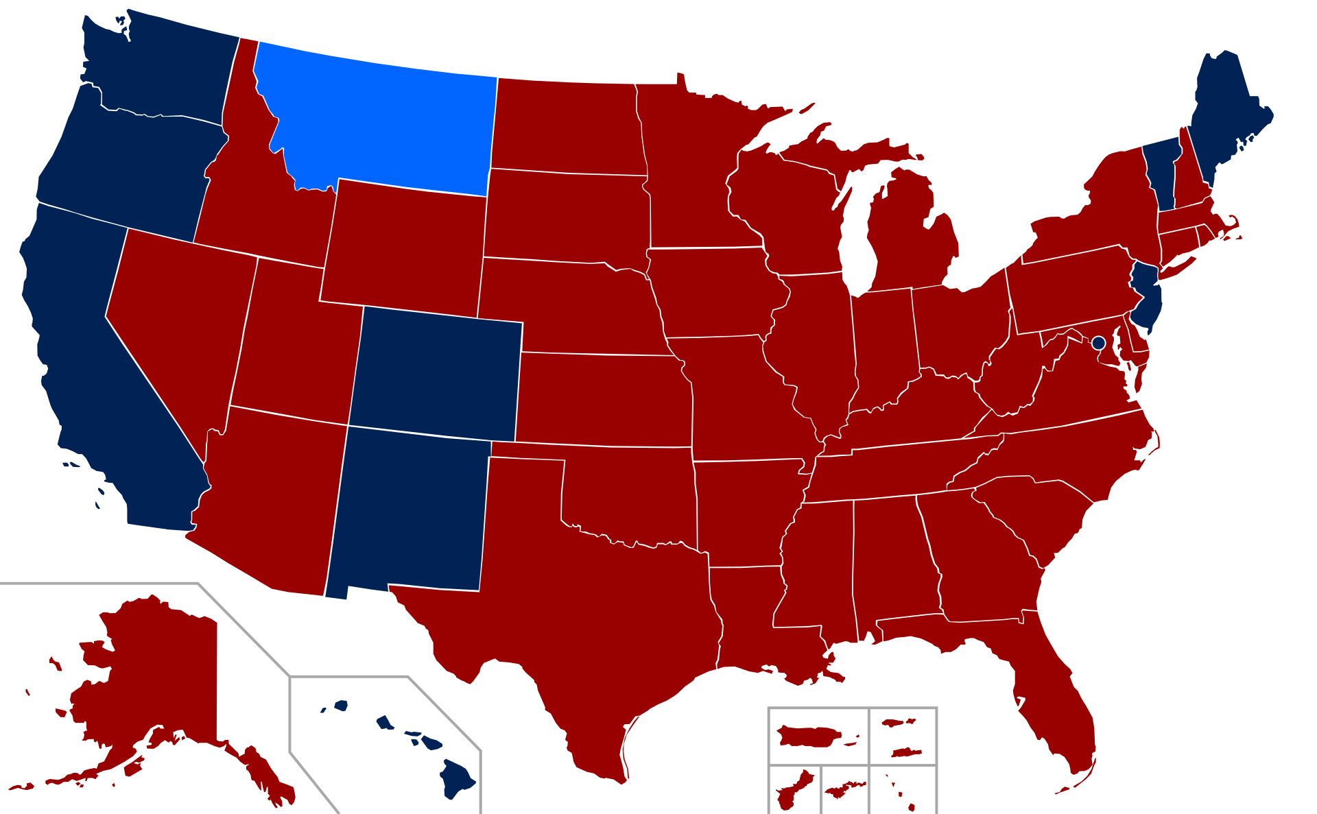
Medical aid in dying is legal in …
Oregon, Washington, Vermont, California, Colorado, Hawaii, the District of Columbia, Maine, Montana, New Jersey, New Mexico
Outside of the U.S.:
Australia (six states)
Austria
Belgium
Canada
Columbia
Luxembourg
The Netherlands
New Zealand
Spain
Switzerland
United Kingdom

Slide 9
Moral arguments against medical aid in dying
Physician’s role as healer
Hippocratic Oath … maybe
Medical associations, including AMA
Slippery slopes
Theoretical/legal/logical: Cannot justify eligibility restrictions
Empirical/practical/psychological: Would lead to abuse
Eugenics
Violations of disability rights
Social pressure

Slide 10
Moral arguments for medical aid in dying
Respect for autonomy
Dignity, self-control, self-determination
Pain management → Loss of autonomy and dignity
Making one’s own value judgments
Beneficence
Reduce suffering
Slippery slopes can be avoided
Theoretical: Can justify restrictions
Practical: Has not been abused where it is legal
Legal regulations
Physician’s role is not corrupted
If passive euthanasia is morally justified and legally allowed, then medical aid in dying should be

Slide 11
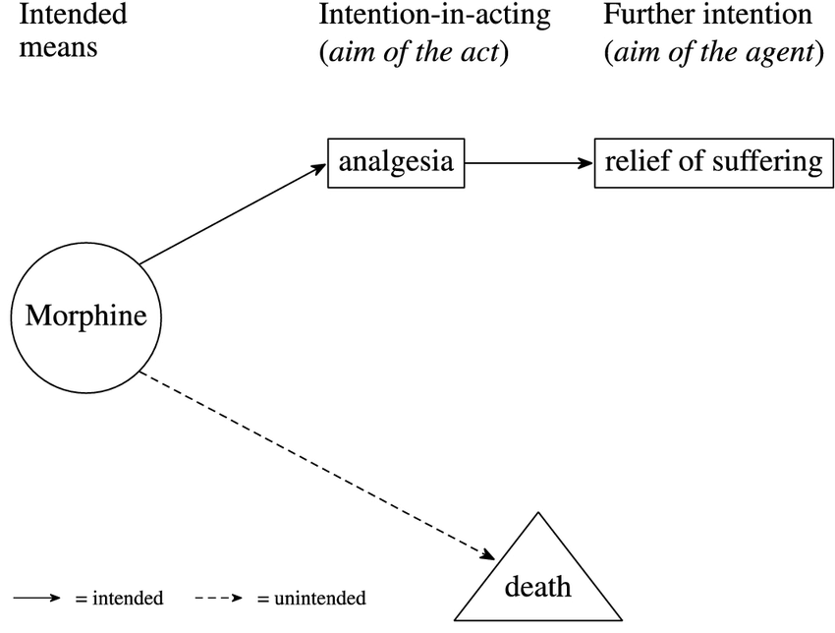
Withholding life-sustaining treatment
Often called “passive euthanasia”
Patients or proxies can choose to withhold or withdraw life-sustaining treatment (including through advance directives)
“Doctrine of double effect”
If the main intent is to respect a patient’s autonomy or protect their well-being (e.g., manage their pain or not prolong their suffering) …
Then decisions about treatment or non-treatment are justified, even if they end up shortening a patient’s life through the natural course of their condition

Slide 12

Questions?
What is the value of human life?
Who should decide when it ends?
What is the physician’s role?

