Slide 1
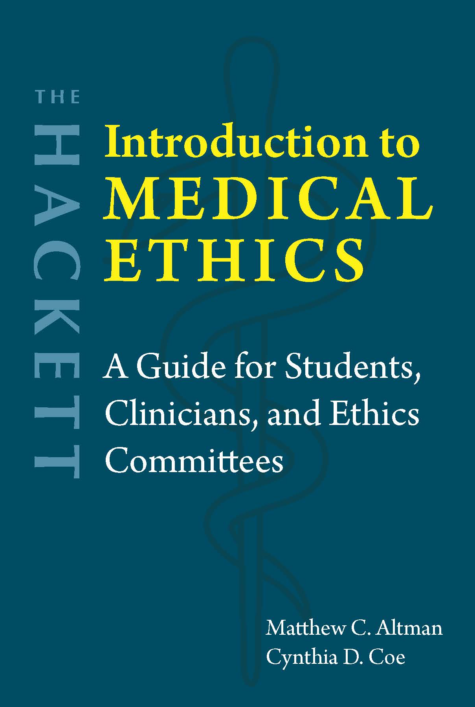
Chapter 9
Healthcare and Social Justice

Slide 2

Allocation = Distribution
vs.
Rationing = Distribution of scarce resources
Macroallocation = General policies
vs.
Microallocation = Application to actual patients

Slide 3
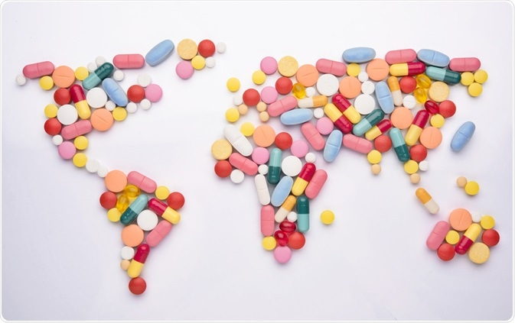
Types of healthcare systems
Single-payer
  Socialized medicine
    National Health Insurance Model (e.g., Canada)
    Beveridge Model (e.g., U.K.)
Free market
  No pure example, but U.S. and Switzerland are closest
Multi-payer
  Bismarck Model (e.g., France)
  Affordable Care Act (U.S.)

Slide 4
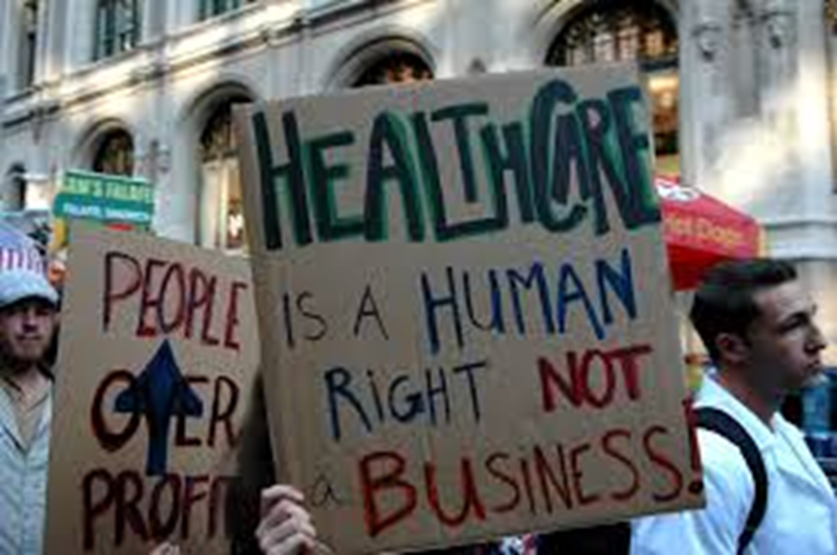
Moral evaluation of free-market systems
Arguments for:
    Forced redistribution of rightly owned property
    Utilitarianism
      Better overall outcomes
Arguments against:
    Healthcare is not a typical free market
      Patients are not simply consumers
    Rule of rescue
      Emergency Medical Treatment and Labor Act (EMTALA)

Slide 5
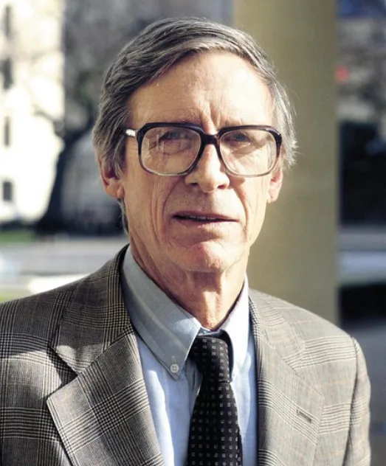
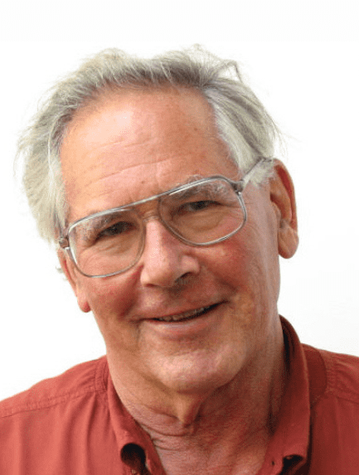
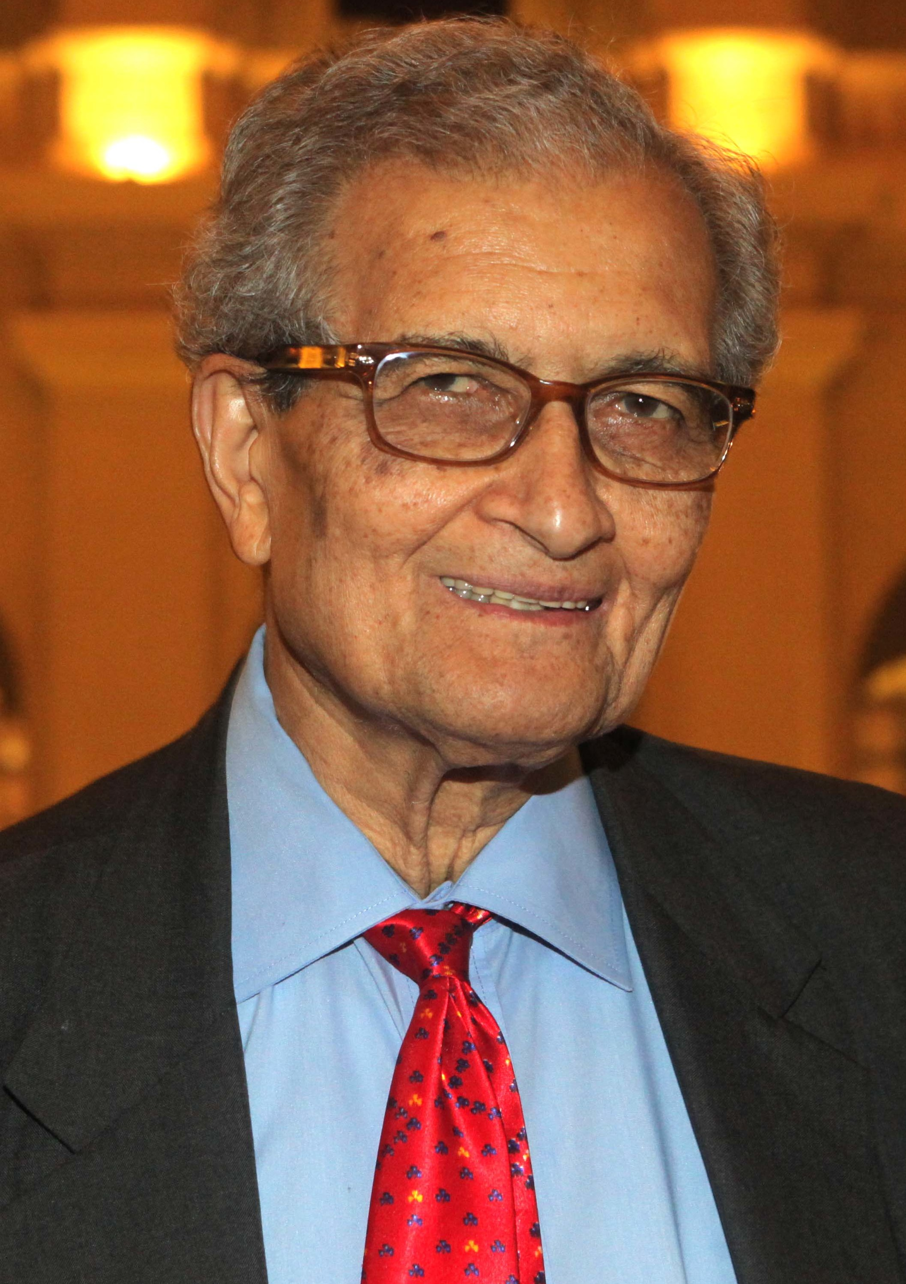
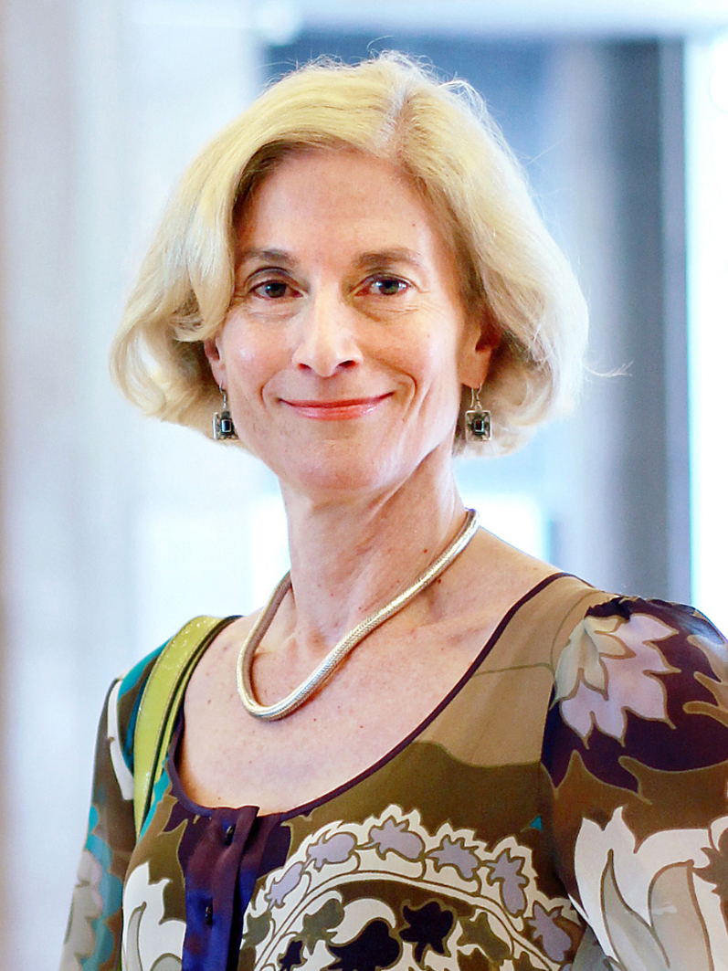
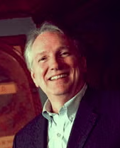

Right to healthcare (or health)?
Rawls: Justice as fairness → People deserve primary goods
  Daniels: “Normal opportunity range” → Healthcare as social primary good → Right to healthcare
Capability theory (Sen and Nussbaum): Capabilities → Opportunity to live well/flourish
Well-being theory (Powers and Faden): Justice → Healthcare → Everyone flourishes
Rawls
Daniels
Sen
Nussbaum
Powers
Faden

Slide 6
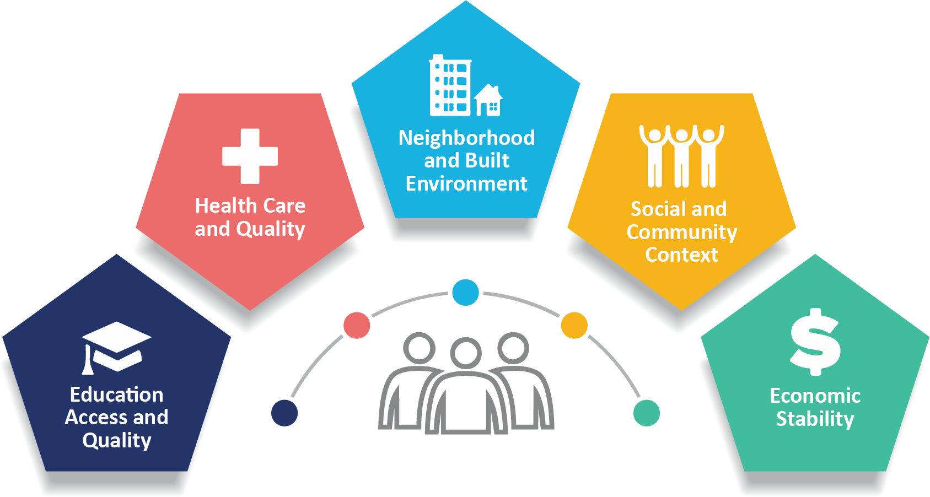
Social determinants of health
Image: https://www.cdc.gov/public-health-gateway/php/about/social-determinants-of-health.html

Slide 7
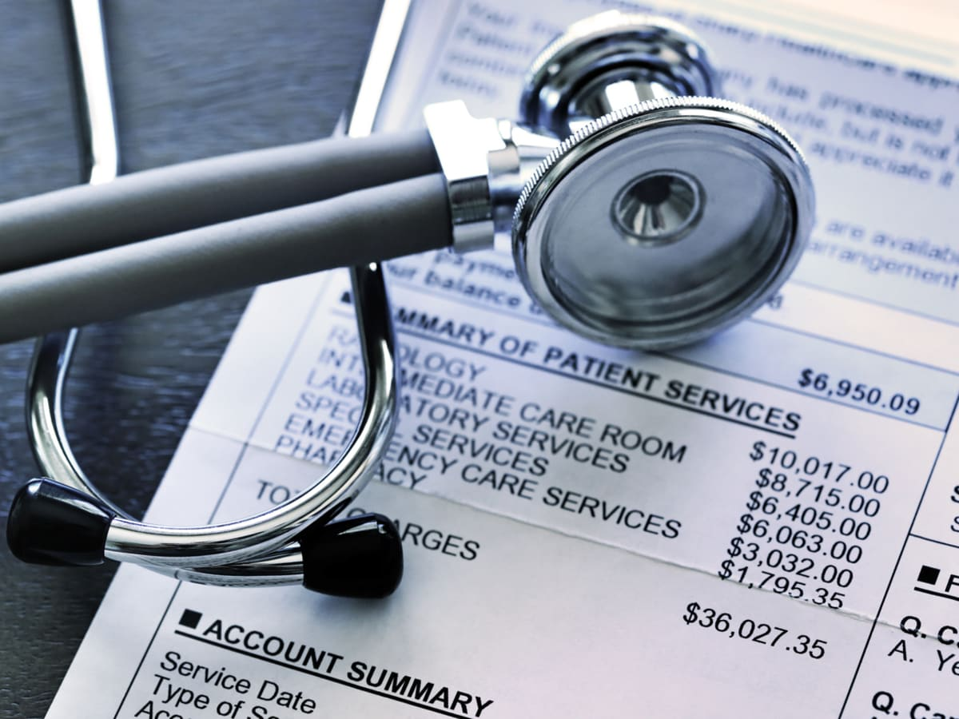
How much healthcare?
“Equitable access”?
  Equality of care
  Everything needed or beneficial
“Adequate level of care”?
“Necessary and appropriate” treatment?
Prudent insurance test
  “If most prudent people would buy a certain level of medical coverage in a free market if they had average means—if nearly everyone would buy insurance covering ordinary medical care, hospitalization when necessary, prenatal and pediatric care, and regular checkups and other preventative medicine, for example—then the unfairness of our society is almost certainly the reason some people do not have such coverage now. A universal health-care system should make sure, in all justice, that everyone does have it” (Dworkin 2000, 315).

Slide 8
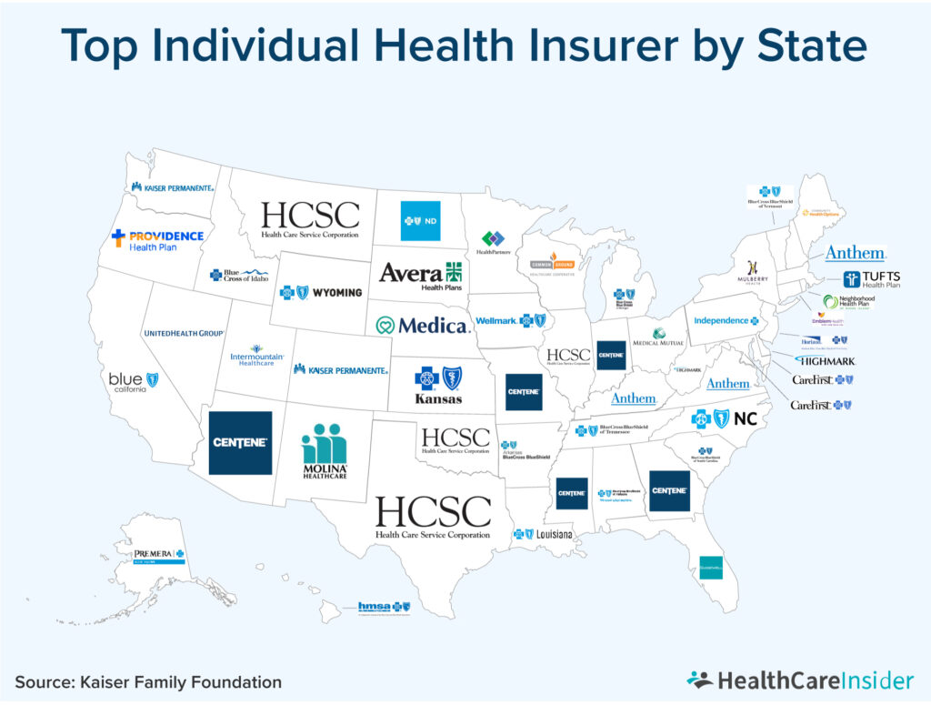
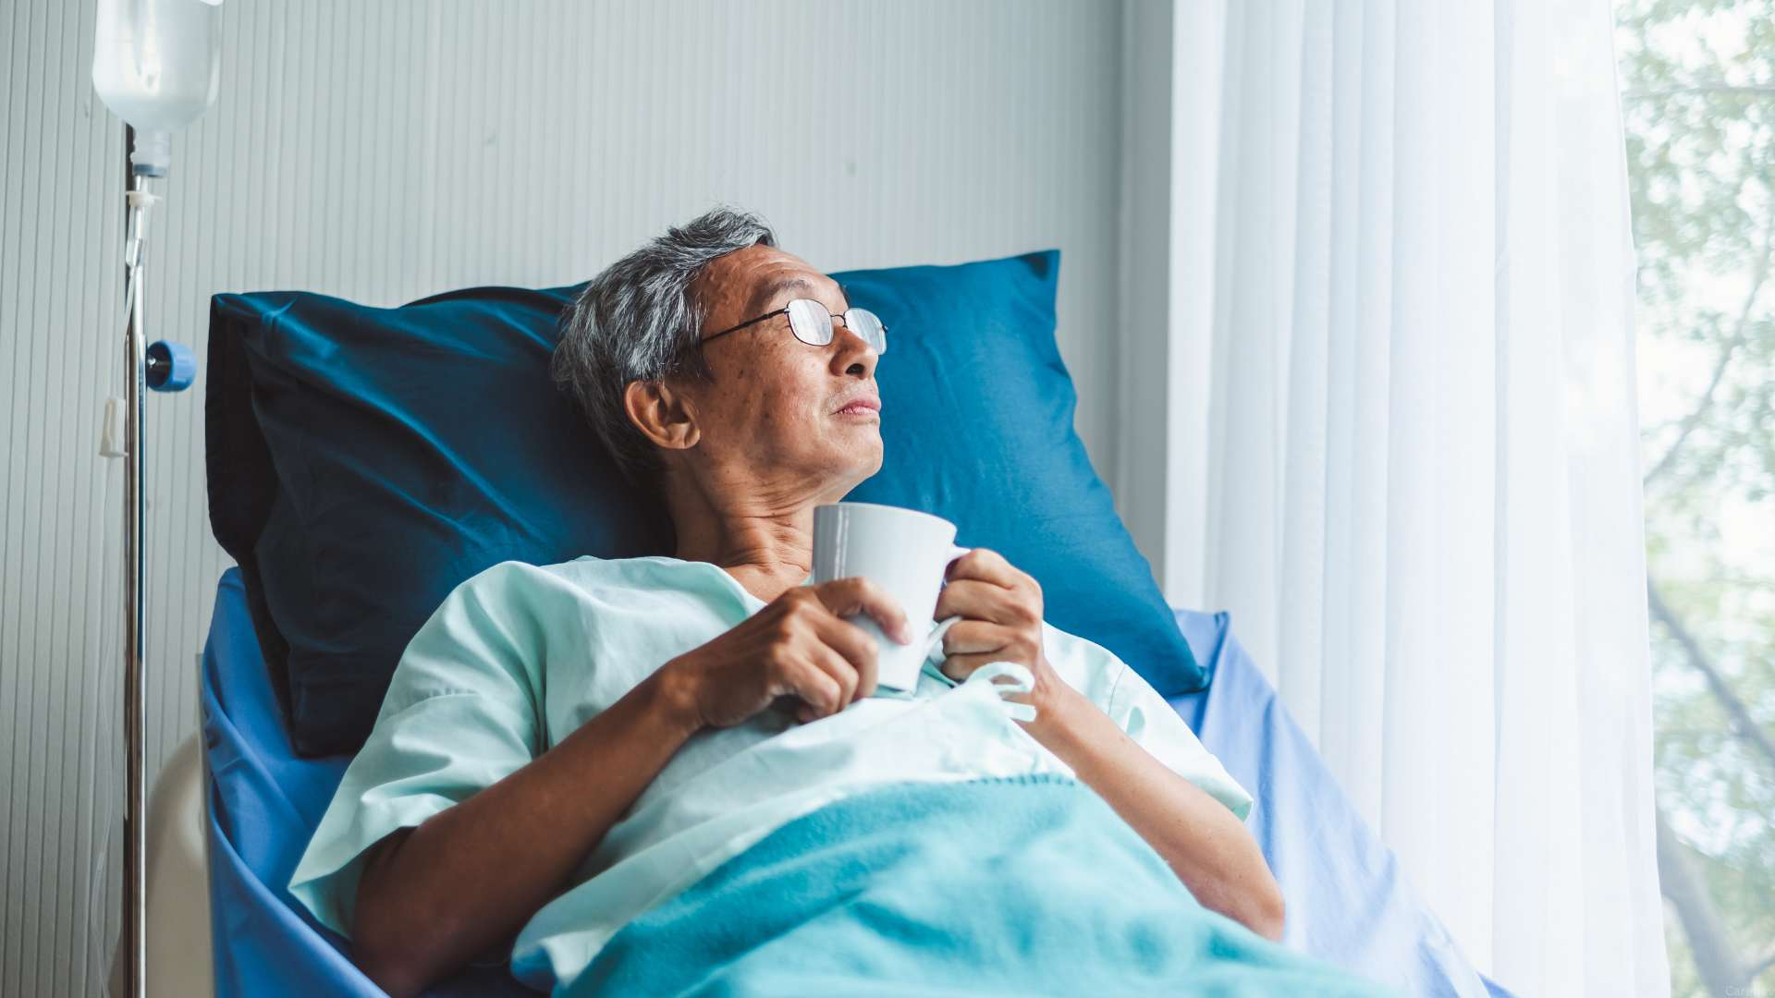

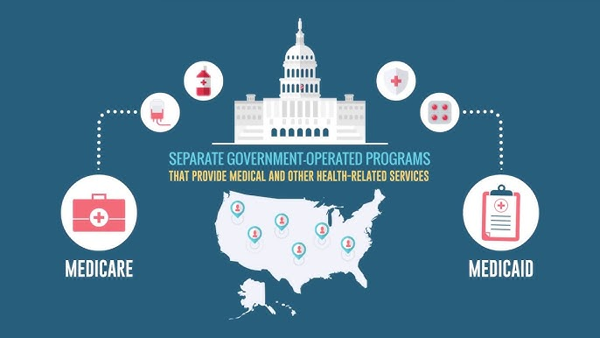
Questions?
Who should control healthcare decisions?
Patients
Insurance companies
Clinicians and healthcare systems
Government programs

